Slide 1
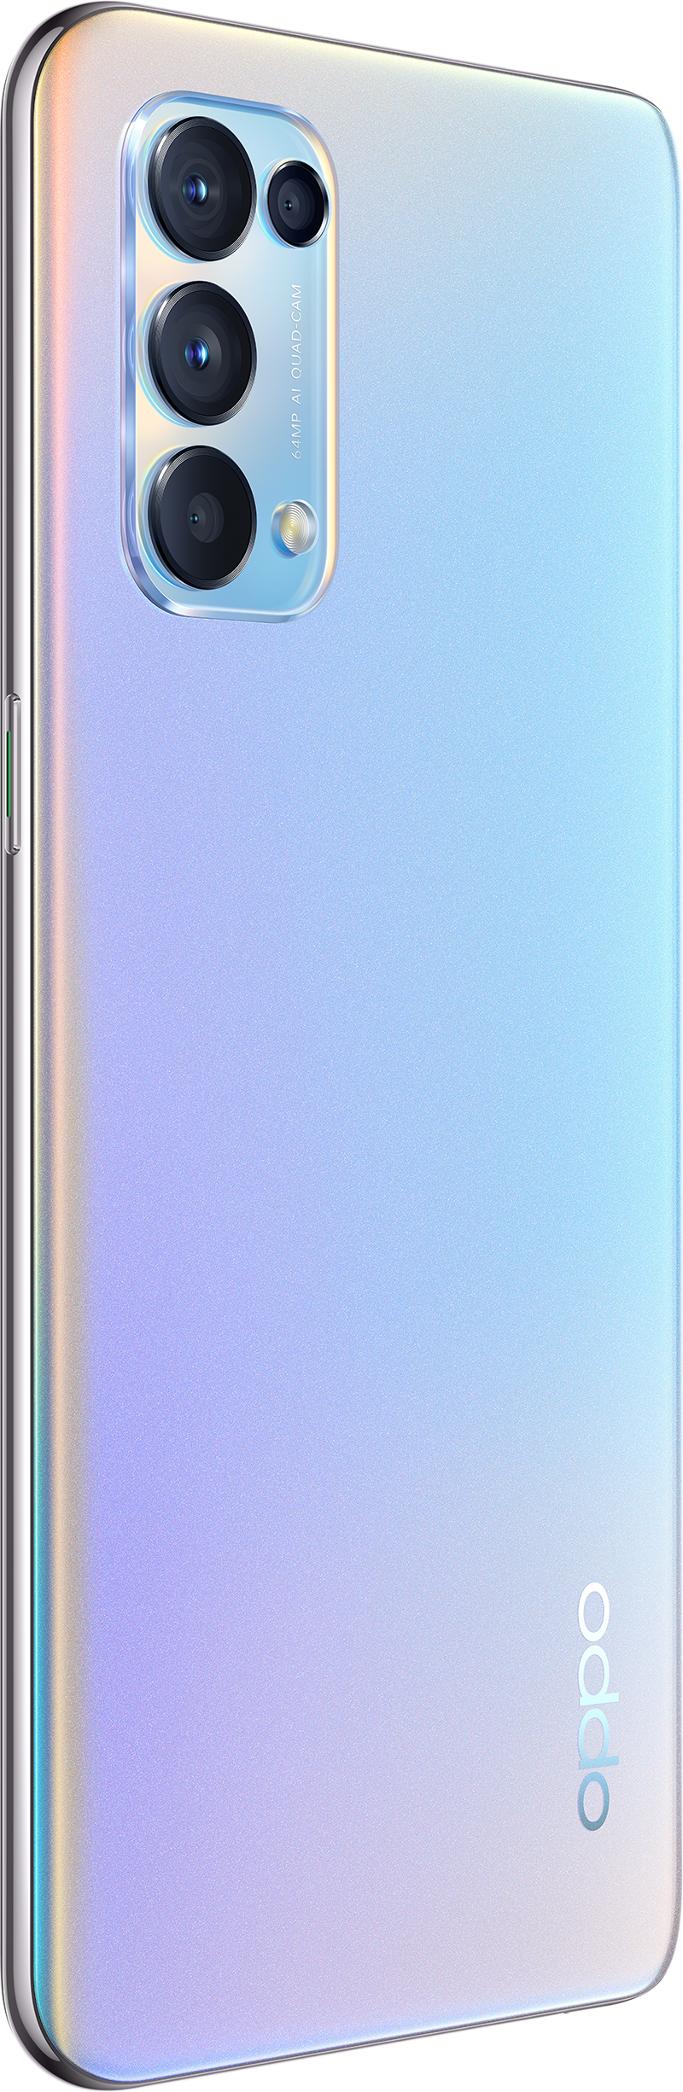
OPPO Reno5 (CPH2159)
最酷影像
最强科技
Fashion design
Latestest technology

Slide 2
Contents
1.1 Appearance parameters
1.2 Configuration parameters
1.3 Frequently used parameters
Basic Parameter
Core Selling Points
ColorOS
Maintenance Precautions
FAQ

Slide 3
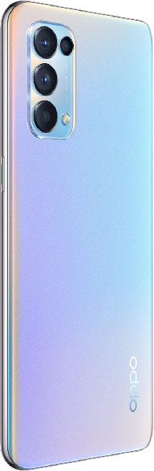
1.1 Appearance parameters
OPPO Reno5 4G
Model name | CPH2159
Weight | About 171g
Screen | 6.43 inch
Refresh rate | 90Hz
Resolution | 2400*1080
Screen ratio | 91.7%
Screen glass | Corning Gorilla Glass GG3+ / AGC DT-Star1
Color | Fantasy Silver / Starry Black
Fantasy Silver
天青白

Slide 4
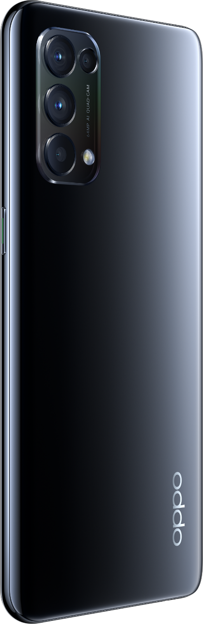
1.2 Configuration parameters
OPPO Reno5 4G
CPU Model | SDM720G
Core | 8 Cores
RAM & ROM | 8GB+128GB
Front camera | 44M
Rear camera | Main 64M Wide Angle 8M Macro 2M B & W 2M
Battery | 4310mAh (Typical value)
Charging time | About 48 mins（50W）
Starry Black
天青白

Slide 5
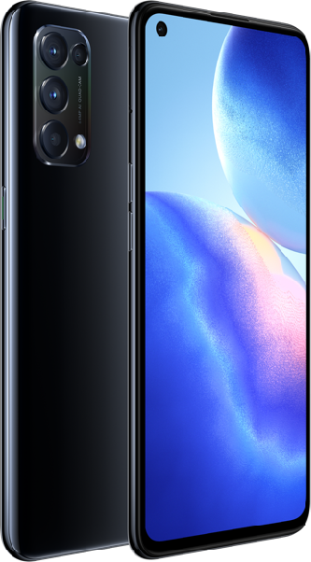
1.3 Frequently used parameters
OPPO Reno5 4G
Front camera | Punch-hole
USB | Micro-USB
USB version | 2.0
Earphone | 3.5mm
Speaker number | 1
Bluetooth | Bluetooth 5.1
ColorOS | ColorOS 11.1
Android version | Android 11

Slide 6
Content
1.1 Appearance parameters
1.2 Configuration parameters
1.3 Frequently used parameters
Basic Parameter
Core Selling Points
ColorOS
Maintenance Precautions
FAQ
2.1 Fashion design
2.2 AON smart sensor
2.3 High brush screen
2.4 Super fast charging

Slide 7

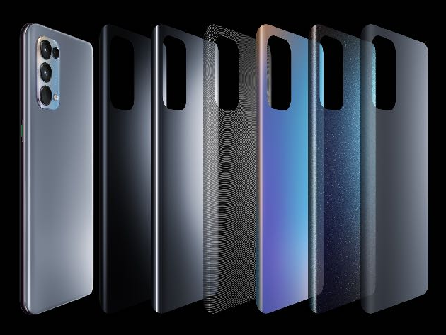
Diamond Spectrum
Thousands of colors change with "light"
OPPO has brought the possibility of color to the extreme
It took months and thousands of experiments to develop.
You can see thousands of colors on one mobile phone, and different colors from different angles.
Indeed thousands of colors.
Notes:
【本页主题】
讲解Starry Black
【参考讲解】
除了Fantasy Silver的颜色，我们也为顾客准备了百搭的Starry Black，低调沉稳又与众不同，摸起来温润，看起来有活力。可以说我们的两款颜色能够很好的满足大家的需求。

Slide 8
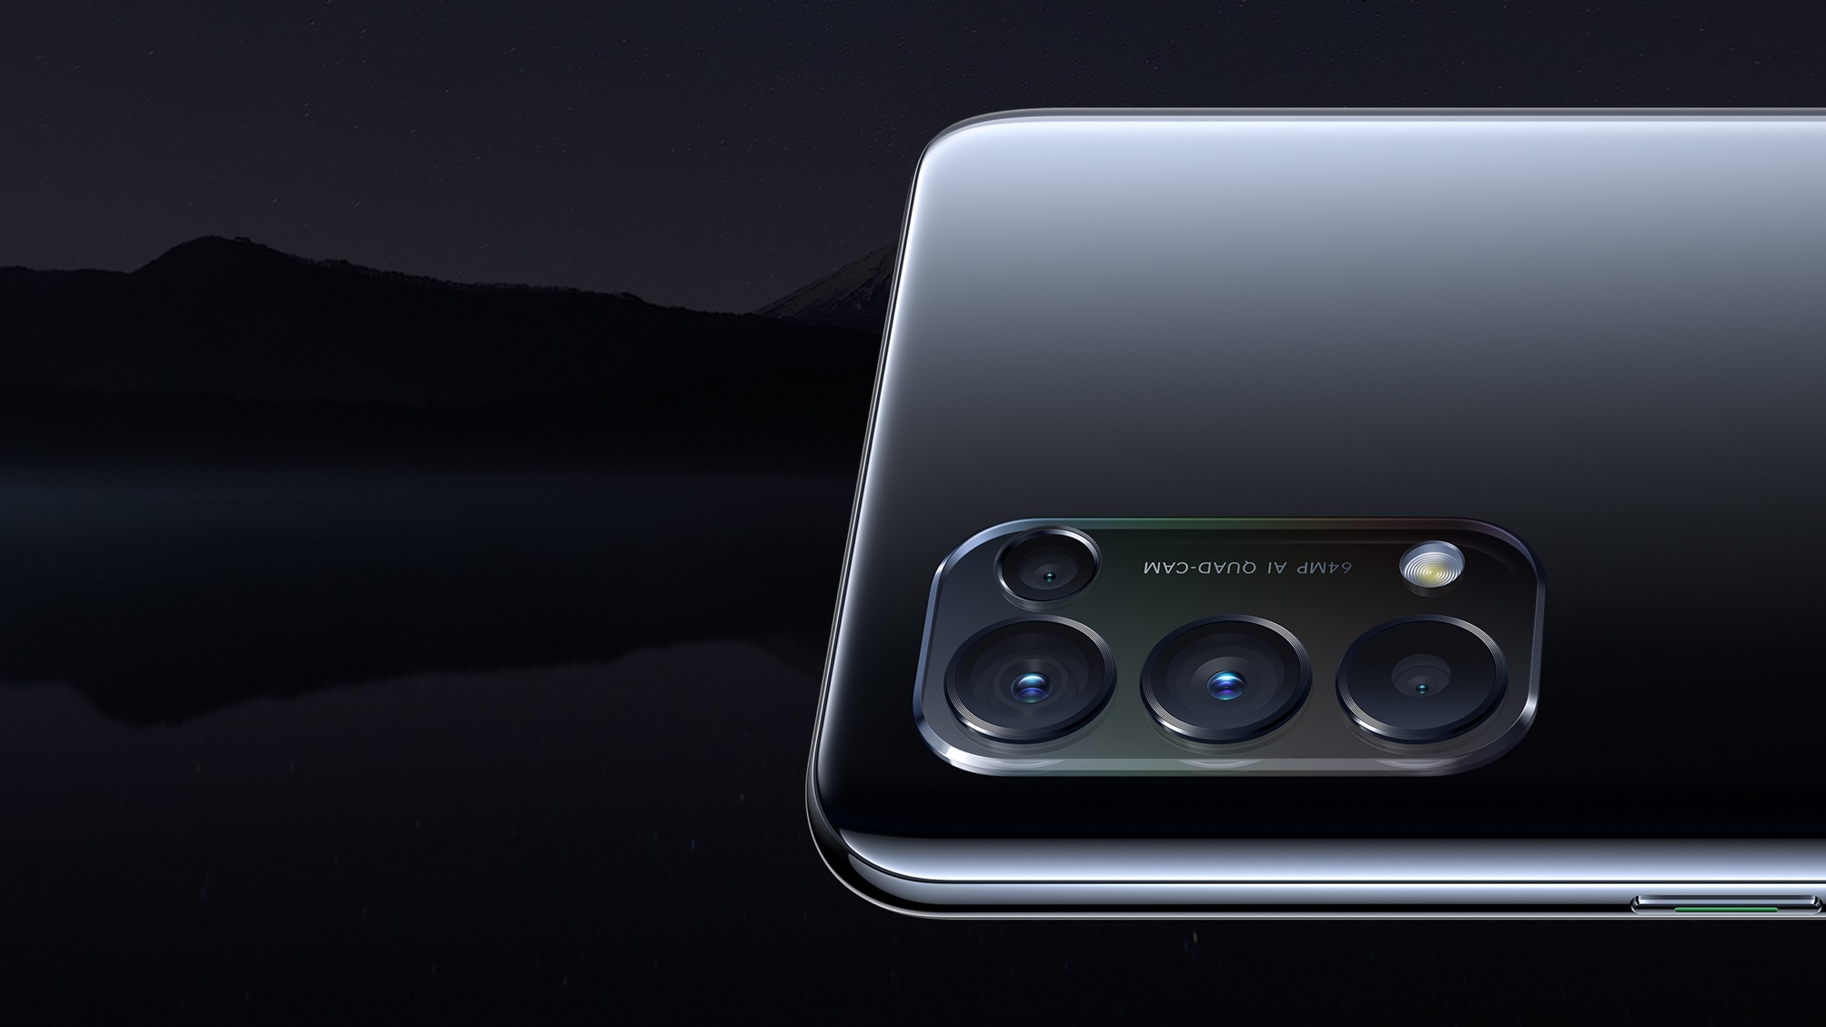

TREND SETTER CONFERENCE
TREND SETTER CONFERENCE
Starry Black
Silver black gradient
Add more vitality to black
经典黑，低调又大气
摸起来圆润，看起来活力
TREND SETTER CONFERENCE
TREND SETTER CONFERENCE
You can see the rainbow
on the camera glass
*梦镜黑是板材工艺
Notes:
【本页主题】
讲解Starry Black
【参考讲解】
除了Fantasy Silver的颜色，我们也为顾客准备了百搭的Starry Black，低调沉稳又与众不同，摸起来温润，看起来有活力。可以说我们的两款颜色能够很好的满足大家的需求。

Slide 9
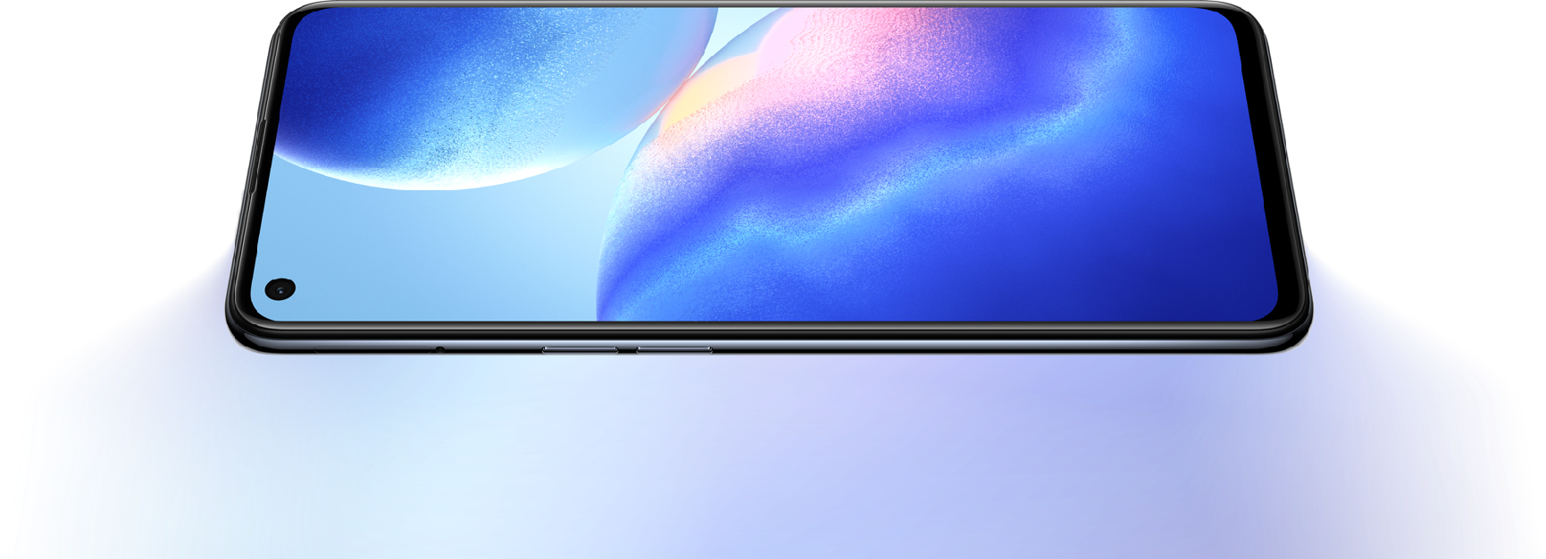
AON Smart sensor
AON is a smart sensor selling point that with an intelligent recognition algorithm.
Anti-peeping
Air gusture
*Realize by front camera

Slide 10

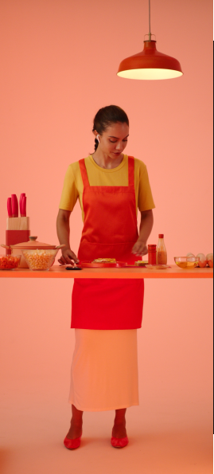
Smart Ai Control
User can swipe in certain apps or answer calls when hands are wet or other inconvenient scenarios
theory
This feature recognizes specific gestures to swipe up and down part of apps (only YouTube, Facebook, Instagram and TikTok at present) and answer a call.
scenarios
Swipe up and down part of apps
Answer a call Business
隔空接电话

Slide 11
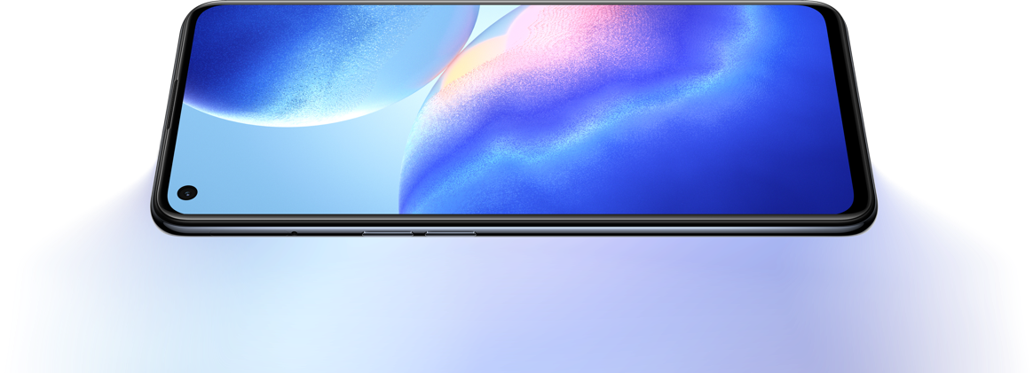
90Hz High refresh
Eye protection screen
Dual Punch-hole Display
6.43-inch Amoled
Eye Care Display Certified by SGS
Narrow border
Corning Gorilla Glass GG3+ / AGC DT-Star1

Slide 12
50W Super fast charging
1. Fast
3.Night charging
48 mins to 100%
Learn your habits intelligently, just fill up just before you wake up, and never worry about overcharging
2. Safety
The world's only "low voltage flash charge" technology
TÜV Rhineland Safe Fast-Charge System Certification
*Night charging path: Battert-More battery settings-Optimised night charging

Slide 13
Content
1.1 Appearance parameters
1.2 Configuration parameters
1.3 Frequently used parameters
3.1 Dual-view Video
3.2 AI mixed portrait
Basic Parameter
Core Selling Points
ColorOS
Maintenance Precautions
FAQ
2.1 Fashion design
2.2 AON smart sensor
2.3 High brush screen
2.4 Super fast charging

Slide 14
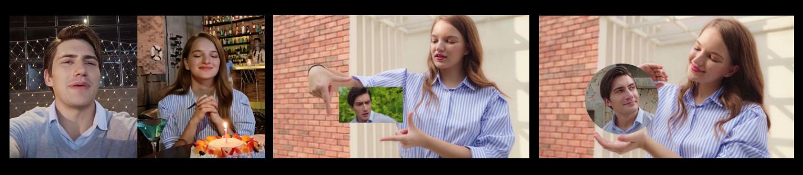
Dual-view Video
Function Description
1. The scenes taken by the front and rear cameras can be recorded at the same time, and support three combined modes, giving you more choices.
2. On the basis of the function, it also support the front custom beauty and rear zoom. The video effect is better.
Split screen
Square window
Round window
*Path: Open camera-More-Dual-View Video
Notes:
【本页主题】
讲解Dual-view Video
【参考讲解】
按照ppt讲解即可。
备注：多景录像目前仅支持前置摄像头和后置摄像头组合，在未来会有更多的组合形式。

Slide 15

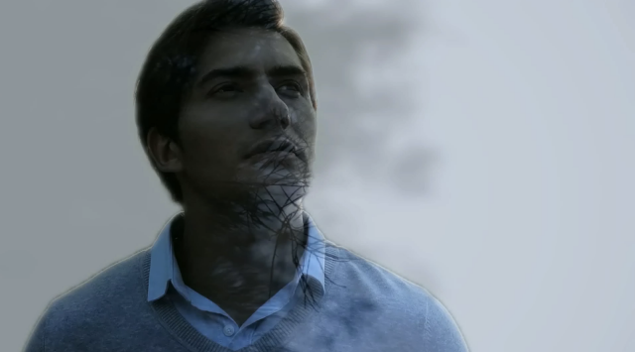
AI Mixed Portrait
Function description
Combine background material and character material to generate a video (up to 15s)
2 kinds of superimposed effect options.
The background material can be a video in the album or a real shot.
Remark: OTA or flashing to the latest version can realize this function.
*Path: Open camera-More
Notes:
【本页主题】
讲解Dual-view Video
【参考讲解】
按照ppt讲解即可。
备注：多景录像目前仅支持前置摄像头和后置摄像头组合，在未来会有更多的组合形式。

Slide 16
Content
1.1 Appearance parameters
1.2 Configuration parameters
1.3 Frequently used parameters
3.1 Super power saving mode
3.2 ColorOS change point
Basic Parameter
Core Selling Points
ColorOS
Maintenance Precautions
FAQ
2.1 Fashion design
2.2 AON smart sensor
2.3 High brush screen
2.4 Super fast charging
4.1 Silver back cover disassembly
4.2 USB disassemble notice

Slide 17
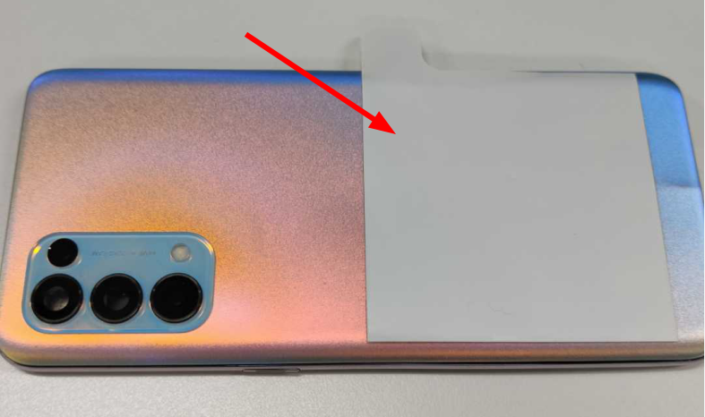
4.1 Back cover disassembly notice
The silver battery cover is rough, and the suction cup cannot be sucked up directly. It needs to be heated and attached to the PET sheet for disassembly.
Material code: 4886067.

Slide 18
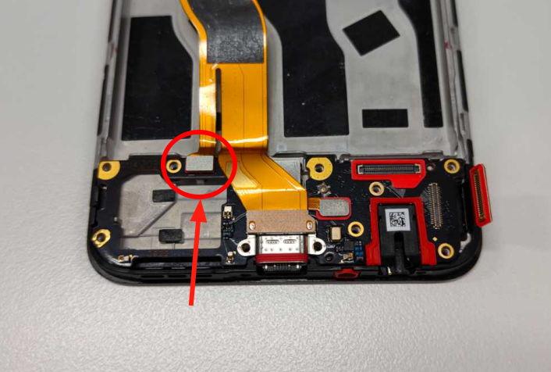
4.2 USB-FPC disassembly notice
If the disassembly involves USB disassembly, turn on and check the fingerprint & speaker functions. If it fails, replace the USB-FPC at first.
Material code: 4906143.

Slide 19
Content
1.1 Appearance parameters
1.2 Configuration parameters
1.3 Frequently used parameters
3.1 Super power saving mode
3.2 ColorOS change point
5.1 Hardware & Structure
5.2 Software
Basic Parameter
Core Selling Points
ColorOS
Maintenance Precautions
FAQ
2.1 Fashion design
2.2 AON smart sensor
2.3 High brush screen
2.4 Super fast charging
4.1 Battery cover disassembly

Slide 20
Hardware & Structure
1、Reno5 support 50w charging, but come with 65w charger
——OPPO Reno5 comes with a 65W SuperVOOC flash charging adapter, which supports 50W Flash Charge of OPPO Reno5 without affecting the charging rate and safety performance.
2、Plug in the adapter to charge at night, and use the phone in the morning to find that the phone cannot be fully charged
——Confirm whether the night charging mode is turned on (this function is turned off by default). After turning it on, the night charging speed will be limited, and the charging will be stopped at 80%. The charging will not be restored to full power until the user turns on the phone for a while The temperature rise effect of charging at night, if you don’t want to use this function, you can turn it off manually
Path: [Battery->More->Night charging mode]
3、Fantasy silver and starry black are different in thickness
——Hello, thank you for your valuable comments on our products. Since the Starry Black and Fantasy Silver battery covers use different processes in the manufacturing process, the two color combinations have different thicknesses. However, the thickness difference between the two is very small, which will not affect your normal use, please rest assured.
Notes:
【参考讲解】
在ColorOS领域，我们还有很多好用的功能，像三指截屏、智能侧边栏等等，这些功能我们都会在ColorOS的专项培训中给大家详细介绍！
因此，可以说Reno3 Pro是不折不扣的“全能影像”

Slide 21
Software
1、The AON/Air gesture function occasionally does not recognize when using it, or the recognition rate is low.
——The recognition rate of AON/Air gesture function is related to the operation method and the environment. If it is not realized occasionally, please operate it in the correct way several times.
Remark: Air gesture support only: Tiktok/facebook/Instagram/YouTube
2、Does not support double exposure (mix exposure)
——Please upgrade your phone software to the latest version
Path: [Settings -> Software Update] or go to the customer service center to upgrade. After the upgrade is complete, open the camera -> more.
3、How to turn on the air gesture
——Settings->Convenient Tools->Gesture & Motions->Air gestures.

Slide 22

Notes:
【参考讲解】
2019年市场竞争变得非常激烈，我们OPPO人要“无所畏惧，勇往直前”，卖爆 Reno3系列！！！

