Slide 1

2020年海外备件管理培训
2020 Overseas Spare Parts Management Training
点击输入具体内容点击输入简要文本内容，文字内容需概况精炼
点击输入具体内容点击输入简要文本内容，文字内容需概况精炼
点击输入具体内容点击输入简要文本内容，文字内容需概况精炼
点击输入具体内容点击输入简要文本内容，文字内容需概况精炼
备件护航 服务创不凡
Spare Parts Supporting
Service Soaring

Slide 2
售后整机管理 After-sale Devices Management

Slide 3
售后整机管理 After-sale Devices Management
售后整机类别 Types of After-sales Devices
检测换货单报表 Report of Inspection Order
售后整机保管 Safekeeping of After-sales Devices
处理方式 Processing Methods

Slide 4
售后整机管理 After-sale Devices Management
售后整机类别 Types of After-sales Devices

Slide 5
售后整机类别 Types of After-sales Devices
开箱坏（DOA—Dead On Arrive）：销售前首次打开纸箱、打开彩盒时功能出现故障的机器，电子保卡未被注册。
The electronic insurance card is not registered for the device with failure
when opening carton and color box for the first time before sales.
其他退/换机（DAP— Dead After Purchase）：机器销售后，电子保卡已被注册，机器出现性能故障而产生的退换机。
After the sale of the device, the electronic insurance card has been registered, and the device is refunded/exchanged due to performance failure.
业务演示机（Demo Deivce）：公司为各区域限额配发的给用户演示的机器。
Devices shown to customers which distributed by the HQ for each region.
编辑汇报标题

Slide 6
售后整机类别 Types of After-sales Devices
类别/Type | 送检类型/Inspection Type | 来源/Source
DOA | 售前开箱坏 DOA | 检测换货单 Inspection Order
DAP | 用户包换 Exchange in Warranty
 | 用户包退 Refund in Warranty
 | 用户强换 Mandatory Exchange
 | 用户强退 Mandatory Refund
 | 特殊换机 Special Exchange
 | 新机型品质换机 New Model Quality Exchange
 | 零散品质换机 Fragmented Quality Exchange
 | 异常事件 Abnormal Quality Issue
业务演示机 Demo Device | / | 销售点 Sales outlets
编辑汇报标题

Slide 7
售后整机管理 After-sale Devices Management
检测换货单报表 Report of Inspection Order

Slide 8
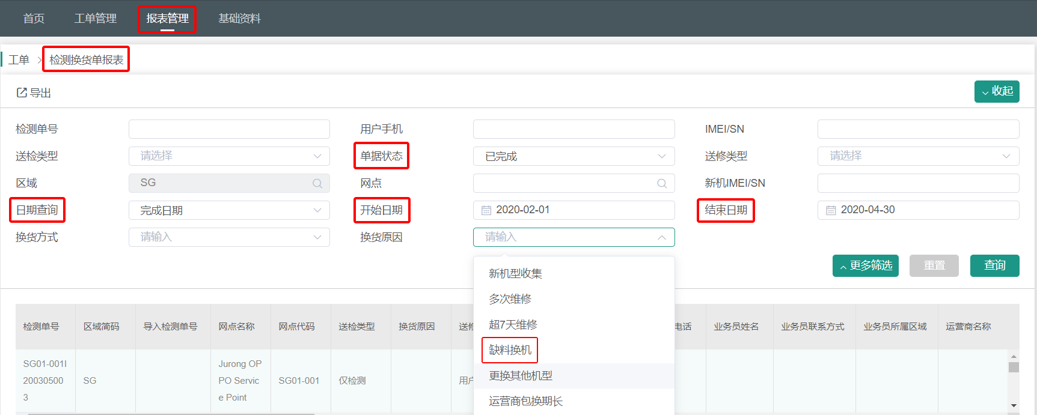

检测换货单报表 Report of Inspection Order
网点库管
SC
Warehouse Administrator
总代备件管理员
Agent Spare
Parts Manager
总代换货管理员
Agent Exchange
Manager
菜单栏：报表管理-工单-检测换货单报表
根据需求筛选检测换货单报表。
编辑汇报标题

Slide 9
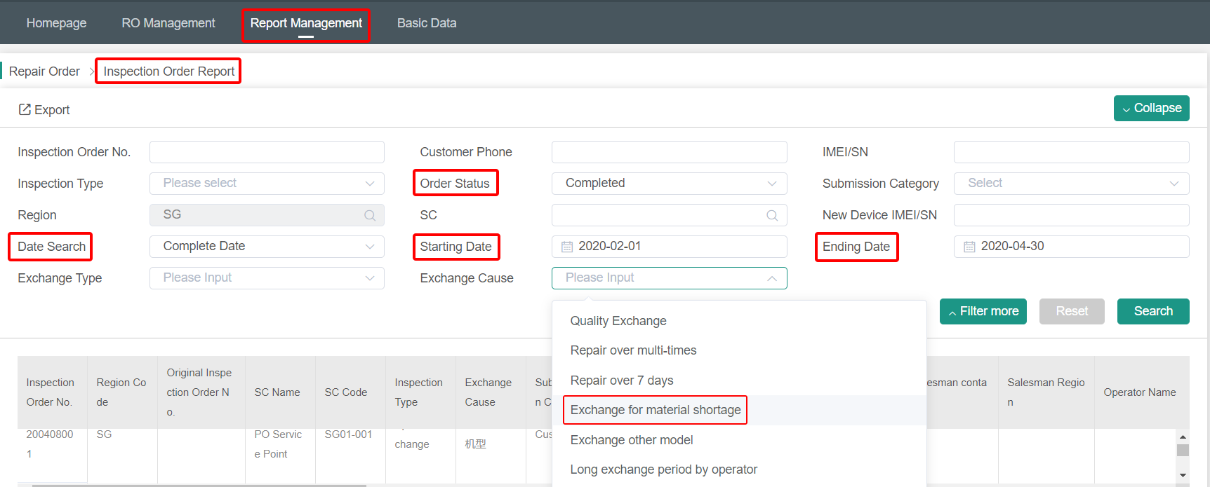
检测换货单报表 Report of Inspection Order
网点库管
SC
Warehouse Administrator
总代备件管理员
Agent Spare
Parts Manager
总代换货管理员
Agent Exchange
Manager
Menu Bar: Report Management - Repair Order - Inspection Order Report
According to your needs, filter the Inspection Order Report.
编辑汇报标题

Slide 10
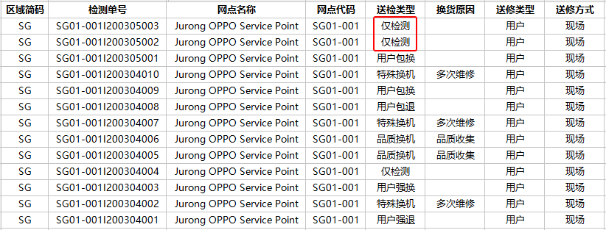
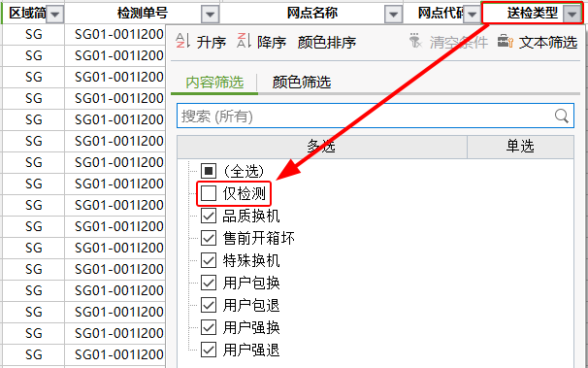
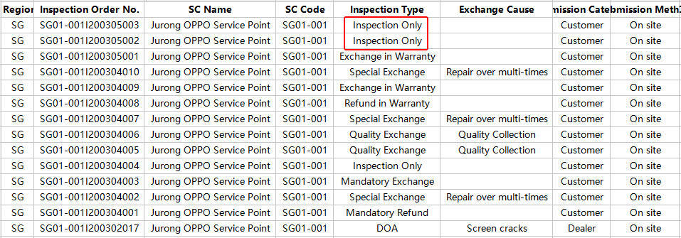
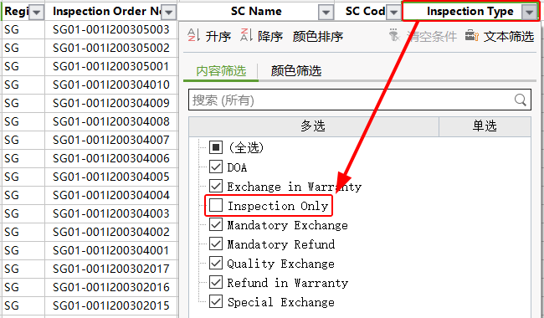
检测换货单报表 Report of Inspection Order
网点库管
SC
Warehouse Administrator
总代备件管理员
Agent Spare
Parts Manager
总代换货管理员
Agent Exchange
Manager
剔除仅检测。
Screened out Inspection Only.
编辑汇报标题

Slide 11
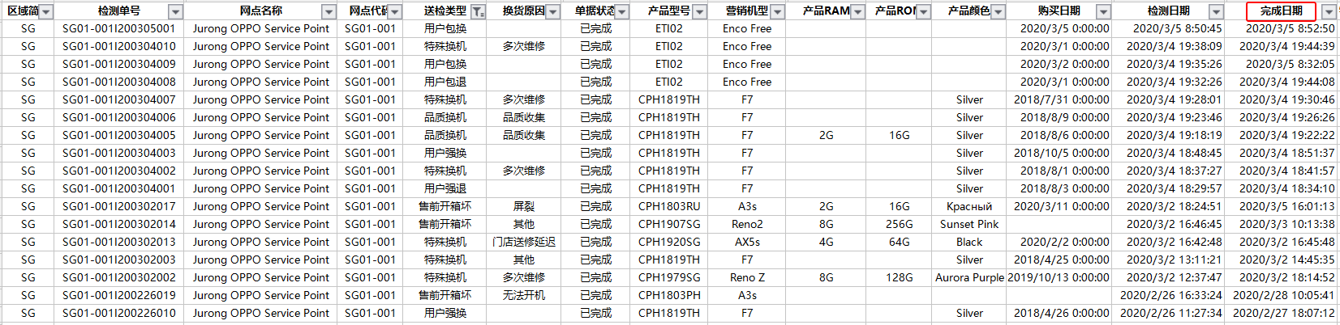
检测换货单报表 Report of Inspection Order
网点库管
SC
Warehouse Administrator
总代备件管理员
Agent Spare
Parts Manager
总代换货管理员
Agent Exchange
Manager
以完成日期为筛选依据。

Slide 12
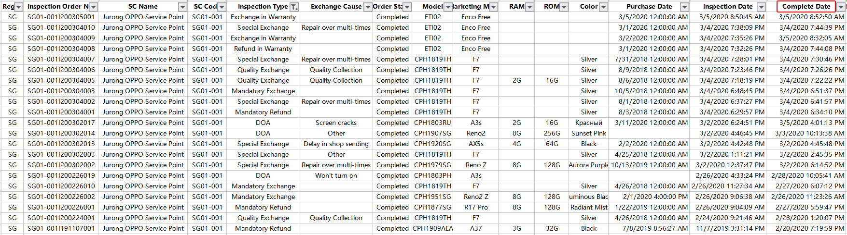
检测换货单报表 Report of Inspection Order
网点库管
SC
Warehouse Administrator
总代备件管理员
Agent Spare
Parts Manager
总代换货管理员
Agent Exchange
Manager
Filter by Complete Date.

Slide 13
检测换货单报表 Report of Inspection Order
IMEI 导出 需要申请权限。
Request permission required for IMEI export.
检测换货单完成后，用户信息可再查看一个月（30天）。一个月（30天）后，将对用户信息进行掩码。
掩码后若再查看用户信息，需向总公司换货管理员进行申请。
The customer's information can be viewed for one month (30 days) after the inspection order completed. After one month (30 days), the customer's information will be masked.
If you want to view the customer's information after mask, you need to apply to the HQ exchange manager.

Slide 14
售后整机管理 After-sale Devices Management
售后整机保管 Safekeeping of After-sales Devices

Slide 15
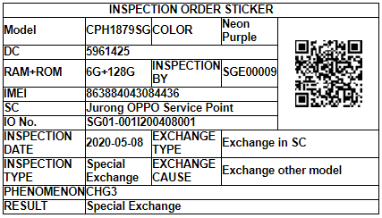
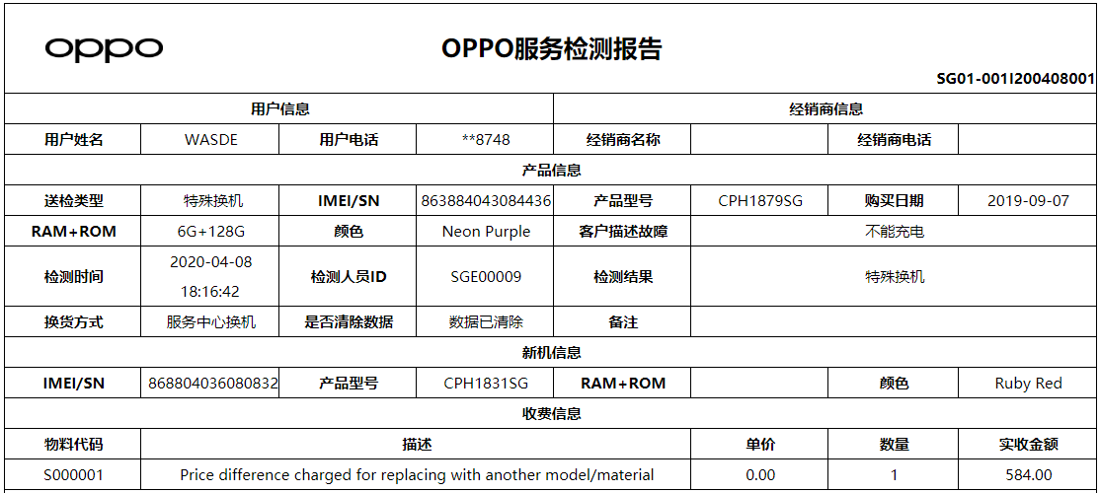
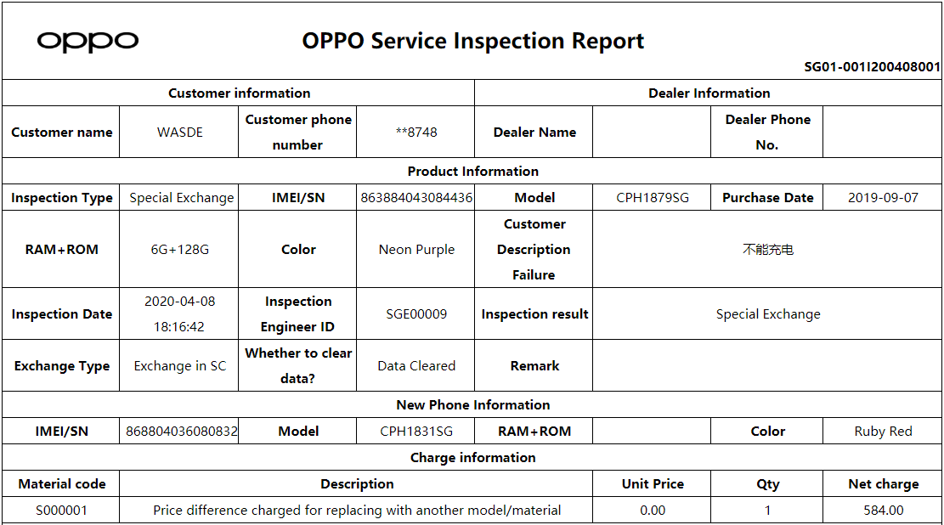
售后整机保管 Safekeeping of After-sales Devices
网点库管
SC
Warehouse Administrator
总代备件管理员
Agent Spare
Parts Manager
手机故障贴：贴在手机背面。
Inspection Order Sticker:On the back of the device.
检测报告：折好或包着手机，放在彩盒里面。
Inspection Report：Fold or wrap the device and put it in the color box.
总代换货管理员
Agent Exchange
Manager

Slide 16
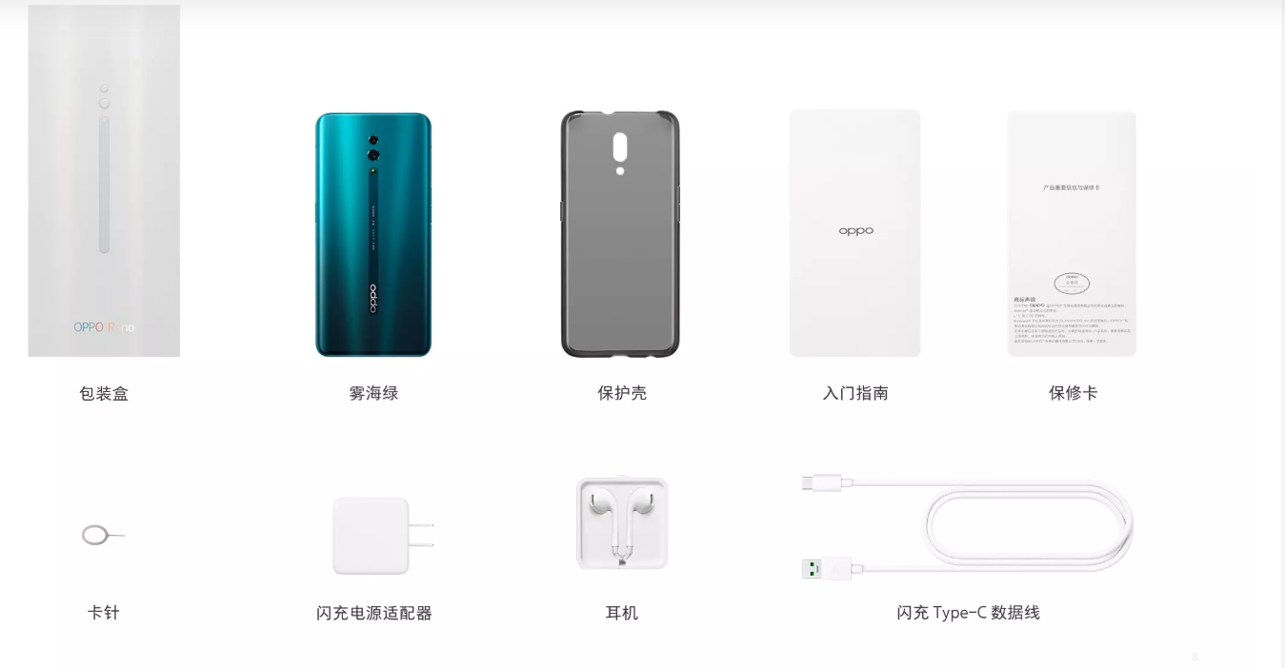
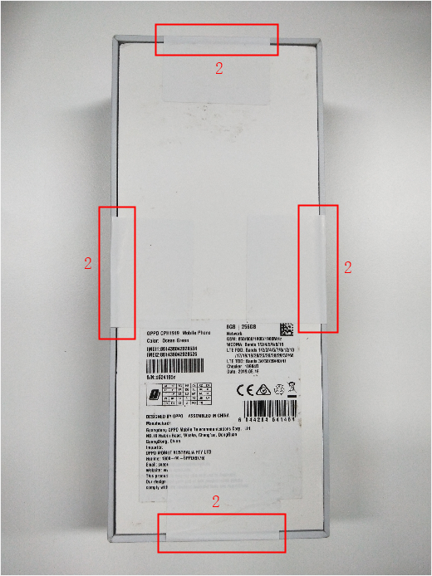
售后整机保管 Safekeeping of After-sales Devices
网点库管
SC
Warehouse Administrator
总代备件管理员
Agent Spare
Parts Manager
1，检查附件是否齐全。
Confirm whether the accessories are complete.
2，贴上易碎贴，防止运输过程中丢失；(为方便总仓检查，贴一面即可)。
Stick fragile stickers to prevent loss during transportation.
(For the convenience of Agent Warehouse inspection, just stick one side.)
3，附上检测换货单报表，与整机一起寄回总仓。
Attach the inspection report form, then send back with the device to the Agent Warehouse.
总代换货管理员
Agent Exchange
Manager

Slide 17
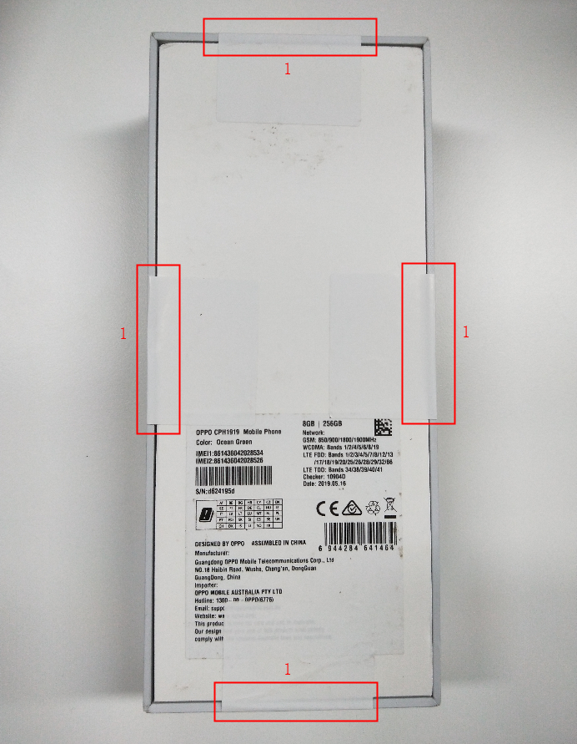
售后整机保管 Safekeeping of After-sales Devices
网点库管
SC
Warehouse Administrator
总代备件管理员
Agent Spare
Parts Manager
1，核对总数。
Check total quantity.
2，检查易碎贴是否损坏。
Check if there is any damages on the fragile sticker.
3，检查附件是否齐全。
Check whether the accessories are complete.
4，入库。按月、按类型进行存放。
Store by month and type.
总代换货管理员
Agent Exchange
Manager

Slide 18
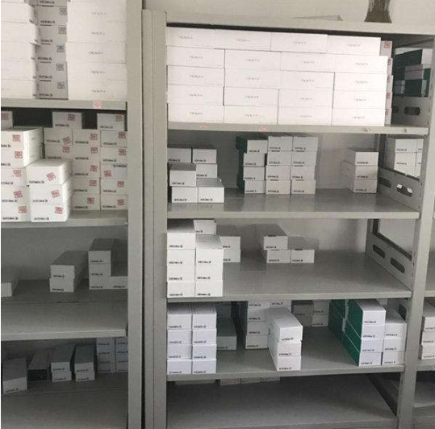
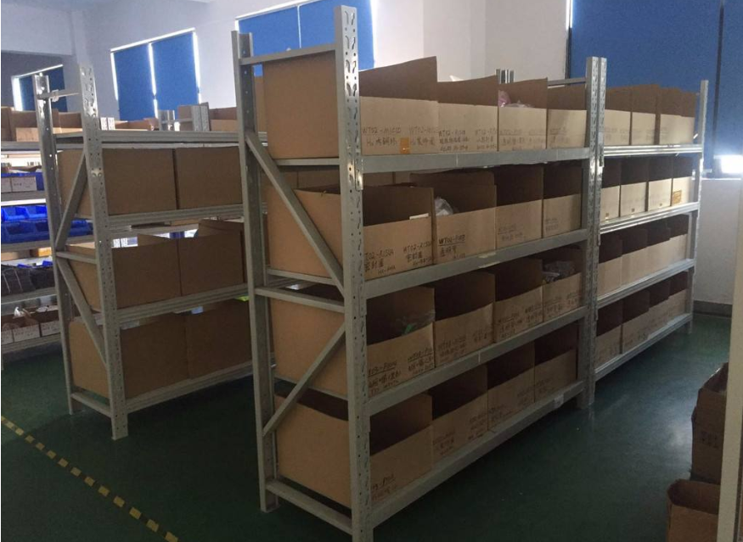
售后整机保管 Safekeeping of After-sales Devices
网点库管
SC
Warehouse Administrator
总代备件管理员
Agent Spare
Parts Manager
总代换货管理员
Agent Exchange
Manager

Slide 19
售后整机管理 After-sale Devices Management
处理方式 Processing Methods

Slide 20
处理方式 Processing Methods
退厂处理
Return to Factory
本地处理
Local Handling

Slide 21
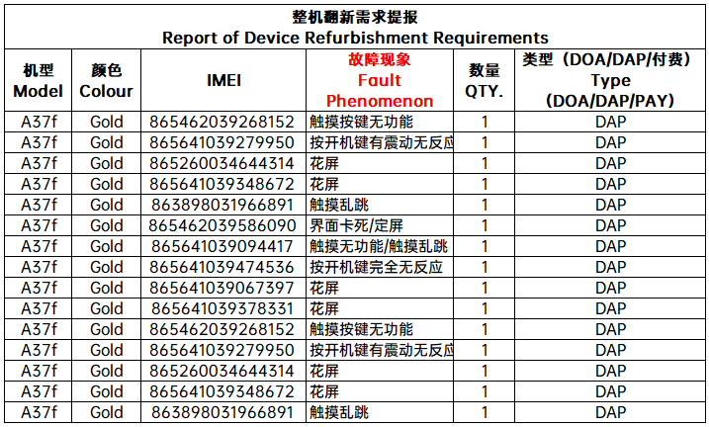
处理方式 Processing Methods
网点库管
SC
Warehouse Administrator
需求提报 Demand report：
类型 Type：DOADAP机器 DOADAP Device、
业务演示机 Demo Device.
区域 Region：越南 Vietnam、泰国 Thailand、
菲律宾 Philippines、马来Malaysia、
新加坡 Singapore、台湾Taiwan、
日本 Japan、澳大利亚 Australia.
总代备件管理员
Agent Spare
Parts Manager
总代换货管理员
Agent Exchange
Manager

Slide 22
处理方式 Processing Methods
网点库管
SC
Warehouse Administrator
翻新周期 Refurbish Period
提报截止时间：渠道宣停之日往后顺延的第60个自然日
Report deadline: the 60th natural day after the date of stopping production; reporting of refurbishment later than this designated deadline will not be accepted by the HQ.
翻新截止时间：渠道宣停之日往后顺延的第90个自然日。
Refurbishment deadline: the 90th natural day after the date of stopping production,refurbishment later than this designated deadline will not be refurbished by the HQ.
总代备件管理员
Agent Spare
Parts Manager
总代换货管理员
Agent Exchange
Manager

Slide 23
处理方式 Processing Methods
数量要求 Return Quantity
DOA/DAP机器 DOA/DAP Devices
渠道宣停前，每款机型的DOA、DAP数量需累计50台以上才可退回保修工厂翻新。
Before stopping production, the return and refurbishment only take place when the quantity of DOA / DAP of each model has reached 50 sets.
渠道宣停后，翻新截止前最后一批，不对每款机型的DOA和DAP数量进行管控。
After stop production, last return,the number of DOA/ DAP of each model will not be controlled.
业务演示机 Demo Devices
需提前通知备件组，备件组同意后才能安排退回。
The Spare Parts Team should be notified in advance, and the return can be arranged after the approval of the Spare Parts Team.
网点库管
SC
Warehouse Administrator
总代备件管理员
Agent Spare
Parts Manager
总代换货管理员
Agent Exchange
Manager

Slide 24
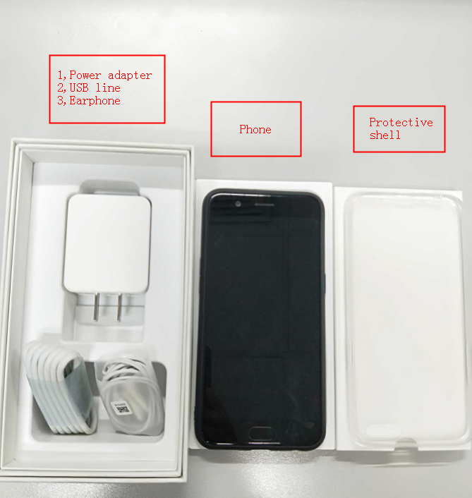
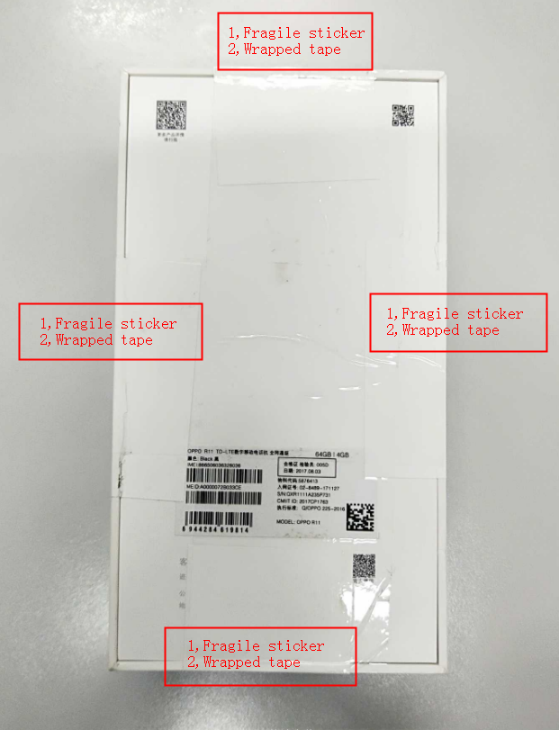
处理方式 Processing Methods
网点库管
SC
Warehouse Administrator
总代备件管理员
Agent Spare
Parts Manager
总代换货管理员
Agent Exchange
Manager

Slide 25
处理方式 Processing Methods
网点库管
SC
Warehouse Administrator
产品退厂包装和运输要求
所有退厂机器不得缺少附件（适配器、耳机、数据线、通针、保护壳），并且附件规格必须与当前机型
出厂配套的规格一致；不得从手机上拆卸任何零部件。如违规，除扣除代理这部分物料损失金额，
并处于500USD/次罚款，情节严重的按照实际产生损失罚款，并全球范围内通报批评。
Packing and shipping requirements for devices return
All devices returned to the factory must with complete all accessories, including adapter,
earphone, USB cable, Nozzle Cleaner, and protective shell; and the specifications of the
accessories must be consistent with the return models; no parts can be removed from the
device. In addition to the amount of material shortage will be deducted from the agent account,
another punished 500USD/time will also be deducted. Huge fines will be incurred if any serious
cases happened, and the punishment will be notified worldwide.
总代备件管理员
Agent Spare
Parts Manager
总代换货管理员
Agent Exchange
Manager

Slide 26
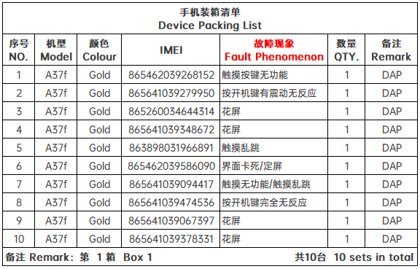
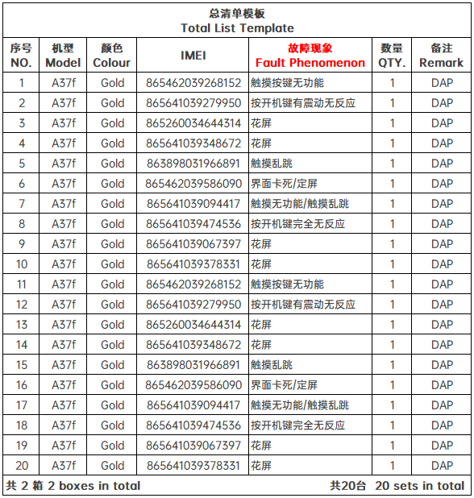

处理方式 Processing Methods
网点库管
SC
Warehouse Administrator
总代备件管理员
Agent Spare
Parts Manager
总代换货管理员
Agent Exchange
Manager
总装箱清单放在第一箱内
The total packing list
placed in the first carton
每箱内需附本箱装机清单
A packing list must
be prepared for each carton

Slide 27
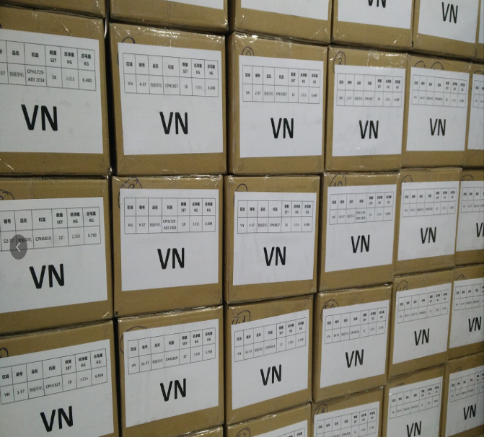
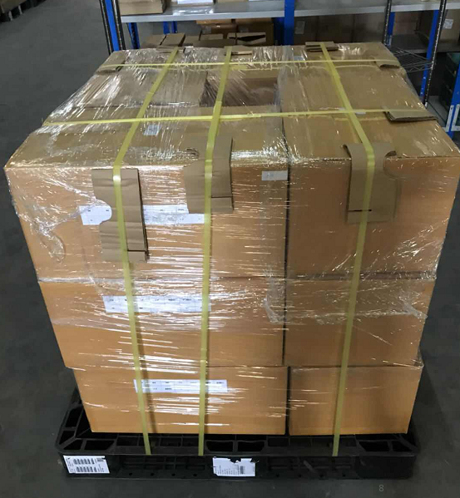
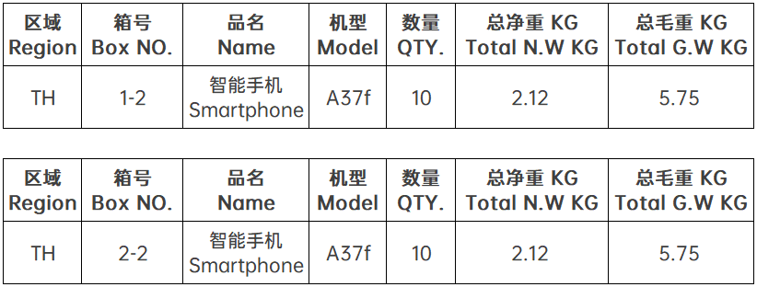
处理方式 Processing Methods
注意：装箱完成后，封箱，贴PASS贴
Note: After packing, seal and paste PASS stickers.

Slide 28
处理方式 Processing Methods
退厂处理
Return to Factory
本地处理
Local Handling

Slide 29
处理方式 Processing Methods
DOA/DAP机器
可退回翻新的区域 The regions which can return the devices
翻新价格冲账：最后一批单一机型数量少于50台，可根据当地实际情况放弃退回，
公司总部将按照各机型的翻新价格给予代理冲账处理（具体翻新价格见《外销机型翻新价格表》）。各区最后一次提报时提供IMEI、机型、颜色、检测单号、检测单完成时间信息。备件组核实过后安排核销。各区根据实际情况对手机进行折价处理，总部不管控。
Refurbishment Price Principle: The regions which can return the devices for refurbishments can choose this solution for the last return which the same model less than 50 sets. The HQ shall write off these devices according to the Price List of OPPO Phone Refurbishment. The detailed information list of DOA/DAP devices should be provided to the HQ, including IMEI, Model、Colour、Inspection order NO. 、Completion date.The discount price according to local markets, HQ will not participate and control.
邮件告知备件组，否则视为放弃此权利
Inform the Spare Parts Team by E-mail, otherwise it will be regarded as waiver of this right.

Slide 30
处理方式 Processing Methods
不可退回翻新区域 The regions which can not return the devices
三七原则处理：针对每月产生DOA、DAP总量少于100台的市场，出于翻新成本考虑，制定三七原则。
公司按照各机型最新出厂价的70%给予代理核销，剩余30%由代理承担，机器的所有权归代理所有，
代理可自行对这部分机器做折价销售或报废处理。
Three-Seven Principle: The regions which DOA/DAP devices produced is less than 100 sets each month in considering of the refurbishment cost. The HQ will offer 70% of the latest shipping price for the total amount of DOA and DAP, and the rest 30% shall be borne by the agent. But the ownership of DOA and DAP devices belongs to the agent, the agent can sell these devices with discounts (do not enjoy the compensation proposal A) or scrap them.

Slide 31
处理方式 Processing Methods
维修后，折价处理
Discount after Maintenance
拆机处理
Dismantling Processing
本地报废
Local Scrap
注意事项 Attention：
1，折价销售后，请保留销售凭证，以待备件管理组后期核查。
After discount sales, please keep the sales voucher for later review by the Spare Parts Team.
2，本区域首次维修DOADAP机器的做折价销售的，维修工单的维修类型必须选择维修。
If the DOA/DAP device is repaired for the first time in this region and sold at a discount, the repair type of the repair order
must be OOW.
3，拆机处理：各区域拆机前，提前向公司备件组报备，经备件组审批通过后方可在客服经理监督下，进行集中拆机处理。
Dismantling Processing: before dismantling in each region, report to the Spare Parts Team of the HQ in advance,
and conduct centralized dismantling treatment under the supervision of the customer service manager after the approval
of the Spare Parts Team.
4，本地报废：各区域报废前，需邮件通知备件管理组。备件管理组同意后方可执行。
Local Scrap: before scrapping in each region, the Spare Parts Team shall be informed by E-mail. After the
Spare Parts Team approval,you can scrap.

