Slide 1

2020年海外备件管理培训
2020 Overseas Spare Parts Management Training
点击输入具体内容点击输入简要文本内容，文字内容需概况精炼
点击输入具体内容点击输入简要文本内容，文字内容需概况精炼
点击输入具体内容点击输入简要文本内容，文字内容需概况精炼
点击输入具体内容点击输入简要文本内容，文字内容需概况精炼
备件护航 服务创不凡
Spare Parts Supporting
Service Soaring

Slide 2
保内保外坏料及呆滞料管理
IW&OOW Defective Materials and Sluggish Materials Management

Slide 3
保内保外坏料及呆滞料管理
IW&OOW Defective Materials and Sluggish Materials Management
保内保外坏料 IW&OOW Defective Materials
呆滞料 Sluggish Materials
处理方式 Processing Methods

Slide 4
保内保外坏料及呆滞料管理
IW&OOW Defective Materials and Sluggish Materials Management
保内保外坏料 IW&OOW Defective Materials

Slide 5
核查原则与要素 Checking Principles & Elements
核查原则 Checking Principles：
保内坏料：维修类型-保修；单价-大于等于3美金。
IW Defective Materials: Repair Type-IW ；Unit Price -higher than or equal to $3.
保外坏料：维修类型-维修；类别-主板/屏幕组件；是否带走坏料-否。
OOW Defective Materials: Repair Type-OOW；Material Species-Mainboard & Screen Assembly；Defective Materials take away or not-No.
核查要素 Checking Elements：
维修工单号、取机时间、维修类型、坏料代码、类型、用户是否带走。
Repair Order No., Handover Date, Repair Type, Defective Material Code, Material Species, Defective Material take away or not.

Slide 6
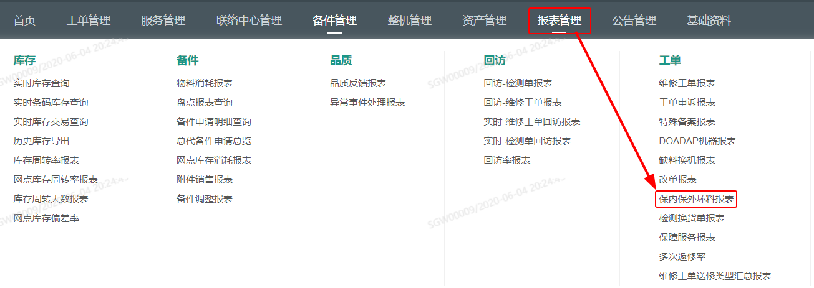
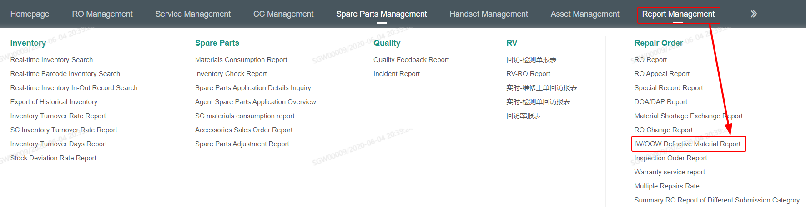

保内保外坏料报表 IW/OOW Defective Material Report
网点库管
SC
Warehouse Administrator
总代库管
Agent Warehouse Administrator
SC/Agent Warehouse Administrator Account
保内保外坏料报表：报表管理--保内保外坏料报表
IW/OOW Defective Material Report:Report Management--IW/OOW Defective Material Report.

Slide 7
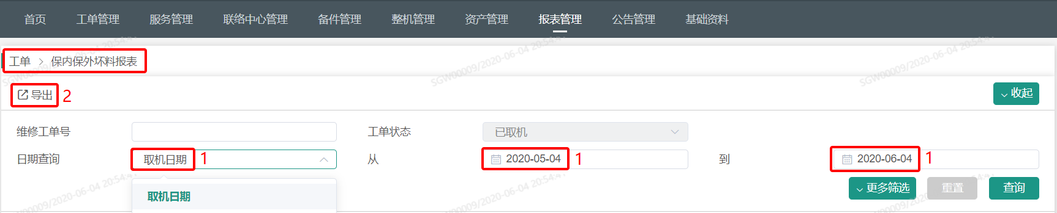
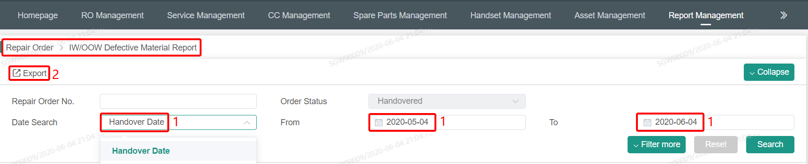
保内保外坏料报表 IW/OOW Defective Material Report
网点库管
SC
Warehouse Administrator
总代库管
Agent Warehouse Administrator
1，确认好日期查询、查询时间（从什么时候到什么时候）。
Confirm the Date Search (from when to when).
2，点击导出。
Click export.

Slide 8
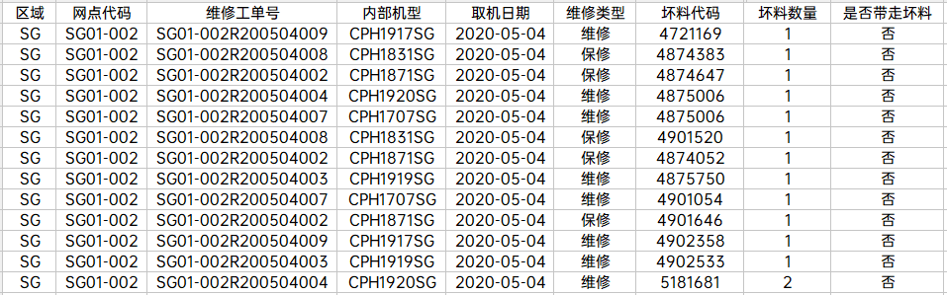
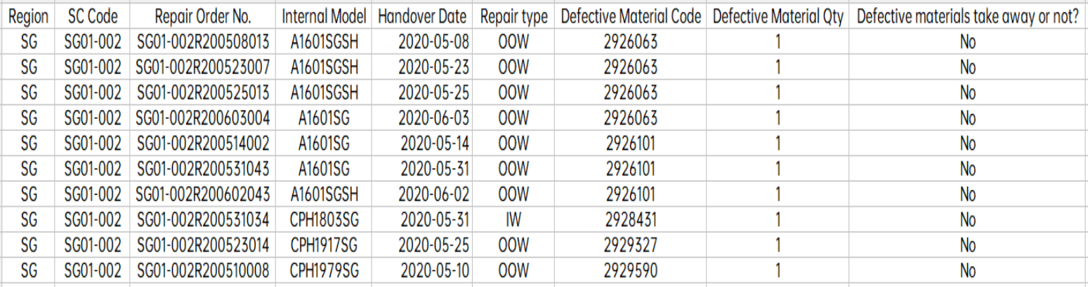
保内保外坏料报表 IW/OOW Defective Material Report
网点库管
SC
Warehouse Administrator
总代库管
Agent Warehouse Administrator
导出原始保内保外坏料报表。
Export the original IW/OOW Defective Material Report .

Slide 9
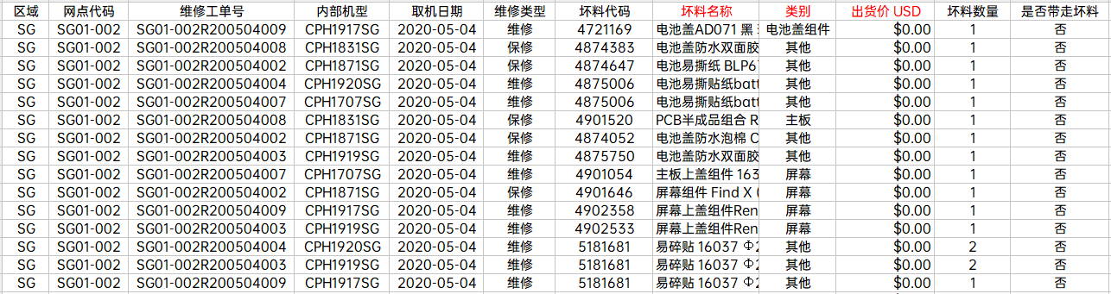
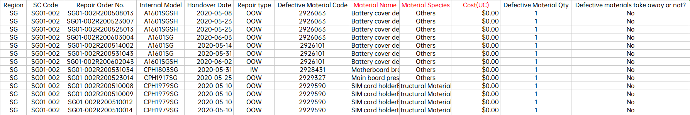
保内保外坏料报表 IW/OOW Defective Material Report
网点库管
SC
Warehouse Administrator
总代库管
Agent Warehouse Administrator
添加物料名称、类别、出货价。
Add Material Name, Material Species(Category) and Cost(Delivery Price).
出货价协助定位坏料。若网点无权限获取出货价，请总仓同事协助筛选。
The cost assists in locating the defective materials. If the SC Warehouse Administrator does not have the right to withdraw the cost, please ask the Agent Warehouse Administrator to assist in screening.

Slide 10
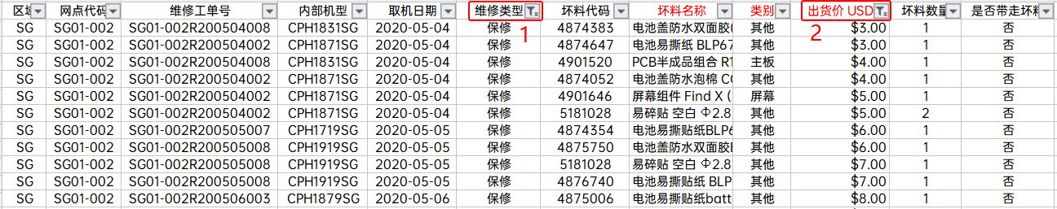
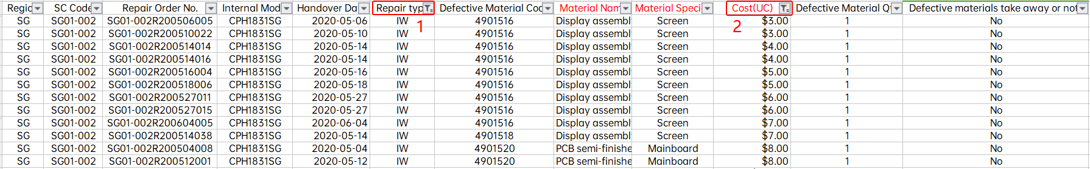
保内保外坏料报表 IW/OOW Defective Material Report
网点库管
SC
Warehouse Administrator
总代库管
Agent Warehouse Administrator
保内物料筛选 Screening of IW defective materials
1，维修类型-保修。Repair Type-IW.
2，出货价≧3USD。Unit Price -higher than or equal to $3.

Slide 11
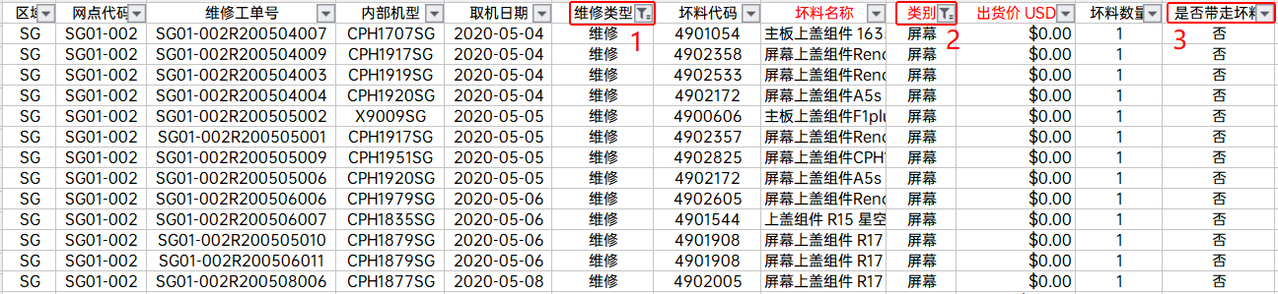
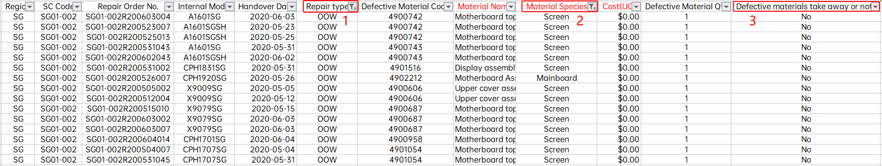
保内保外坏料报表 IW/OOW Defective Material Report
网点库管
SC
Warehouse Administrator
总代库管
Agent Warehouse Administrator
保外物料筛选 Screening of OOW defective materials.
1，维修类型-维修。Repair Type-OOW.
2，类别-主板和屏幕组件。Material Species-mainboard and screen assembly.
3，是否带走坏料-否。Defective Material take away or not-No.
当前用户带走的维修坏料暂不纳入考核。呼叫中心定期回访，若维修工单弄虚作假，按不本分处罚。
The customer take away the OOW defective material are not included in the assessment temporarily. Call Center will revisit regularly. If the repair order is fraudulent, it will be punished according to non-Benfen.

Slide 12
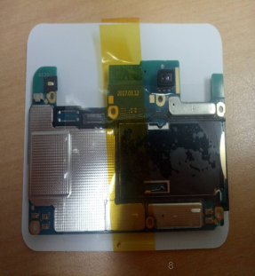
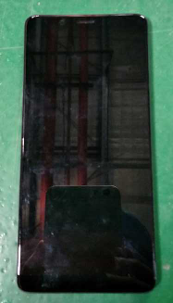
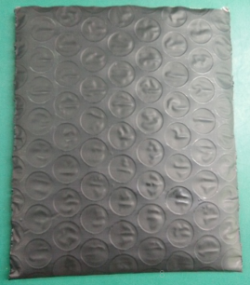
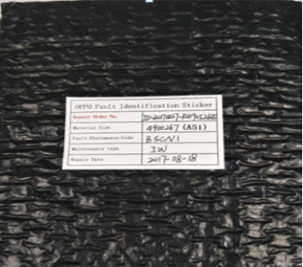
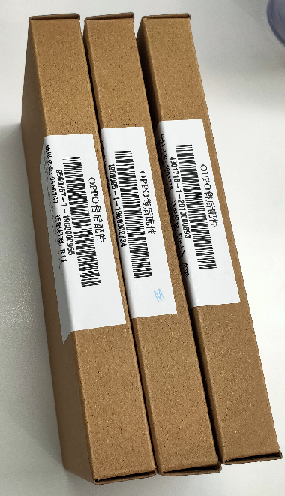
保内保外包装 IW/OOW Defective Material Packing
保内主板和屏组件包装：
IW mainboard & screen assembly packing：
1，气珠袋。
Bubble bag.
2，故障标志贴。
Fault identification sticker.
3，小纸盒。
Small Carton.
网点库管
SC
Warehouse Administrator
主板
Mainboard
屏幕组件
Screen assembly
总代库管
Agent Warehouse Administrator

Slide 13
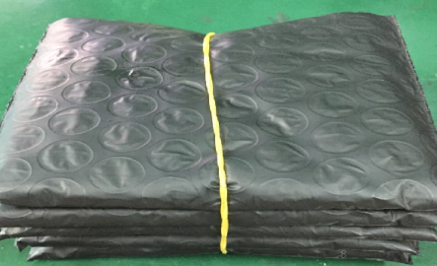
保内保外包装 IW/OOW Defective Material Packing
保外主板和屏幕包装：
IW mainboard & screen assembly packing：
1，气珠袋。
Bubble bag.
2，故障标识贴。
Fault identification sticker.
3，同个代码捆绑在一起（5个或10个一捆）。
Tied together with the same code (5 or 10 bundles).
网点库管
SC
Warehouse Administrator
主板
Mainboard
屏幕组件
Screen assembly
总代库管
Agent Warehouse Administrator

Slide 14
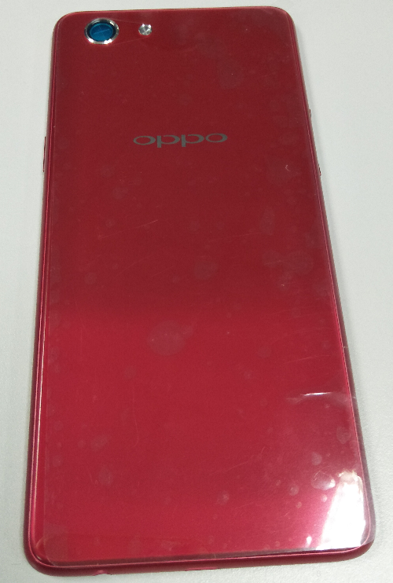
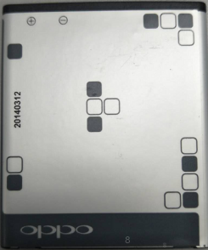
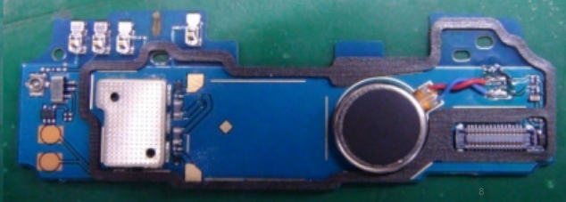
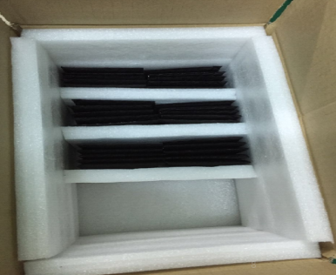
保内保外包装 IW/OOW Defective Material Packing
网点库管
SC
Warehouse Administrator
FPC
电池盖
Battery cover
锂电池
Battery
打包
Packing
总代库管
Agent Warehouse Administrator

Slide 15
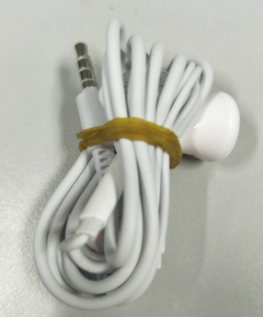
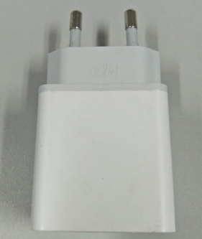
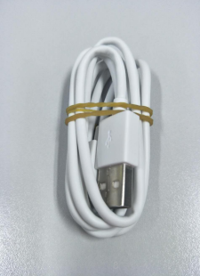
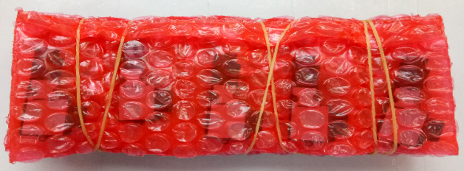
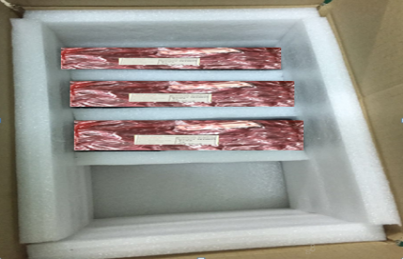
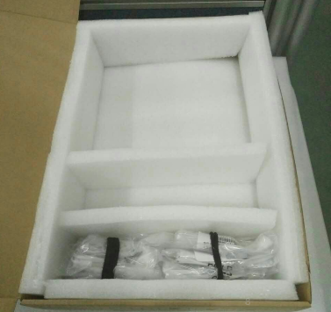
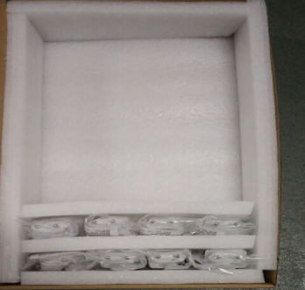
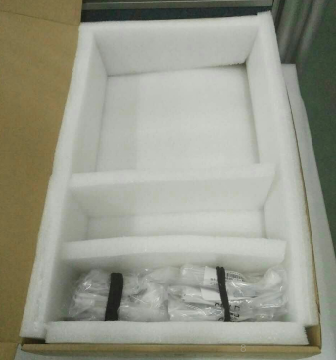
保内保外包装 IW/OOW Defective Material Packing
网点库管
SC
Warehouse Administrator
扬声器/受话器
Speaker/Receiver
耳机
Headphone
适配器
Adapter
USB线
USB cable
打包
Packing
总代库管
Agent Warehouse Administrator

Slide 16
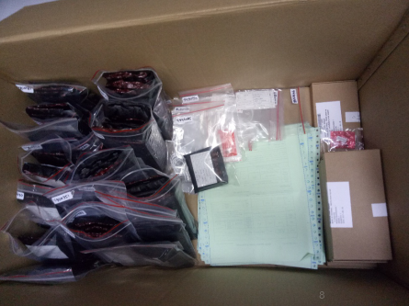
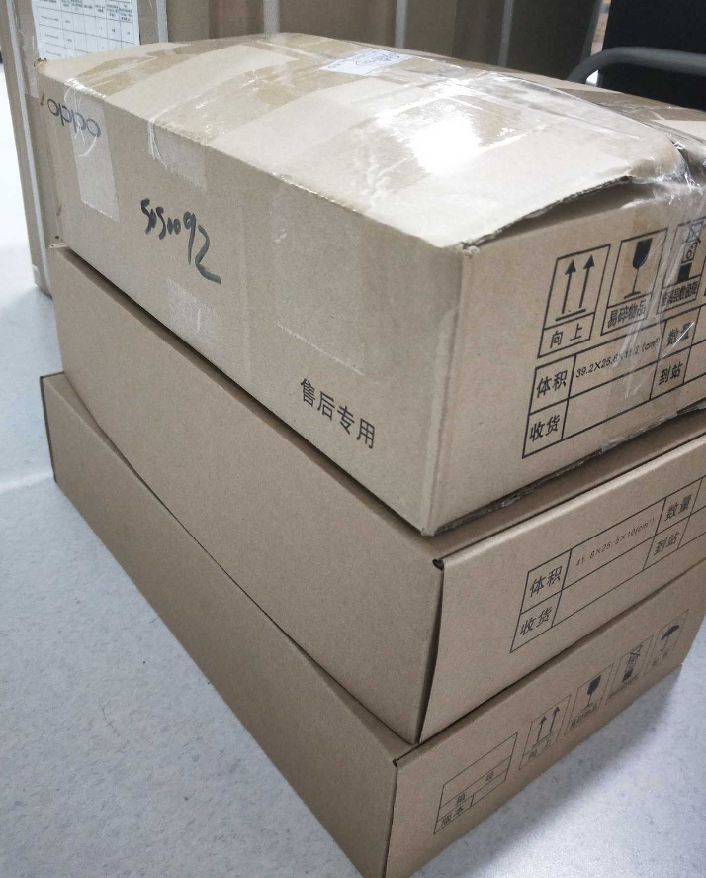
保内保外包装 IW/OOW Defective Material Packing
网点库管
SC
Warehouse Administrator
总代库管
Agent Warehouse Administrator
1，保内保外坏料分开装箱。
Separate IW&OOW Materials into different cartons.
2，坏料清单与维修工单单据放入箱内。
IW&OOW defective materials list and repair order documents are put into the cartons.
3，封箱，寄送，通知总代。
Seal, send and notify the Agent Warehouse Administrator.

Slide 17
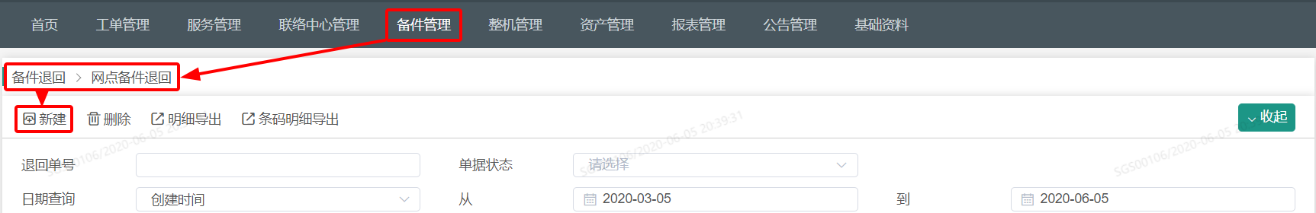
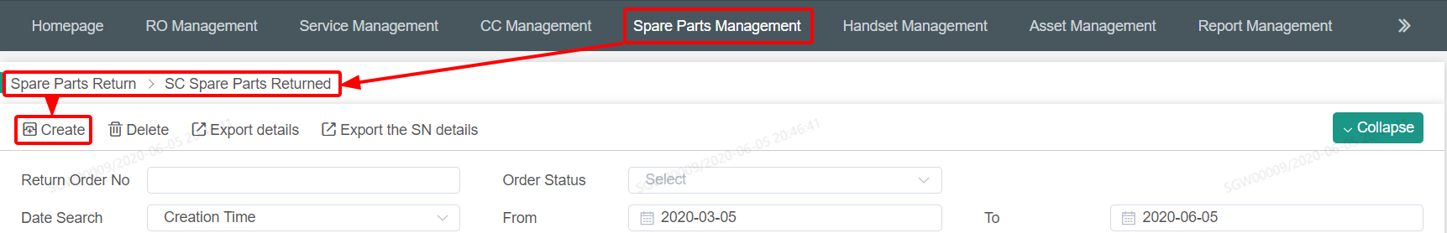
网点备件退回系统操作 The System Operation of SC Pare Parts Returned
网点库管
SC
Warehouse Administrator
总代库管
Agent Warehouse Administrator
网点备件管理员账号 SC Warehouse Administrator Account
1，菜单栏：备件管理-备件退回-网点备件退回。
Menu Bar: Spare Parts Management - Spare Parts Return - Agent Spare Parts Returned.
2，点击新建。
Click Create.
其他具体操作参考 WCSM系统操作指导-备件退回。
For other specific operations, refer to WCSM system operation instruction - Spare Parts Returned.

Slide 18
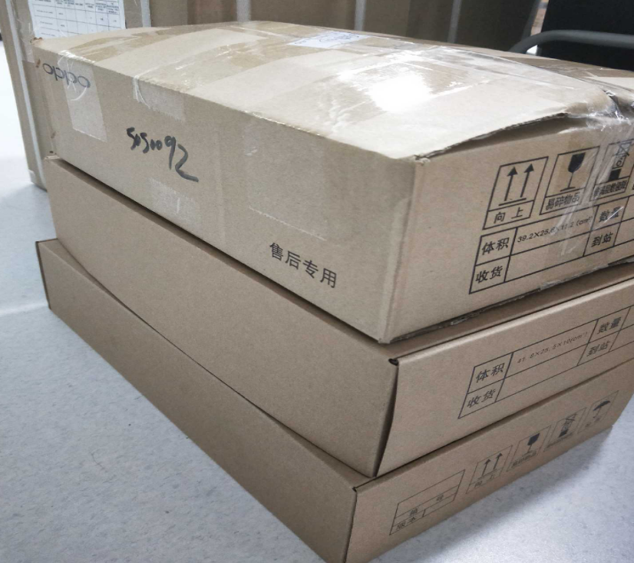
总代库管接收坏料 The Agent Warehouse Received the Defective Materials
网点库管
SC
Warehouse Administrator
网点库管
SC
Warehouse Administrator
总代库管
Agent Warehouse Administrator
1，检查外箱是否破损。
Check whether the outer box is damaged or not.
2，核对实物。
Check the material.

Slide 19
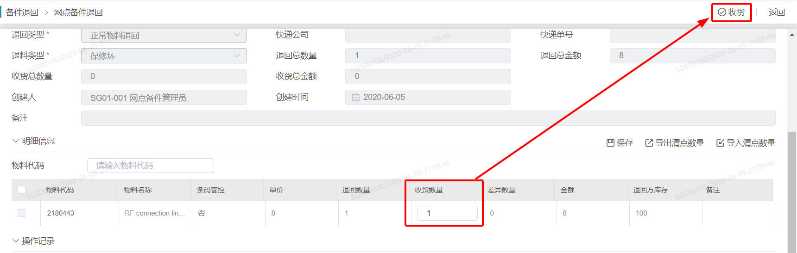
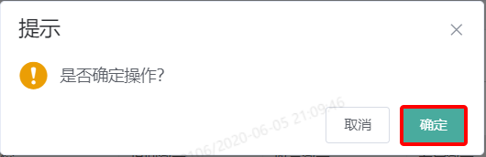
总代库管接收坏料 The Agent Warehouse Received the Defective Materials
网点库管
SC
Warehouse Administrator
总代库管
Agent Warehouse Administrator
总代备件管理员账号
1，根据实际收货量更新收货数据。
2，点击收货。
3，点击确定，流程结束（系统会根据收货量，更新双方的系统库存数据）。

Slide 20
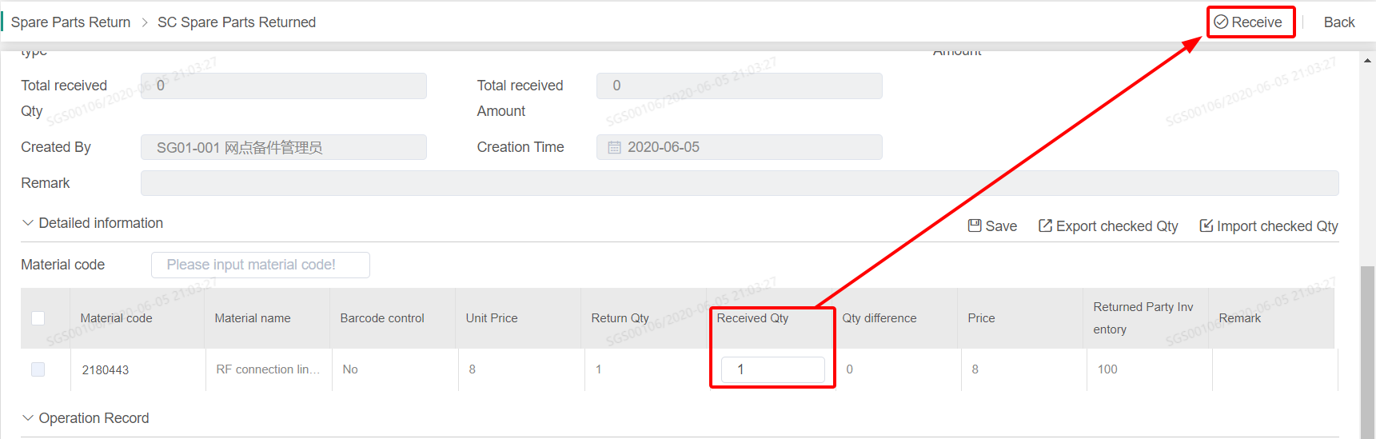
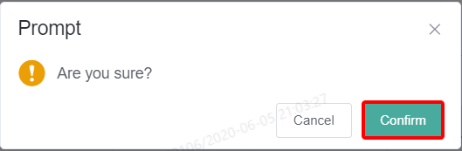
总代库管接收坏料 The Agent Warehouse Received the Defective Materials
网点库管
SC
Warehouse Administrator
总代库管
Agent Warehouse Administrator
Agent Warehouse Administrator Account
1. Update the receiving data according to the actual receiving quantity.
2. Click receive.
3. Click confirm to finish the process (the system will update the system inventory data of both parties according to the received quantity).

Slide 21
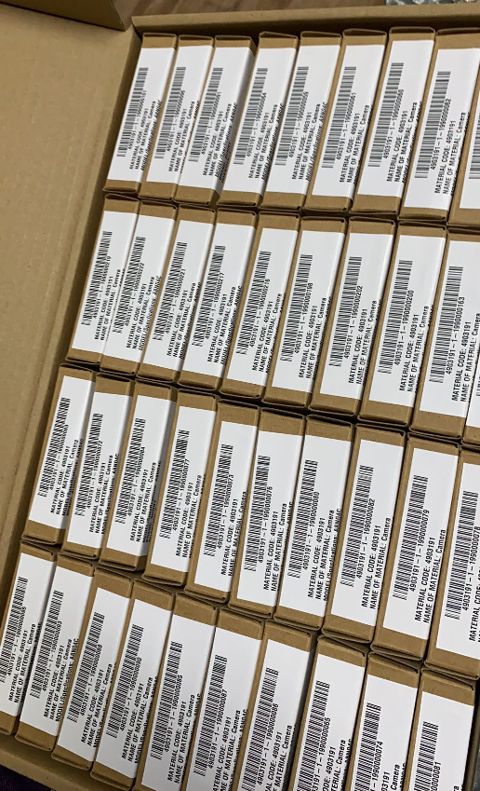
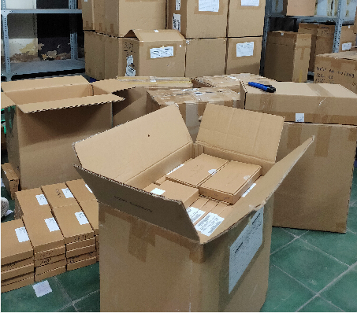
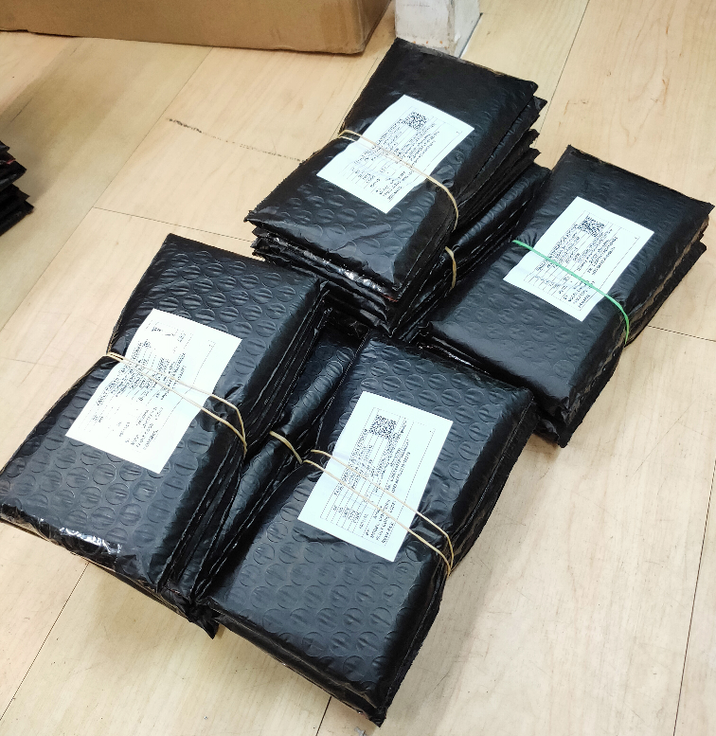
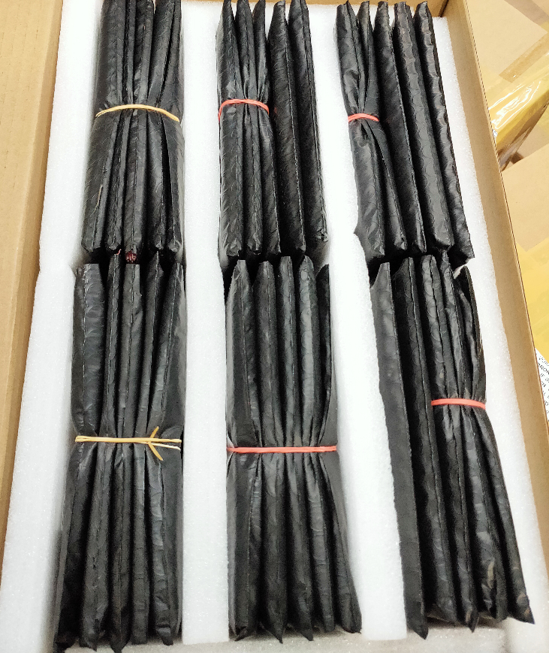
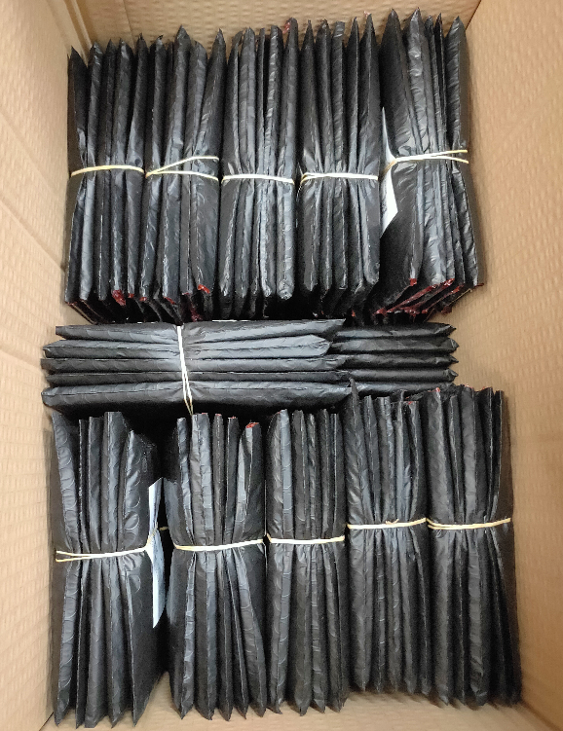
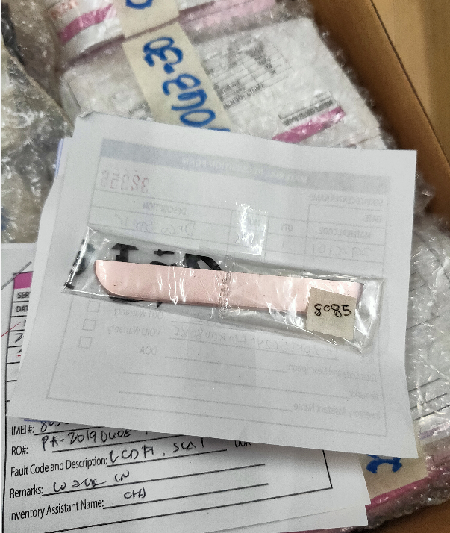
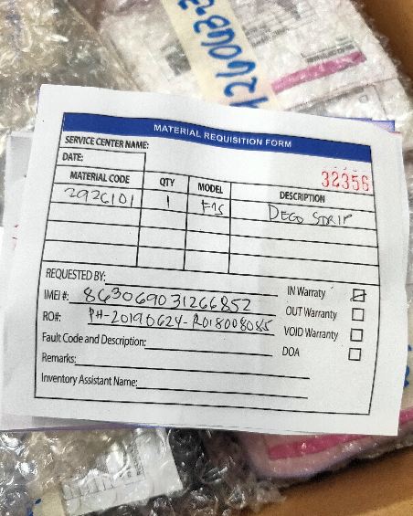
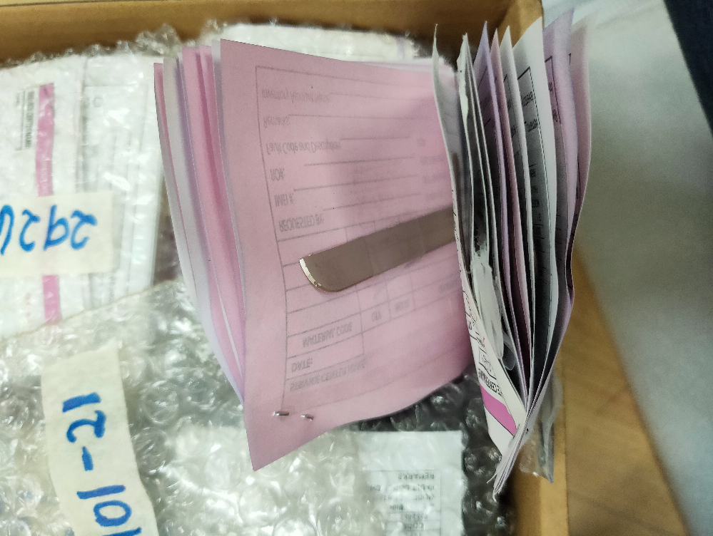
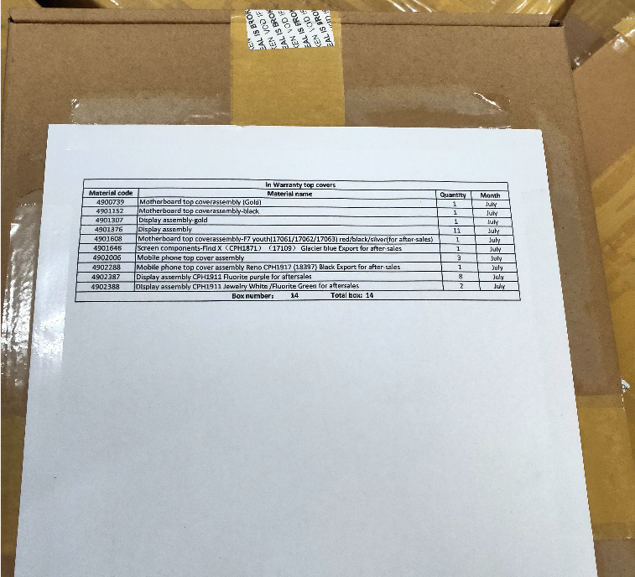
保内保外坏料打包 IW/OOW Defective Materials Packing

Slide 22
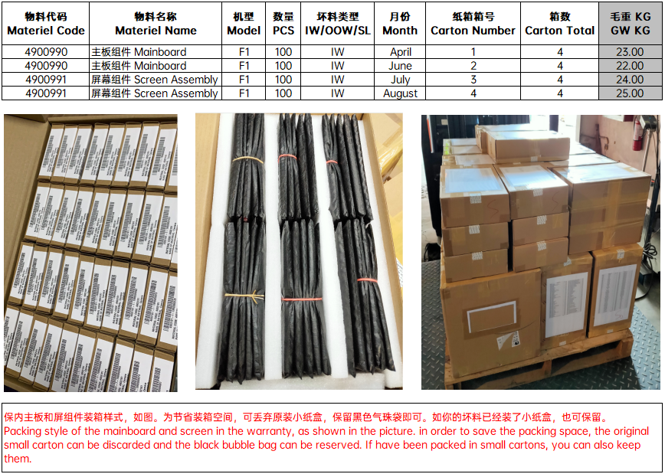
保内主板和屏组件包装 IW Mainboard & Screen Assembly Packing
网点库管
SC
Warehouse Administrator
总代库管
Agent Warehouse Administrator
1，坏料按月、按类别统一封箱保存。
The defective materials shall be sealed and stored by month and category.
2，工厂备件组不定期检查。
The spare parts team will check irregularly.
注意 Attention：
外箱不能出现物料价格 No price should be shown on outer box.

Slide 23
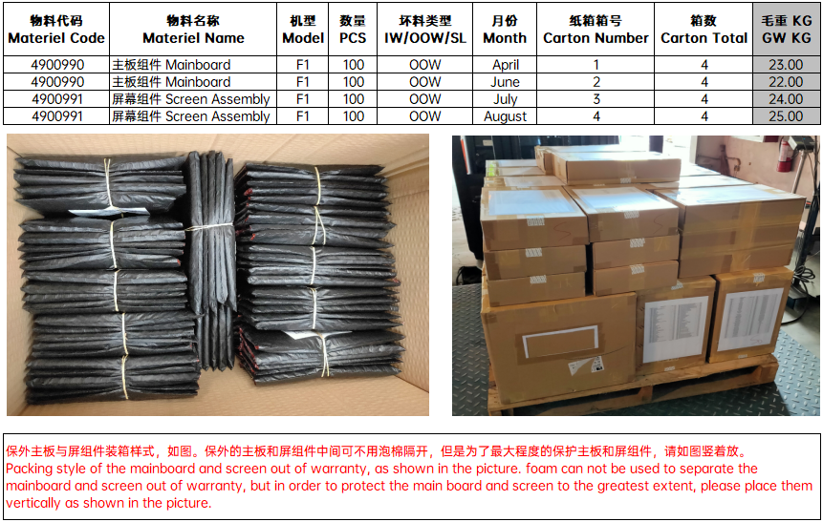
保外主板和屏组件包装 OOW Mainboard & Screen Assembly Packing
网点库管
SC
Warehouse Administrator
总代库管
Agent Warehouse Administrator
1，坏料按月、按类别统一封箱保存。
The defective materials shall be sealed and stored by month and category.
2，工厂备件管理组不定期检查。
The spare parts team will check irregularly.
注意 Attention：
外箱不能出现物料价格 No price should be shown on outer box.

Slide 24

保内保外其它物料包装 IW/OOW Other Materiels Packing
网点库管
SC
Warehouse Administrator
总代库管
Agent Warehouse Administrator
1，坏料按月、按类别统一封箱保存。
The defective materials shall be sealed and stored by month and category.
2，工厂备件组不定期检查。
The spare parts team will check irregularly.
注意 Attention：
外箱不能出现物料价格 No price should be shown on outer box.

Slide 25




锂电池处理方式 Lithium Battery Processing Method
步骤一：将水桶盛满水，容量15-20L。
Fill the bucket with water with 15-20L.
步骤三：将待处理电池放入盐水中浸泡。
Put the to-be treated battery into it.
网点库管
SC
Warehouse Administrator
步骤二：在水桶中放入食用盐约200g。
Put 200g salt into it.
步骤四：盖上水桶盖，放入通风环境中48H。
Cover the bucket and put it in the
ventilated environment for 48H.
总代库管
Agent Warehouse Administrator
步骤五：将电池取出晾干。
Remove the battery and dry it.

Slide 26
保内保外坏料及呆滞料管理
IW&OOW Defective Materials and Sluggish Materials Management
呆滞料 Sluggish Materials

Slide 27
呆滞料 Sluggish Materials
呆滞料的定义：过去6个月之内消耗数量为0，或者物料现有的库存数量远大于过去6个月的消耗量，并且预计在未来的全生命周期中都无法消耗的这部分的物料。
其他注意事项：
1. 用于销售的物料或者附件，不在工厂核销范围内（包括但不限于耳机，USB线，锂充，电池组件，电源适配器，通针等）。
2. 单价为3美金及以下的物料不在核销范围内。
3. 原则上工厂不再安排物料的返厂，工厂特别发文需退回的物料除外。有利用价值可以退回的物料，需要保留原包装，并且退回公司之后品质验收合格才能够收货入仓。
4. 工厂备件组将协助提供跨国调货的需求信息给各区域，一旦确认可以调货，各区域自行负责调货的物流安排以及自行确认财务账目的往来，其中有可能产生的运输费用，关税及风险由物料调出方代理承担。
5. 除上述情况外的，用于维修的呆滞物料，工厂和代理按照二八分原则进行财务结算，其中工厂承担呆滞物料费用的百分之二十，代理承担百分之八十。
6. 以物料最新出货价进行核销。
Definition of sluggish material:Consumption in the past 6 months is 0,Or the existing inventory of materials is far greater than the consumption in the past six months.And it is expected that this part of materials will not be consumed in the future life cycle.
Other precautions:
1. Materials or accessories for sale,Not within the scope of factory write off (including but not limited to Headphones, USB cable, Lithium charge, Battery components, Power adapter, Pins, etc.).
2. Materials with a unit price of $3 or less are not included in the write off scope.
3. In principle, the factory will not arrange the return of materials.Except for materials that need to be returned by special documents issued by the factory.Materials with use value that can be returned need to retain the original packaging, and can be received and warehoused only after they are returned to the company and pass the quality inspection.
4. The Spare Parts Group of the factory will assist in providing the demand information of cross-border transfer to each area.Once it is confirmed that the goods can be transferred, each region shall be responsible for the logistics arrangement of the goods transfer and the transaction of its own financial accounts.The possible transportation costs, customs duties and risks shall be borne by the agent of the material transfer out party.
5. In addition to the above, the sluggish materials used for maintenance,The factory and the agent shall carry out financial settlement according to the principle of two eight points.The factory bears 20% of the cost of sluggish materials and the agent 80%.
6. Write off based on the latest delivery price of the material.

Slide 28


呆滞料提报 Report of Sluggish Materials
网点库管
SC
Warehouse Administrator
总代库管
Agent Warehouse Administrator
按照模板提报，否则打回。
Report according to the template, or back to you.

Slide 29



呆滞料包装 Sluggish Materials Packing
网点库管
SC
Warehouse Administrator
备件组管理组确认后
After the Spare Parts Management Team confirms
1，下架，清点数量。
Remove and count the quantity.
2，打包，制作装箱清单。
Packing and making packing list.
3，系统出库。
Out of the stock on the system.
总代库管
Agent Warehouse Administrator

Slide 30
保内保外坏料及呆滞料管理
IW&OOW Defective Materials and Sluggish Materials Management
处理方式 Processing Methods

Slide 31


总代备件退回 Agent Spare Parts Returned
网点库管
SC
Warehouse Administrator
总代库管
Agent Warehouse Administrator
1，菜单栏：备件管理-备件退回-总代备件退回。
2，选择好退料类型和处理类型。
3，点击保存。

Slide 32


总代备件退回 Agent Spare Parts Returned
网点库管
SC
Warehouse Administrator
总代库管
Agent Warehouse Administrator
1. Menu Bar: Spare Parts Management - Spare Parts Return - Agent Spare Parts Returned.
2. Select the return material type and processing type.
3. Click Save.

Slide 33


总代备件退回 Agent Spare Parts Returned
网点库管
SC
Warehouse Administrator
总代库管
Agent Warehouse Administrator
下载模板，上传系统。
Download the template and upload the system.

Slide 34


处理方式 Processing Methods
网点库管
SC
Warehouse Administrator
总代库管
Agent Warehouse Administrator
注意事项 Attention：
1，所有坏料处理方式均不可违反当地法律法规。
All treatment methods should not violate local laws and regulations.
2，物料报废前需向备件组申请，备件组同意后方能进行报废。
Apply to Spare Parts Team before materials scrap and scrap materials only after approval from Spare Parts Team.

Slide 35


处理方式 Processing Methods
网点库管
SC
Warehouse Administrator
总代库管
Agent Warehouse Administrator
注意事项 Attention：
1，坏料报废需确保物料信息安全，不可影响公司形象。
The scrap of materials should ensure information security and could not have a bad influence on company's image.
2，所有坏料报废照片与视频不可外传，发给备件组存档除外。
All photos and videos of scrap materials are not allowed to be transmitted, only except those sent to the Spare Parts
Team for record.

