Slide 1
Incidents Identification Manual

Slide 2
Incidents identification flow chart
After-sales incidents identification flow chart

Slide 3
Common conditions of burnt damage
Fault phenomenon: the phone casing is with burnt marks

Slide 4
With undamaged battery
Fault phenomenon :
The phone casing is with different degrees of burnout, but the battery is still undamaged.
1.1 With burnt Antenna;
1.2 Burnt by external fire;

Slide 5
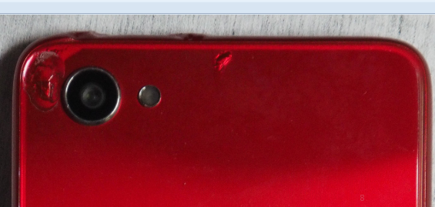
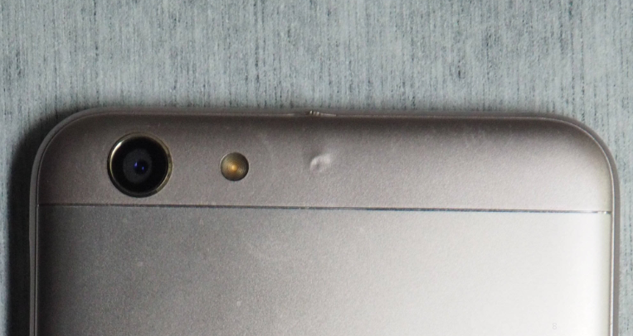
1.1. Antenna or other connectors (Mild event)
Phenomenon: The plastic battery cover has thermal damage. If the situation is slight, the damage may not be obvious.
Fault cause: The antenna receives a very strong electromagnetic signal, causing the antenna related circuit to burn out. For example, the mobile phone was placed in the microwave oven.
Handling suggestions: This case will easily trigger conflicts with customers, and it is not easy to reach a consensus; It is suggested to repair the phone as In-warranty.
Defective area: headphone jack, antenna (top or bottom of the phone)
If the damage is serious, and the plastic cover will be with burnt damage

Slide 6
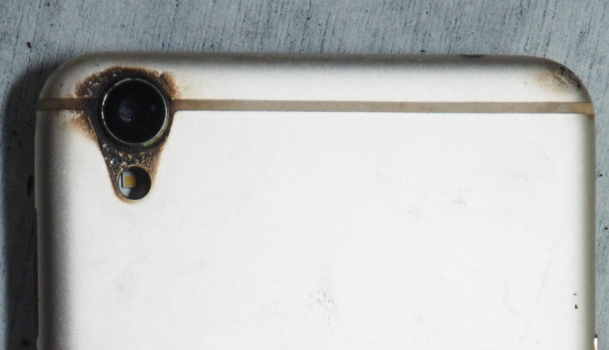
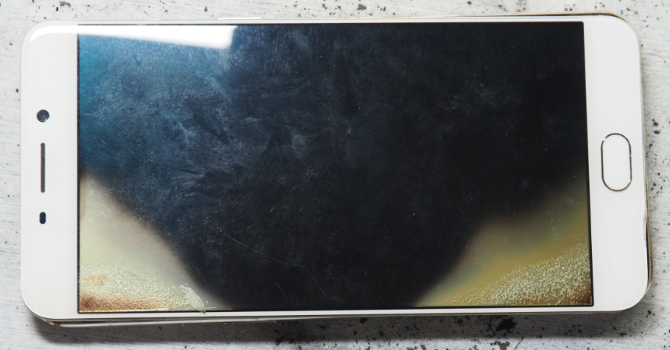
1.2. Burnt by External fire (Battery is undamaged)
1.2.1 Burnt by external fire at the edge or local parts; (Models with Metal casing)
The edge of screen is burnt into white, but the battery is without brunt marks
Burnt marks
Phenomenon: the burnt position is in the edge of the phone(instead of being burnt in the battery)
Way to judge the good battery : the battery does not swell up or burn out and the phone case is not cracked.
Fault cause: The phone is burnt by an external heating source, causing damage to the phone appearance.
Models with metal cases are typically found brunt marks in cameras, screens, connectors or buttons.
Handling suggestions: Refer to the “Handling Process of Incidents ”.

Slide 7
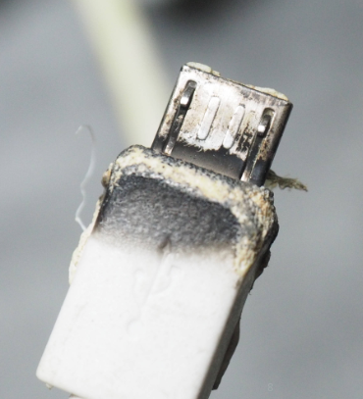
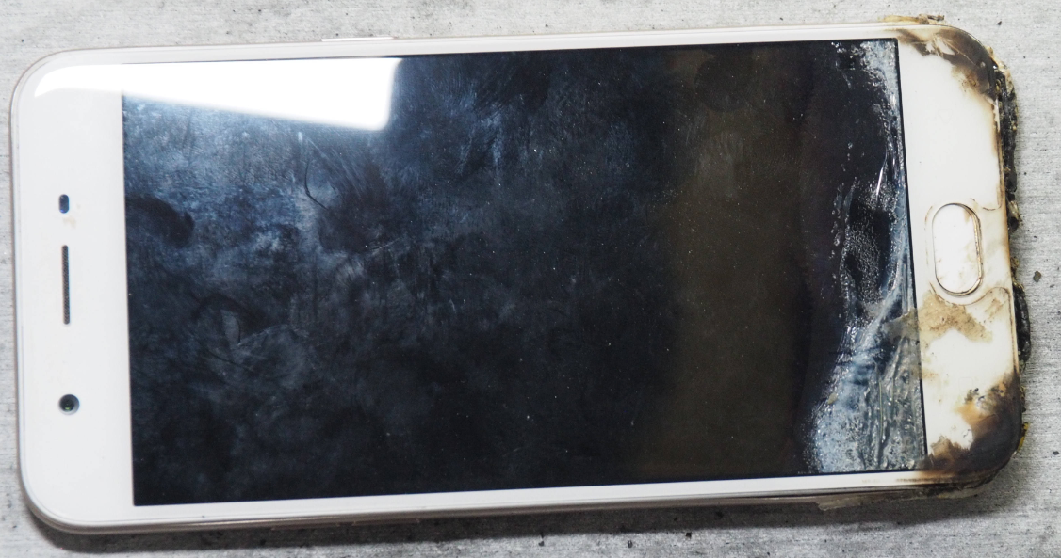
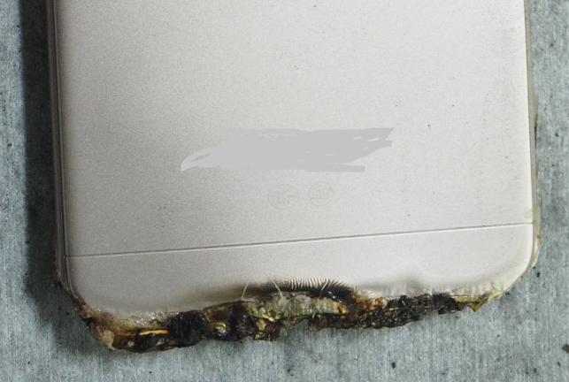
1.2.2 Partial external fire burning at the edge
(Models with plastic casing)
The plug surface gets burnt
The edge gets burnt
The edge gets burnt
Phenomenon: The serious location of burning is generally at the edge of the phone, but not in the battery .
Way to judge the good battery : the battery does not swell up or burn out and the phone case is not cracked.
Fault cause: The phone is burnt by an external heating source, causing damage to the appearance.
Models without metal casing get burnt at the edge, camera, screen, socket, buttons, etc.
Handling suggestions: Refer to the “5.1 Handling Process of Incidents in the Handling Regulations of OPPO Overseas Incidents ”.

Slide 8
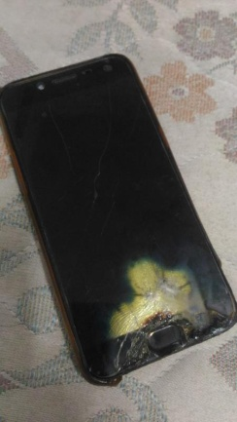
1.2.3 Large areas of the edge gets burnt by External fire
Only edge position gets burnt and other place was still good
Handling suggestions: Refer to “5.1 Handling Process of Incidents in the Handling Regulations of OPPO Overseas Incidents ”.

Slide 9
2. With burnt battery（ Mega event ）

Slide 10
2.1 Damaged by the third-party force (Mega event )
Phenomenon: apparently affected by external force or heat source, causing the battery or the phone to get burnt.
Handling suggestions: the “5.1 Handling Process of Incidents in the Handling Regulations of OPPO Overseas Incidents ”.
2.2 Unable to confirm specific cause by the appearance (Mega event)
Phenomenon: There is no obvious external force f, and the cause of the burning cannot be accurately judged from the appearance.
Handling suggestions: Refer to “5.1 Handling Process of Incidents in the Handling Regulations of OPPO Overseas Incidents ”.

Slide 11
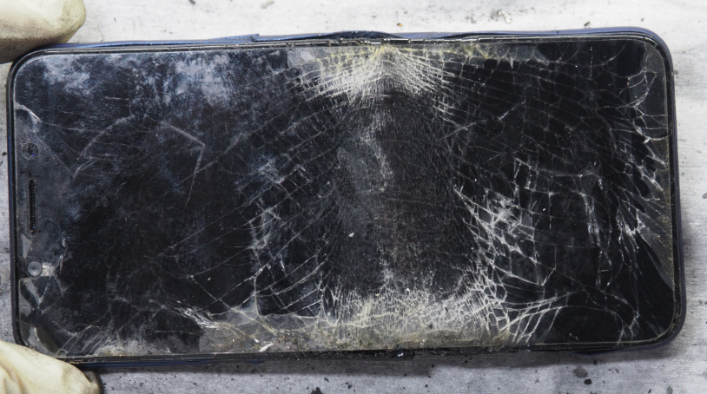
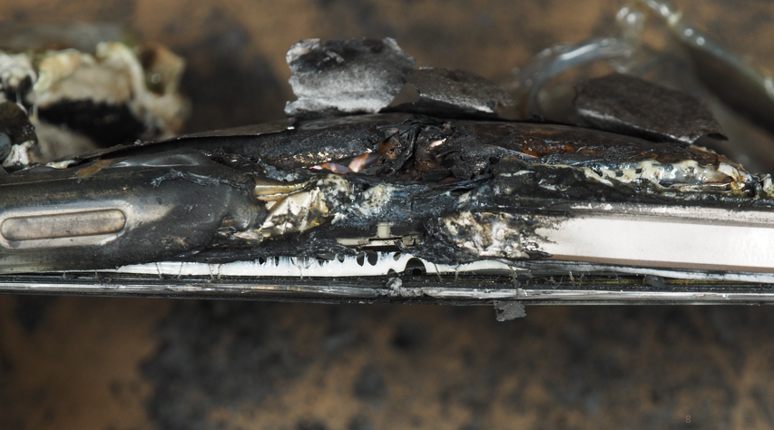
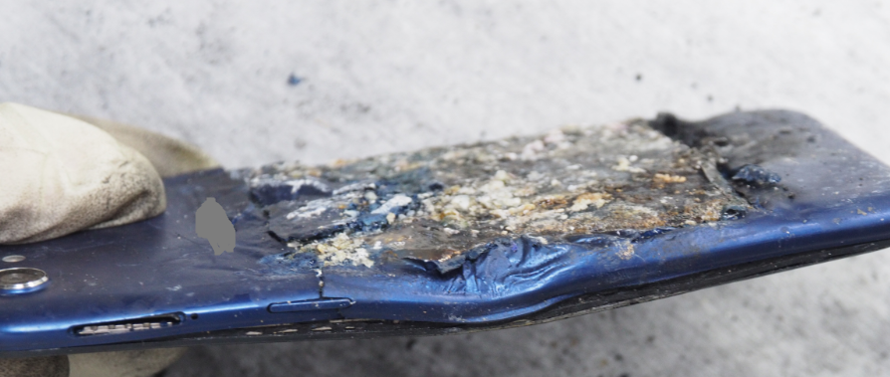
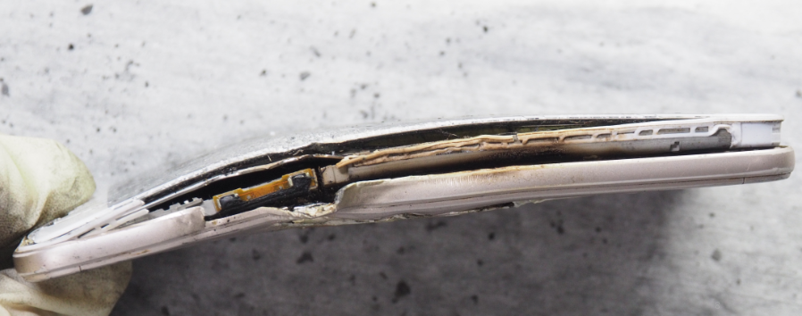
2.1 Damaged by the third party cause
2.1.1 Deformed phone
Fault phenomenon：The burnt battery can be seen by observing the appearance from the side, and the phone has been bent and deformed.
Fault cause: the phone is bent and the electronic chip is deformed, causing the internal pole piece to be squeezed and short-circuited.
The body gets deformed

Slide 12
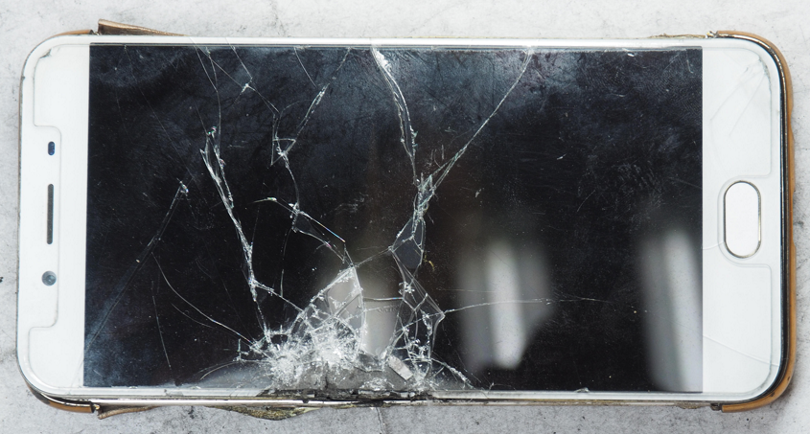
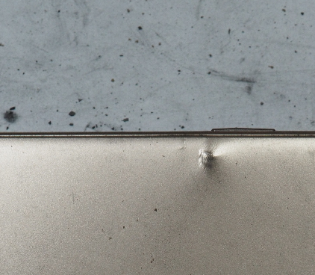
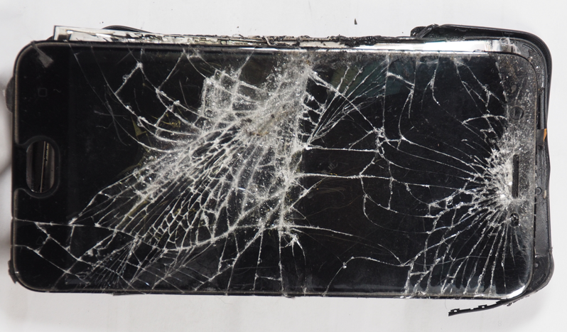
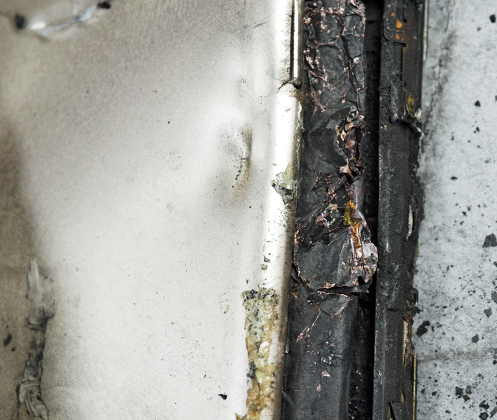
2.1 Damaged by the third party force
2.1.2 Impact and extrusion
Fault phenomenon： The phone is deformed and mechanical impact marks are visible on the front or back of the phone.
Fault cause: The phone is impacted and the electronic chip is deformed, causing the internal pole piece to be short-circuited

Slide 13
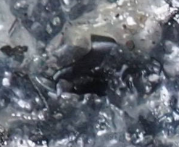
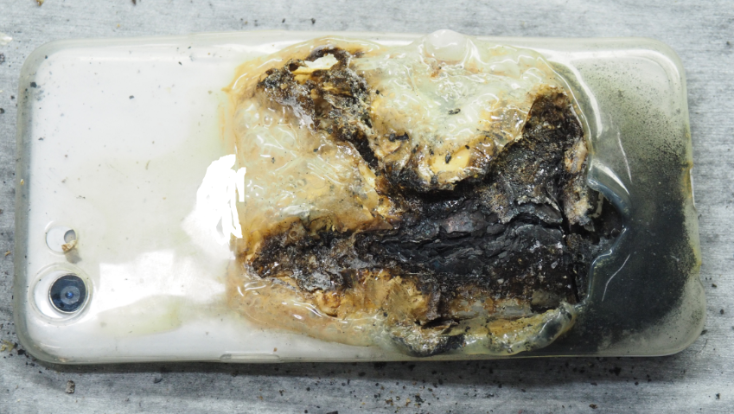
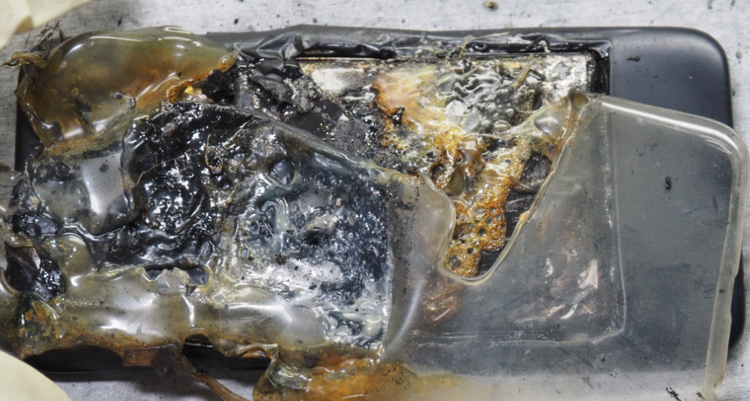
2.1 Damaged by the third party cause
2.1.3 Obviously pierced by foreign matters
There are cracks on the battery;
Fault phenomenon： The burnt battery can be judged by the appearance of the mobile phone, and the burnt damage is visible on the battery cover.
Fault cause: external objects pierce the battery cover and the electronic chip is deformed, causing the internal pole piece to be squeezed and short-circuited
This fault is more common in plastic battery cover models.
The pierced hole can be seen on the battery;

Slide 14
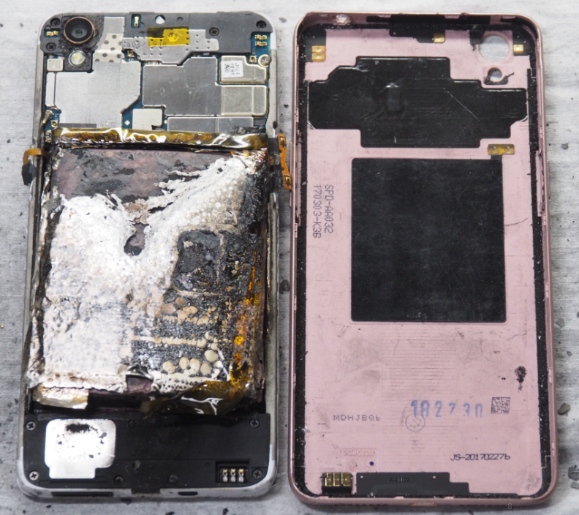
2.1 Damaged by the third party cause
2.1.4 Private disassembly of the battery
Fault phenomenon： The battery has got burnt, but there is no burnt mark on the battery cover. This phone casing has been disassembled, and except the battery no other components gets damaged.
Fault cause: When the user privately disassembles the mobile phone battery, the improper operation will easily cause the internal pole piece to be squeezed and short-circuited
The battery gets burnt;
The battery cover isn’t damaged;

Slide 15
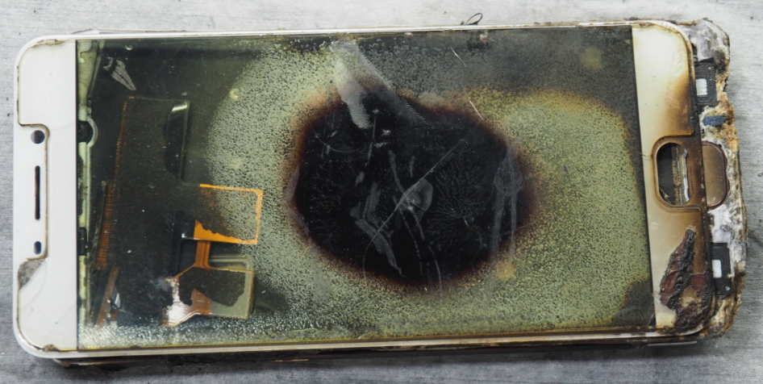
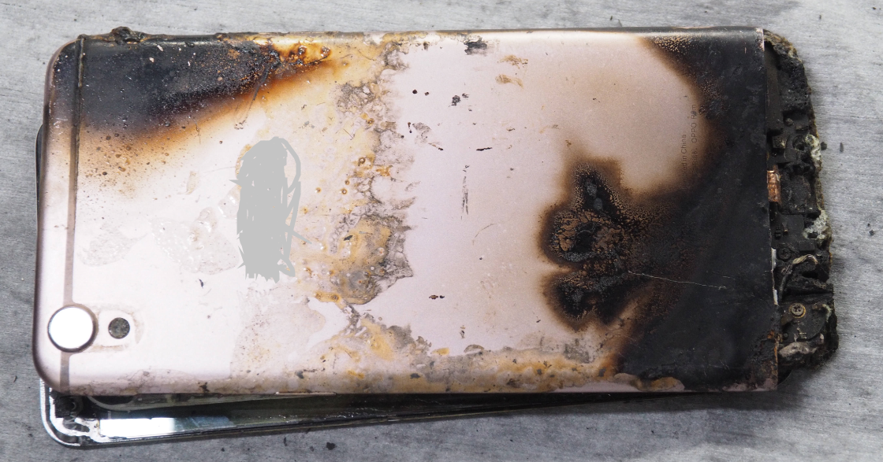
2.1 Damaged by the third party cause
2.1.5 Burnout by the external fire
burnout mark by external fire
Fault phenomenon： The burnt part in the front screen is caused by the burnt battery in the corresponding location; The casing of the mobile phone has an external burnt mark.
Fault cause: The mobile phone is baked by the external fire, and the inner diaphragm of the electronic chip is damaged by heat, causing the positive and negative electronic chip short circuit to get burnt.
burnout mark by external fire

Slide 16
2.2 Unable to confirm the specific cause by the appearance
Fault phenomenon：
There is no obvious damage of external force, and the cause of burning cannot be
accurately determined from the appearance.
For example :The phone is completely burnt out, and the cause cannot be accurately judged
Handling suggestions: Refer to the “Procedures for Abnormal Problems”.

Slide 17
3. Burnout near the USB Connector (mild event)
Fault phenomenon： The USB connector or the area near the connector gets burnt, such like burnout of the USB connector, smoke, USB connector plastic case and deformation.

Slide 18
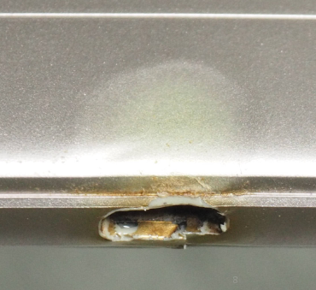
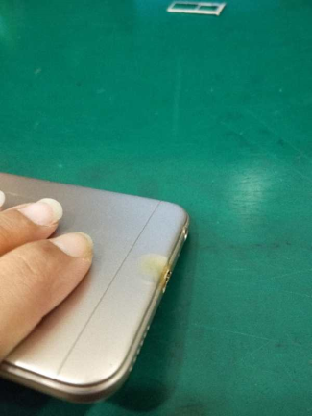
3.1 Casing deformation
The paint gets discolored, but without cracks, deformation or shrink
The paint gets discolored, but without cracks, deformation or shrink
Common causes:
1. The internal circuit was damaged by the liquid;
2. The connector had foreign matter, resulting in poor contact or short circuit;
3. The batter was continuously charged, causing serious heat in the connector.

Slide 19
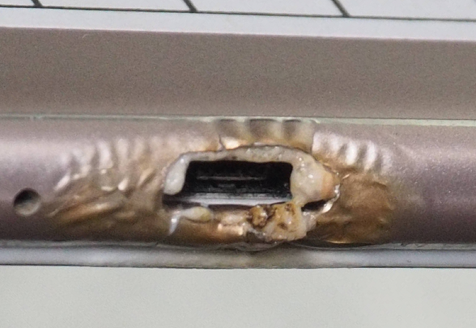
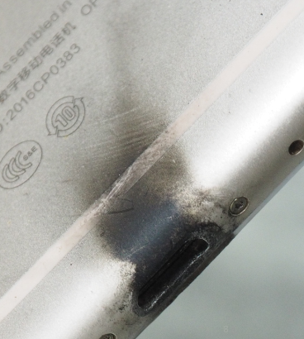
3.2 The casing gets burnt but not obviously
Appearance identification: the surface of the paint plastic is discolored, the paint surface is broken and cracked, and there are black marks on the black, and the plastic deformation is serious, but the USB connector is not damaged.
Fault phenomenon: If the USB connector and the USB cable do not get burnt out, only the outer casing gets burnt out, it can basically be judged that the deformation is caused by the external heating source.
Handling suggestions: Repair it as In-Warranty

Slide 20
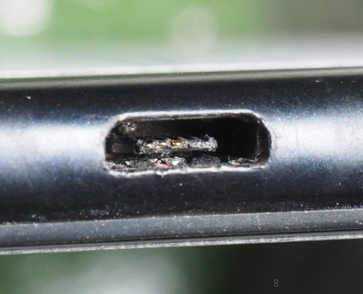
3.3.1 USB connector is damaged and the casing is good
Appearance identification: USB connector gets burnt but with no obvious deformation and burnt mark;
Cause: The original adapter is not used or the adapter is damaged, and the data cable is in a foreign matter or is severely deformed. These reasons may cause the USB connector to burn out. the USB socket will be damaged and the casing will not have obvious signs of burns.
Handling suggestions: OOW, but the reason of charging adapter and data cable needs to be excluded to avoid such damages happening again.
USB connector is damaged

Slide 21
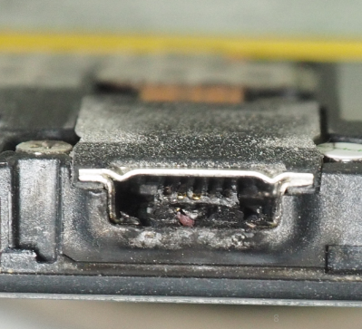
3.3.2 The USB connector is damaged and the casing has a slight burnt mark
The discharging period is too short to damage the appearance;
Fault phenomenon : The USB connector gets burnt in a large area, and even the outer casing also has slight burnt marks with black smoke.
Fault cause: The USB connector is connected to a high-current power supply, and the energy of high-voltage discharge, ignition, black smoke is too small to cause the casing to get burnt.
Handling suggestions: IW/OOW

