Slide 1


Slide 2
国际联保 International Warranty Service
2020/6/15

Slide 3
目录 Contents
Part A 国际联保政策 International Warranty Service Policy
Part B 国际联保注意事项 Notice
Part C 备料策略 Material Ordering Guidance

Slide 4


国际联保政策 International Warranty Service Policy

Slide 5
国际联保政策 International Warranty Service Policy
针对指定设备*，在其正式销售的国家/地区，可以在任意一家OPPO授权服务中心享受设备的保修、维修以及升级服务（不涉及设备的退换）
For designated devices *, you have access to services of warranty, repair, and upgrade at OPPO authorized service centers in the country/region where these devices are sold through official channels. (Not include refund and replacement service)
* 指定设备是指Find X2 系列（Find X2 Pro 兰博基尼版、Find X2 Pro 和 Find X2）
* Designated devices refers to Find X2 Series（Find X2 Pro Lamborghini 、Find X2 Pro and Find X2）
*在日本购买的Find X2系列机型不支持国际联保，但在日本可正常接受国际联保服务
*Find X2 Series purchased via Japanese official channels will not be available for International Warranty Service.
Find X2 Series purchased in other countries/regions are able to accept International Warranty Service in Japan.

Slide 6
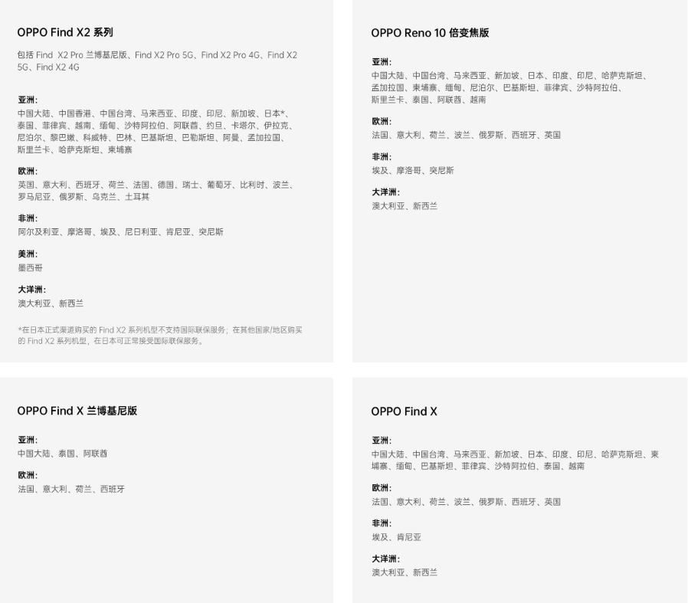
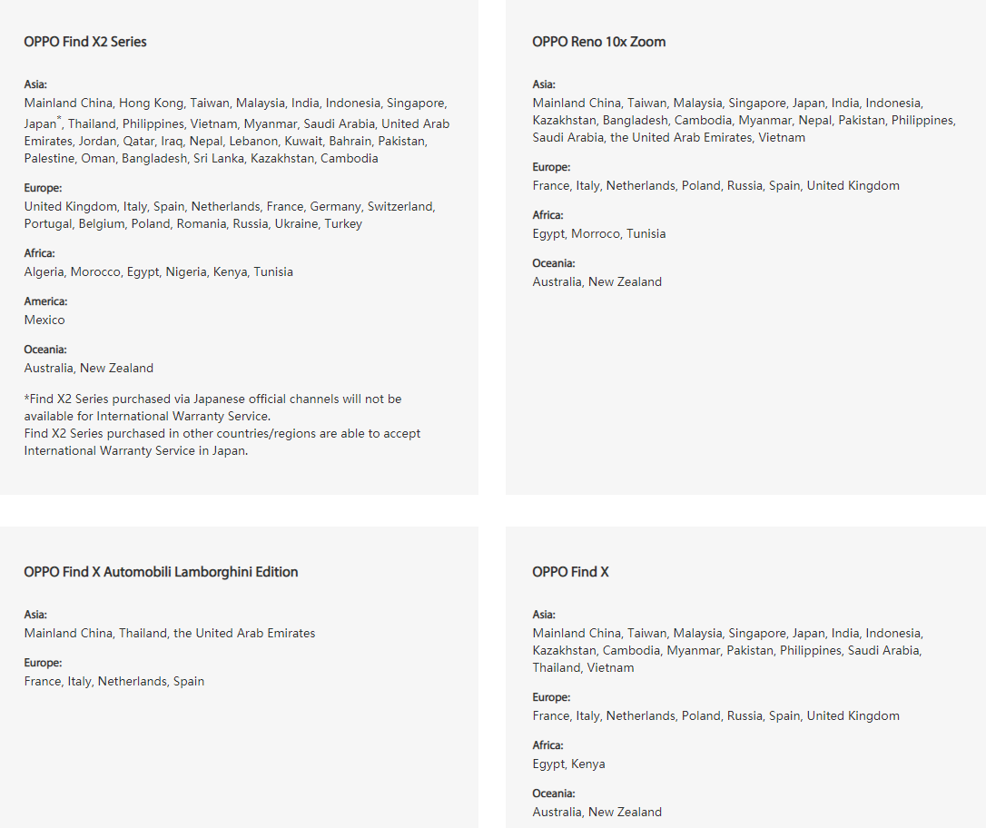
机型与国家/地区 Models, Countries & Regions

Slide 7
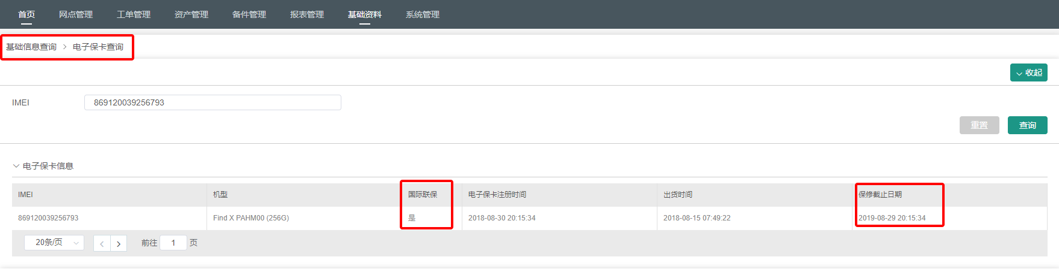
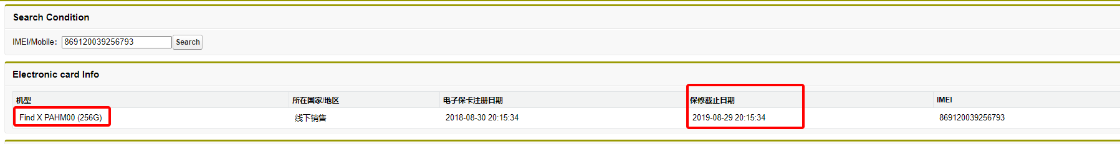
国际联保注意事项 Notice
保修期/维修期： Warranty period/Maintenance period:
保修期以购买地的保修时长为准，维修期以服务地为准。
The warranty period will depend on the place of purchase while the maintenance period is subjected to place providing the service.

Slide 8
国际联保注意事项 Notice
收费标准： IWS Charges:
在符合保修政策下，保修期内不收取任何费用；若不符合保修政策，维修费用按服务地为准。
In-warranty devices will be free of charge while devices out of warranty will be subjected to the policies and regulations on the place providing the service.
是否可以单独购买： Can I purchase IWS separately?
购买支持国际联保服务的设备后，即可享受该服务，无需单独购买，该服务也不会进行单独售卖。
After purchasing the device with IWS, you are entitled to the service without having to purchase it separately. Also, the service is not sold separately.
其他保障类服务如屏碎保是否支持国际联保服务 Do other services I have purchased such as Screen Broken Warranty support the IWS?
其他保障类服务如碎屏保请参照该服务的具体说明，与国际联保没有联系。
The warranty service is not included in the IWS and subject to its conditions thus it does not support IWS. For more information, please refer to the regulations for the warranty service.

Slide 9
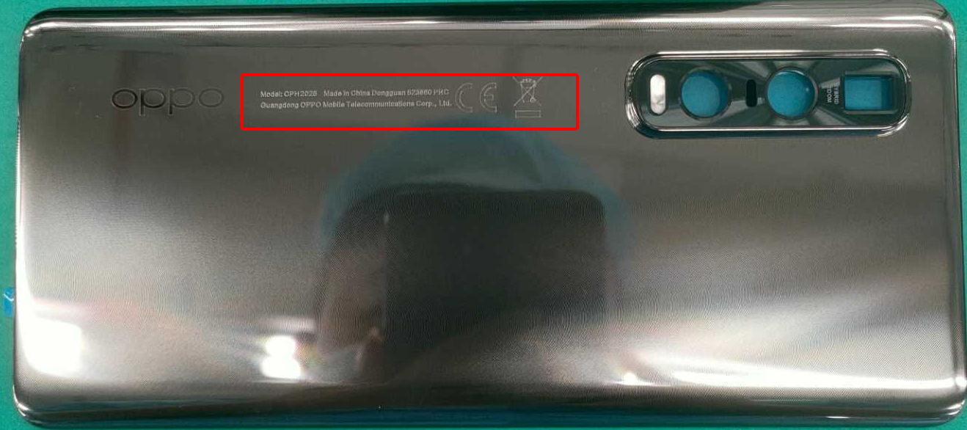
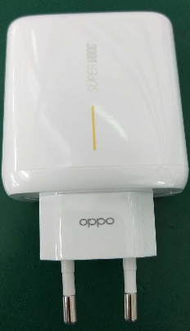
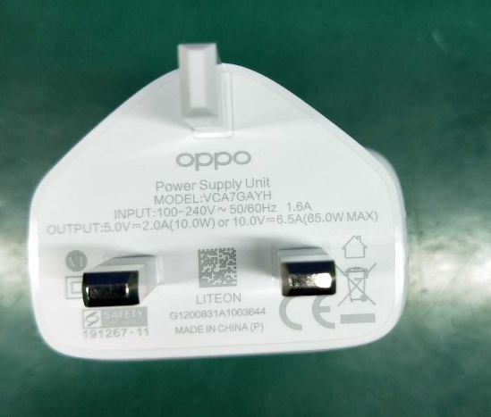

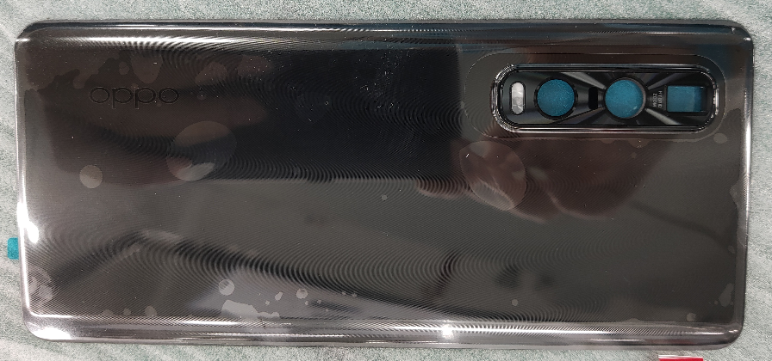
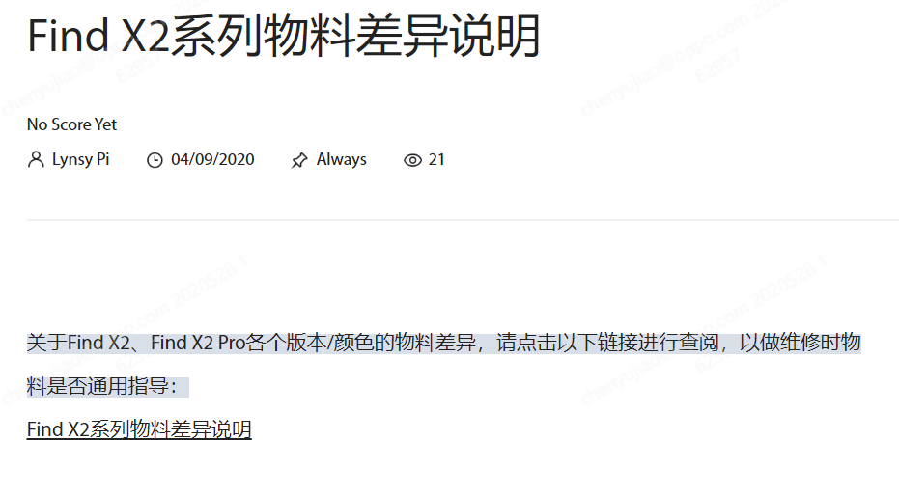
国际联保注意事项 Notice
物料差异性 Material Differences：
因国家、区域间相关制度、规定、上市版本、制式要求不同，部分物料可能存在外观或功能差异
Due to the different regulations between different countries and regions, as well as the different versions on markets, there will be differences in appearance and function on some materials.

Slide 10
不属于国际联保范围
The following is not covered by the International Warranty Service
  不支持国际联保的设备型号
  Device models that are not covered by the International Warranty Service.
  非官方正规渠道售卖的设备
  Devices that are not sold through official channels.
  任何未经过OPPO授权许可的改装、拆卸、维修后的设备
  Any devices modified, disassembled, or repaired not authorized by OPPO.
  超出服务地物料提供时限的设备
  Devices that exceed the time limit of the service.
  退、换机处理
  Refund or replacement service.
  用户拒绝签署国际联保说明单
  Refusal to sign the International Warranty Statement.

Slide 11
不属于国际联保范围
The following is not covered by the International Warranty Service
  用户享受国际联保服务后，因产品差异导致的转让风险、相关法律责任或损失
  All risks and legal liabilities or losses associated with any transfer due to any differences in the product after you obtain the International Warranty Service.
  用户享受国际联保服务后，因产品差异导致的个人商业行为的利润、收入或者时间损失
  Any loss of profit, income, or time incurred as a result of any personal business activity due to any differences in the product after you obtain the International Warranty Service.
  设备因跨区域而不是设备故障造成的无法使用（例如不支持其它区域网络制式无法上网等）
  Any inability to use your device caused by cross-region rather than device fault (such as the inability to access the internet because it does not support the network frequency adopted in that region).
  超出服务地的法定服务政策范围
  Beyond the scope of the legal service policy in the place where the service is provided.
  在日本购买的Find X2系列机型
  The Find X2 series sold in Japan.

Slide 12
国际联保备料 Material Ordering Guidance
提前备料区域：Order Material in Advance:
JP/TH/VN/ID/MY/PH/KH/SG/TW/HK/IN/PK/MM/FR/IT/ES/NL/UK/AU/NZ
根据FIND X2 IWS 和 FIND X2 PRO IWS BOM提前下单备料，当消耗物料后需补齐物料
Order the material in advance according to the BOM of FIND X2 IWS and FIND X2 Pro IWS. When the material is consumed, the material needs to be replenished.
按需备料区域：Order Material when IWS occurs:
NP/BD/LK/OM/BH/QA/KW/IQ/JO/LB/BL/SA/EG/MA/DZ/TN/KE/NG/DE/BE/RU/KZ/PL/TR/UA/RO/MX/PT/AE/CN
当发生需求时，向总部以邮件的方式申请，总部从香港发国际快递到区域
When an international warranty case occurs, please order the spare parts you need to HQ spare part team by email. The spare parts will be sent from Hong Kong by international express delivery.

Slide 13
Q&A

Slide 14
随堂测试 Test
1、国际联保的标语是什么？ What is the slogan of International Warranty Service?
随时随地畅享贴心服务 Travel Worry-free
2、保修期按照服务地保修时长为准. The International Warranty Service is available as provided in the place where your mobile phone is purchased
错误，保修期按照购买地保修时长为准
False，the International Warranty Service is available as provided in the place where your mobile phone is purchased
3、以下支持国际联保的机型有 Which models support International Warranty Service?
A. Find X B. Find X2 Series C. Reno 10x Zoom D. Reno 3 Pro
A. Find X B. Find X2 Series C. Reno 10x Zoom D. Reno 3 Pro

