Slide 1
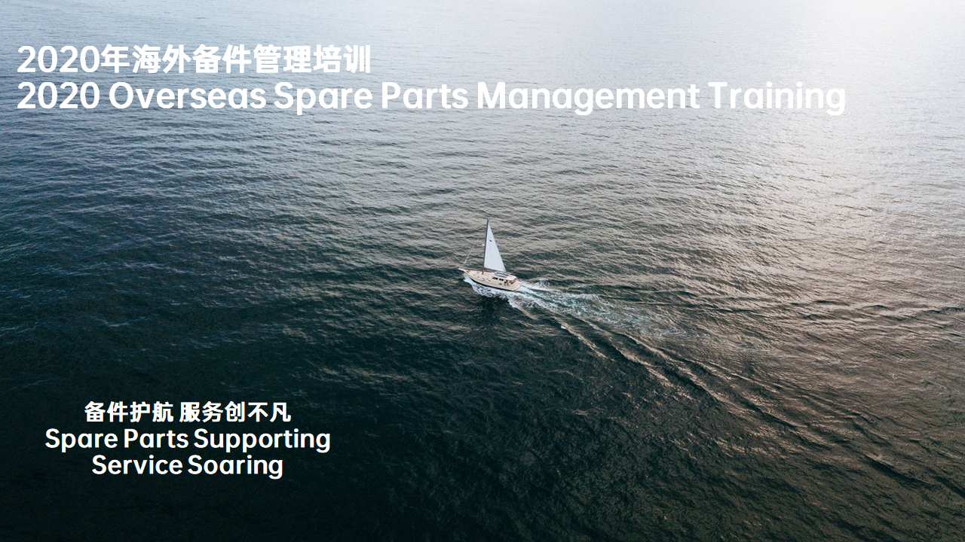

Slide 2



IoT产品售后知识
Introduction of IoT Products
2
0
2
0
甘庆 Gan Qing
2020/6/15

Slide 3



培训目标 Targets
通过半小时的学习和日常工作的实践，您将达到以下目标：
From this 30 mins training course, you could learn:
1. 公司万物互融战略 OPPO's IoT Strategy
2. IoT产品及市场介绍 Introduction of IoT Products and Market
3. IoT与手机产品备件业务对比 Spare Parts: IoT Products vs. Smart Phones

Slide 4
重点内容 Key Contents
本课程重点学习内容及考核内容为：
The key contents of this training course are:
1. 认识IoT What is IoT?
2. IoT的重要性 Why is IoT so important?
3. 主流IoT产品 Mainstream IoT Products
4. IoT产品的特性 Main characteristics of IoT products
5. IoT与手机产品备件业务对比 Spare Parts: IoT Products vs. Smart Phones

Slide 5
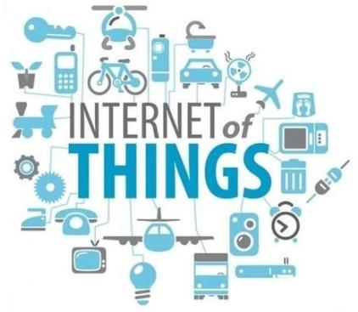
认识IoT What is IoT?
IoT的定义：
物联网（Internet of Things）,即“万物相连的互联网”，将各种传感设备、控制设备与互联网结合起来而形成的一个巨大网络，实现在任何时间、任何地点，人、机器、物体的互联互通。
随着5G技术的兴起，IoT的发展显得更为重要。
Definition of IoT
IoT, also known as Internet of Things, is basically the “Internet of Everything”. It combines a variety of sensors and controlling device with the Internet, to form a huge network, enabling the interconnection of people, machines, and objects at any time, any place.
With the development of 5G technology, IoT is becoming more important than ever.

Slide 6
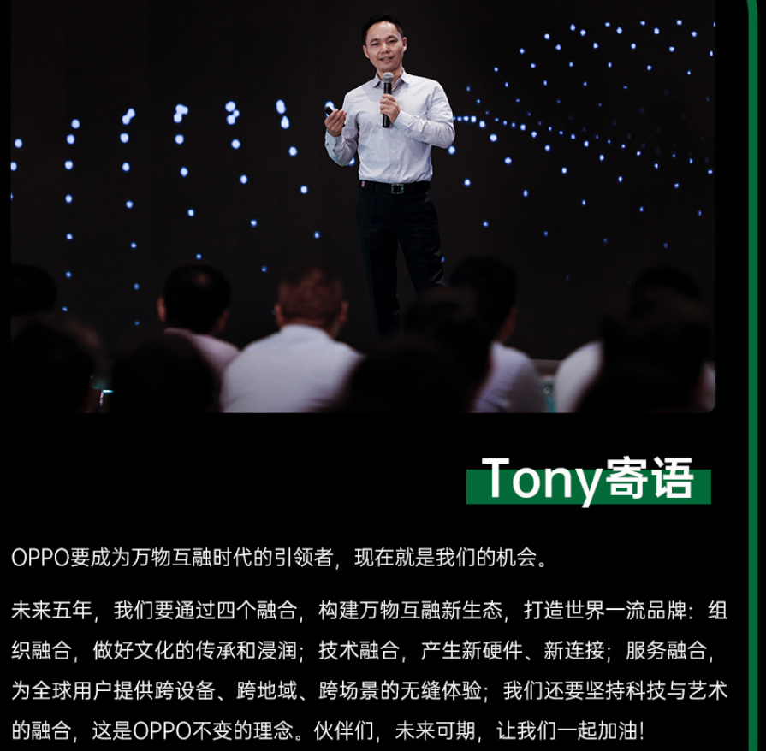
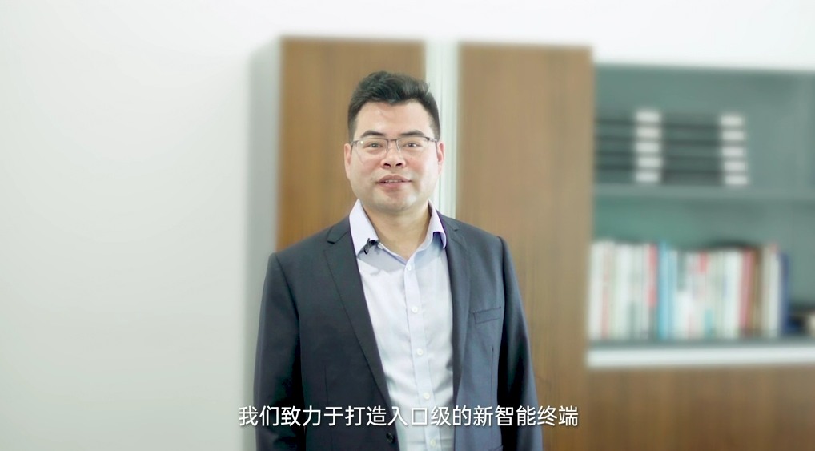
OPPO的万物互融战略 OPPO’s IoT strategy
战略/Strategy
Bobee：我们将打造以个人为中心的智能穿戴产品，以及以家庭为中心的智能家居平台和家庭入口级产品
Bobee： We will create personal-centric smart wearable products, as well as home-centric smart platforms, and entry-level home appliances with IoT technology.
*入口级主要指的是是粘性强、频次高、无法替代的
Entry level mainly refers to sticky, high frequency, irreplaceable

Slide 7
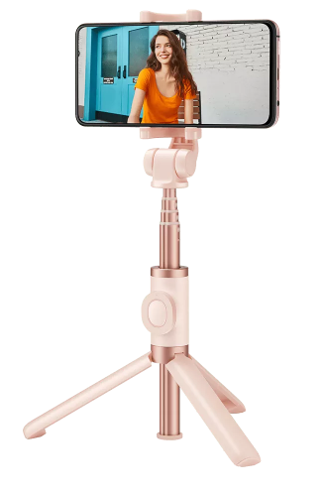
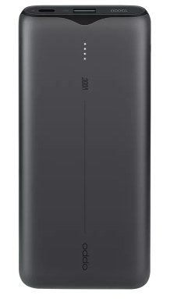
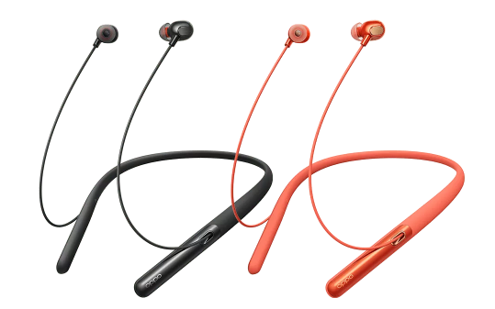
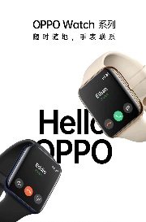
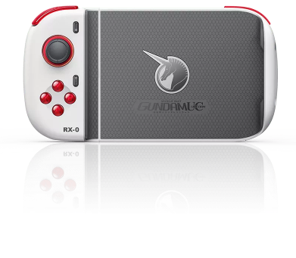
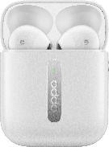
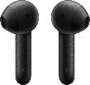
OPPO的IoT产品 OPPO’s main IoT products
蓝牙自拍杆
Bluetooth Selfie Stick
VOOC闪充移动电源
VOOC Power Bank
OPPO Enco Q1 无线降噪耳机
OPPO Enco Q1 Wireless Noise Cancelling Headphones
OPPO 游戏手柄 C1
OPPO Gamepad C1
OPPO Enco Free真无线耳机
OPPO Enco Free TWS Headphones
OPPO 智能手表
OPPO Watch
2019.5.1正式上市
2019.6.1正式上市
2019.9.10正式上市
2019.11.11正式上市
2019.12.31正式上市
2020.3.6正式发布

Slide 8
OPPO的IoT发展方向/Trends of OPPO’s IoT Products
穿戴产品/Wearable Products
音频产品/Audio Products
其他智能产品/Smart Products
Smart Watch
Smart Band
TWS Earphone
5G-CPE
Headset
Backpack
Bluetooth Speaker
Table Lamp
产品将会在国内首先上市，全球各区域需做服务政策、服务模式的准备
Smart TV will first be launched in China domestic market, but other regions should also be prepared for service policies and service models.
Patch Panel
Smart TV

Slide 9

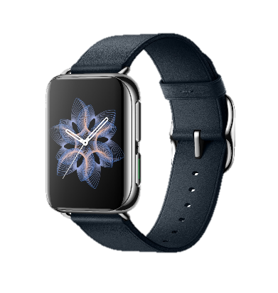
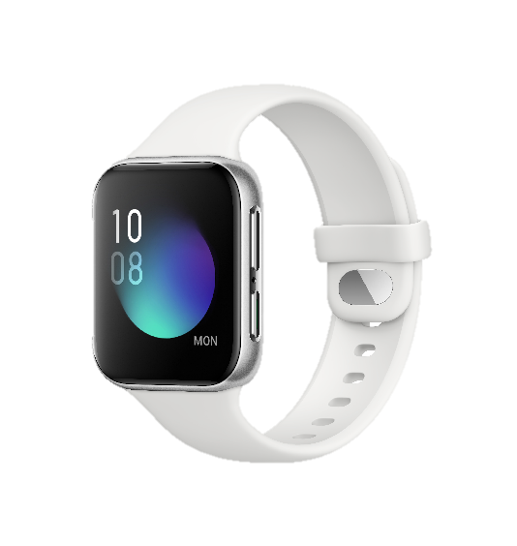
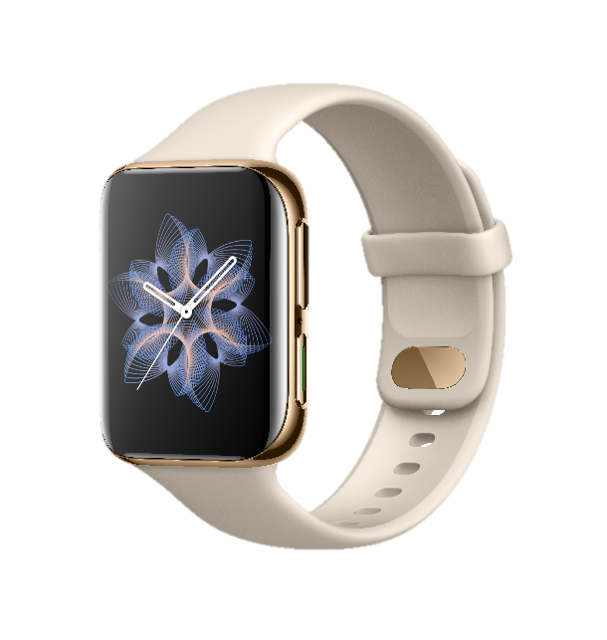
重点IoT产品1：智能手表 Key Product 1: OPPO Watch
1台OPPO智能手表，就是一台“小手机”
An OPPO Watch is a small version of smart phone
下载APP Download APP
付款 pay, 音乐 music
收音机 broadcasting, etc.
NFC功能 NFC
公交卡 simulated card,
支付 NFC payment
网络连接 Internet
在线音乐 online music
在线地图 online map
智能助手 Smart assistant
语音助手 Breeno voice assistant
天气 weather, 闹钟 alarm
雾银
蓝牙耳机连接
Connect with bluetooth headphones

Slide 10
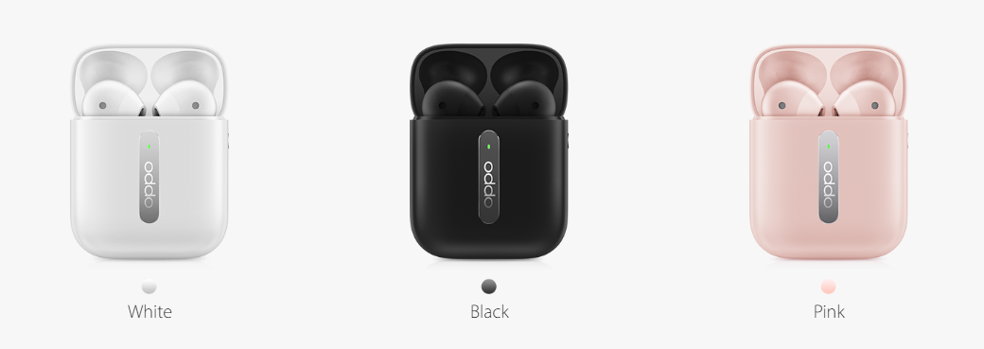
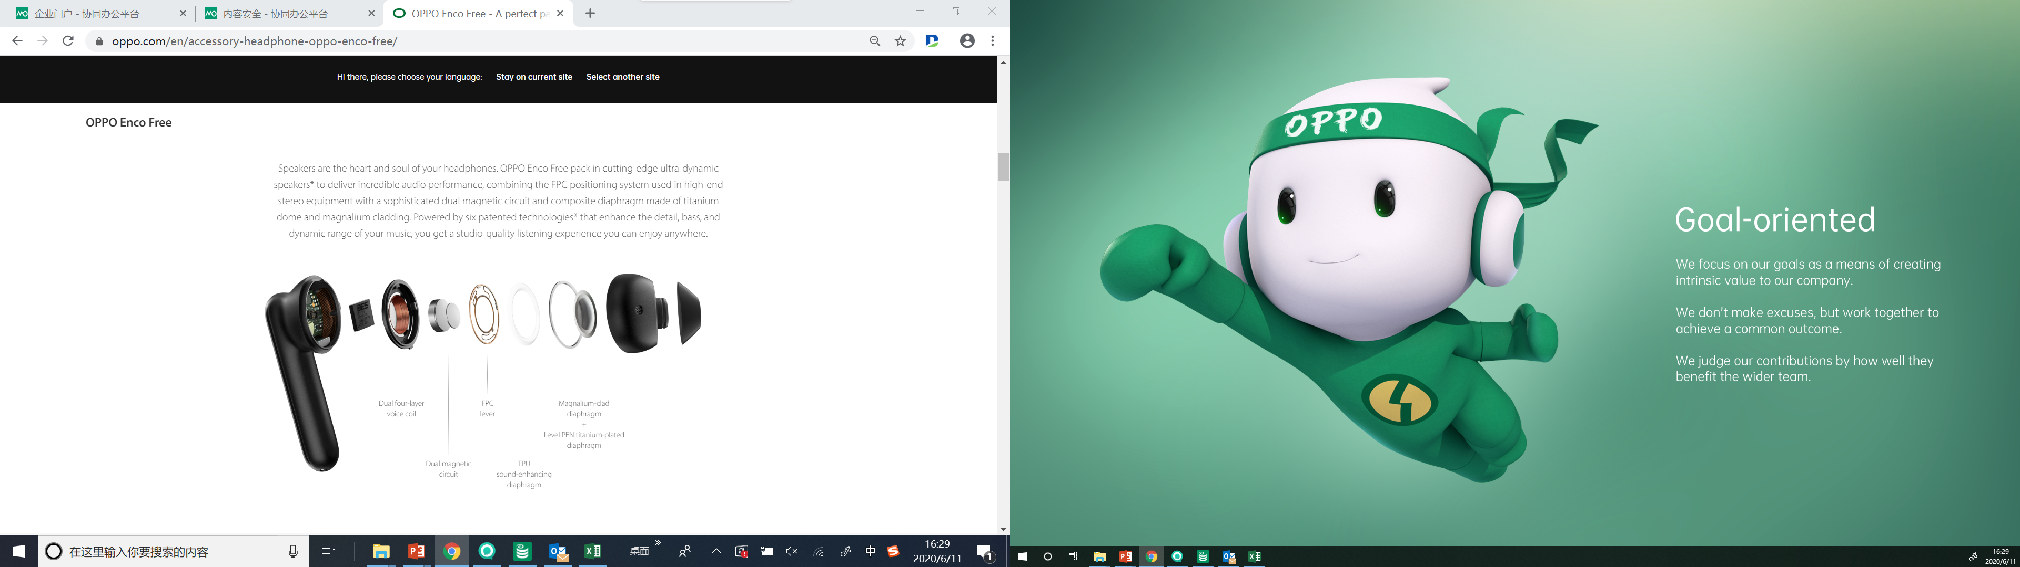
重点IoT产品2：真无线耳机 Key Product 2: TWS headphones
Name | OPPO Enco Free True Wireless Headphones
Model | ETI02
Driver | 13.4mm dynamic driver
Frequency response range | 16Hz-20kHz
Microphone sensitivity | -42dBV/Pa
Supported audio formats | AAC/SBC
Bluetooth version | 5.0
Wireless range | 10m
Battery type | Rechargeable Lithium-ion battery
Weight | 4.6g(Single earphone) 39g(Charging Case)
Battery capacity | 31mAh(Headphones) 410mAh(Charging Case)
Music play time(50% volume) | 5h(Single charge) 25h(With Charging Case)
Charging time | 70min(Headphones) 110min(Charging Case)
Charging Case model | ETI03
Input(Charging Case) | 5V⎓1A

Slide 11
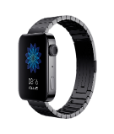
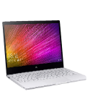

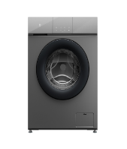

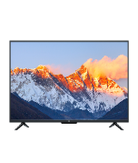
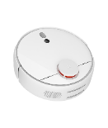
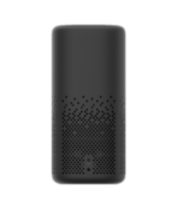
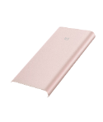
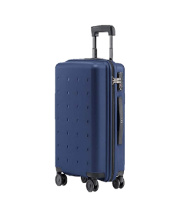
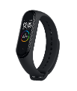
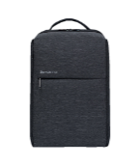
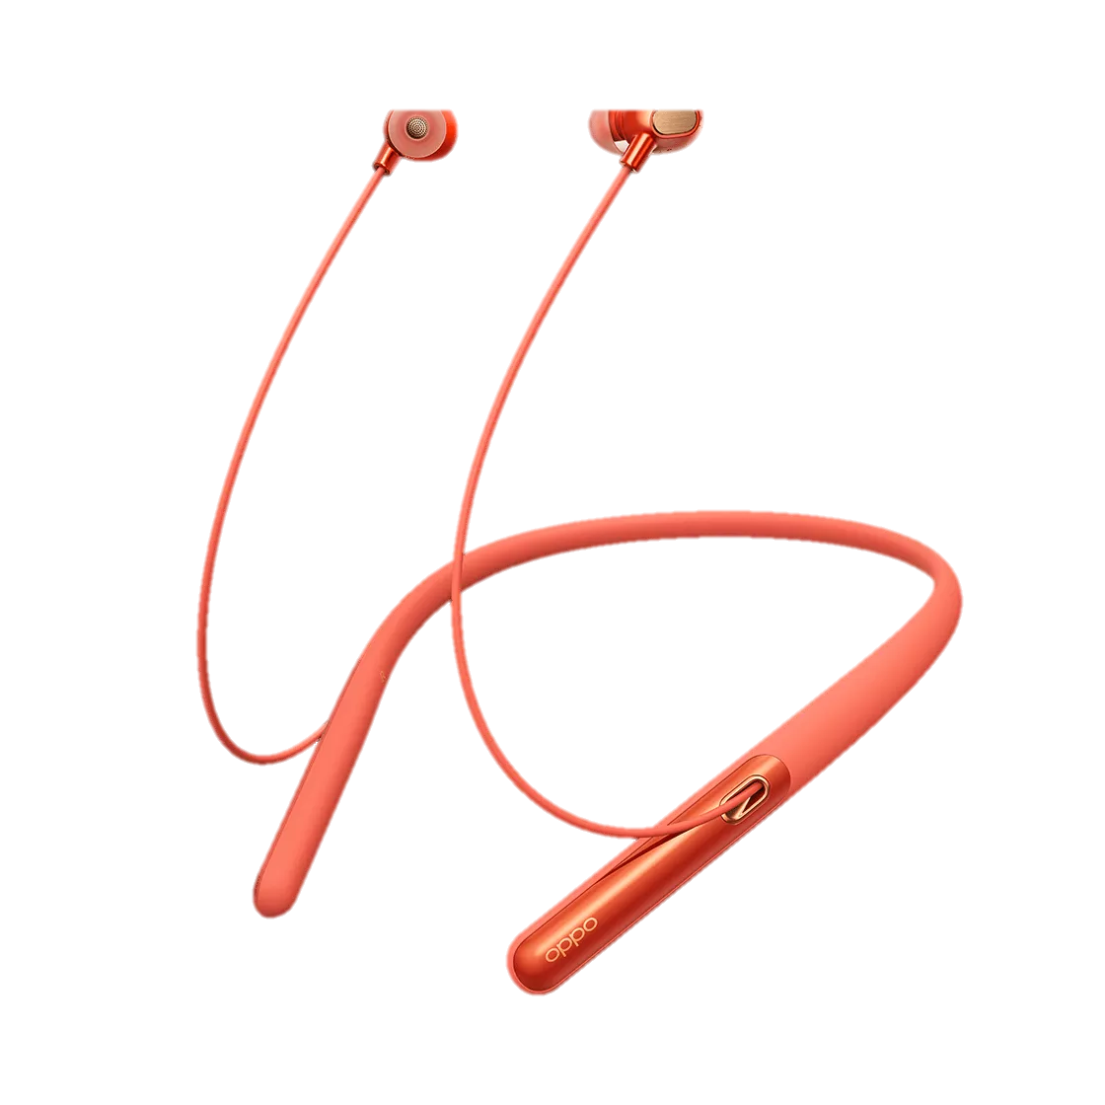
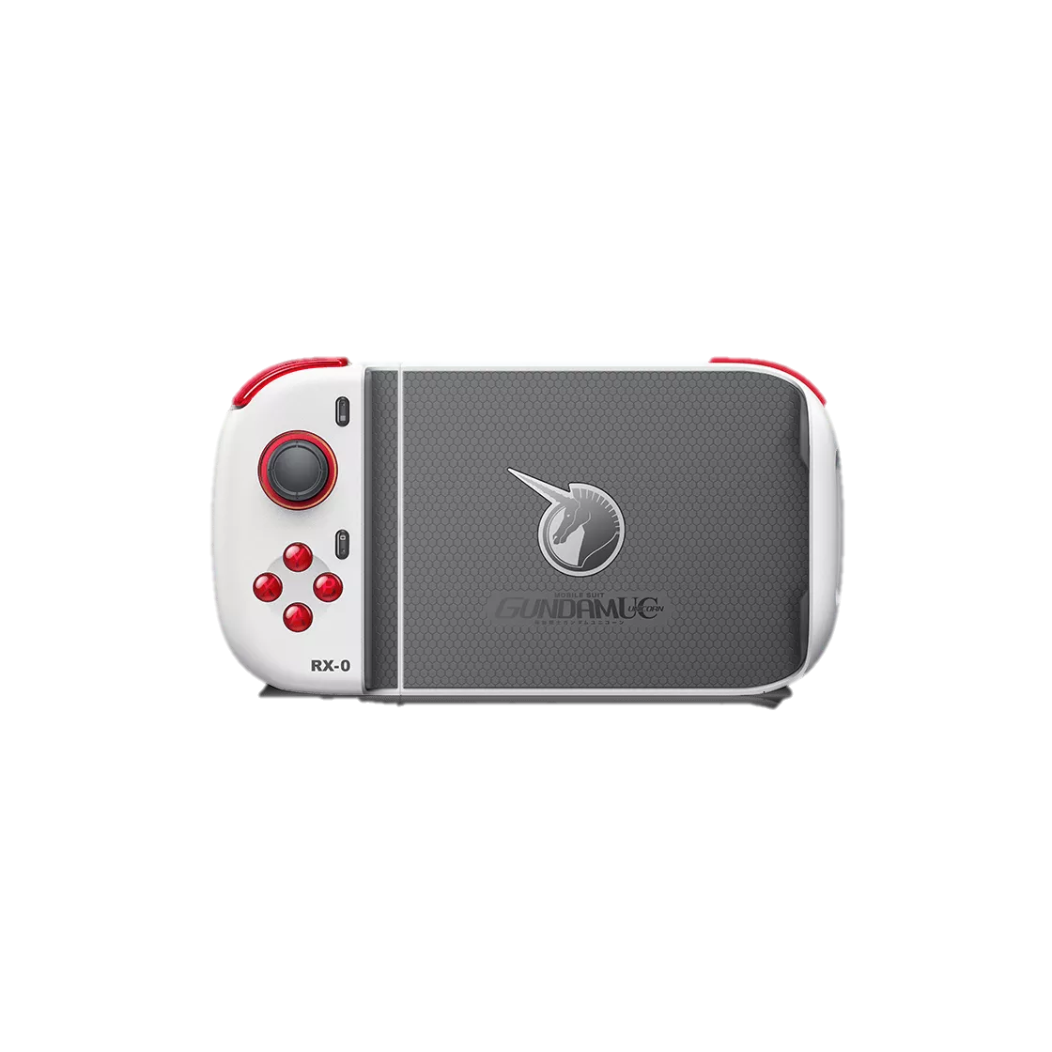
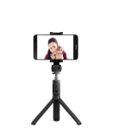
IoT产品的维修策略 Repair strategy of IoT Products
网点维修/寄修 Regular repair
上门服务 On-site repair
以换代修 SWAP
IoT产品的维修策略选择三要素：可维修性、产品体积、产品销量；海外IoT产品主要采取以换代修的策略，但各区域均可根据以上原则自行调整。
The repair strategy of IoT products is defined by repairability, product size and sales volume. For the time being, “SWAP” is the recommended strategy of all IoT products in overseas market.

Slide 12
IoT产品的备件管理流程 SP Business Procedure of IoT Products
备件组：获取IoT产品信息并传递至各上市区域
SP team: Get IoT products launching info & transfer to overseas region
备件组：初期备料并维护系统信息
SP team: Initial stock & set product info in SP system
海外各区域：向销售团队了解当地IoT产品出货规模
Overseas region: Get IoT product sales volume from local sales team
海外各区域：向销售团队调用整机或向备件组申请整机及备件
Overseas region: Get finish goods from local sales team or order from HQ

Slide 13
随堂测验 Quiz
IoT是”Internet of things“的缩写。IoT is short for "Internet of things".
答案：对 T
2. 以下哪些属于OPPO生产的IoT产品？Which are the IoT products manufactured by OPPO?
A：Enco W31; B: OPPO Watch; C: FreeBuds; D: AirPods.
答案：AB
3. IoT产品维修策略制定主要取决于？What's the main items when we evaluate the repair strategy of IoT products?
A: 可维修性 Repairability; B: 产品体积 Product size; C: 产品销量 Sales volume; D: 产品价格 Product price.
答案：ABC

