Slide 1
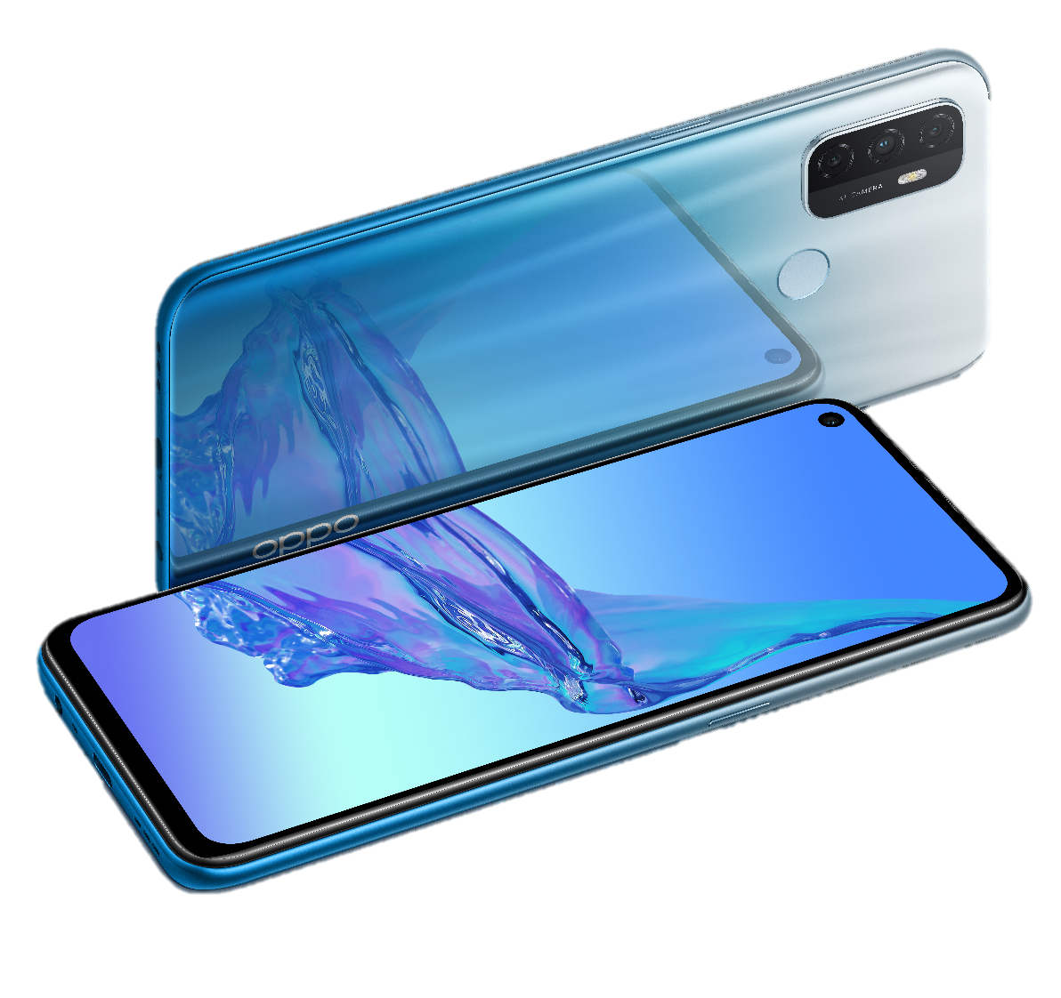
OPPO A53&OPPOA53s&OPPOA33
Triple Strong Triple Smart
Present by OPPO Global Training Team

Slide 2
Contents
1.1 Appearance parameters
1.2 Configuration parameters
1.3 Frequently used parameters
Basic Parameter
Core Selling Points
ColorOS
Maintenance Precautions
FAQ

Slide 3
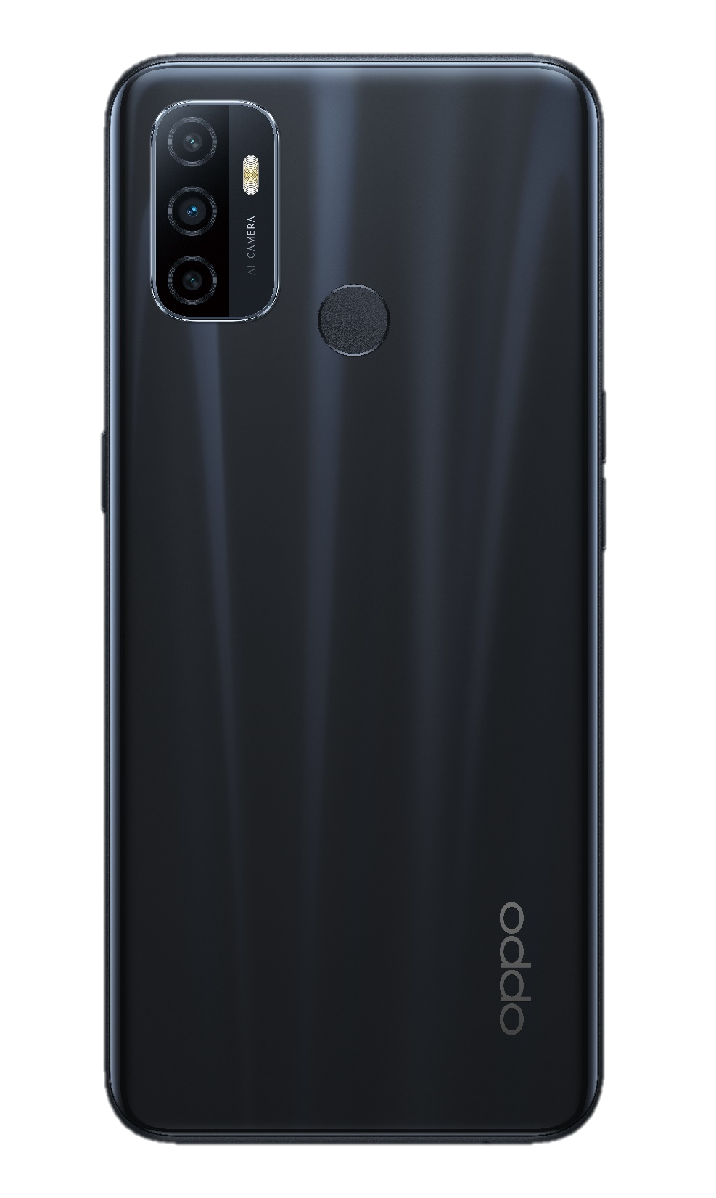
1.1 Appearance parameters
OPPO A53&OPPO A53s&OPPO A33
Model name | PDVM00
Size | About163.9mm×75.1mm×8.4mm
Weight | About186g
Screen size | 6.5 inch
Screen resolution | 1600*720
Screen ratio | 89.2%
Screen glass | GG3+(Corning Gorilla Glass)
Color | Electric Black/ Mint Cream/Fancy Blue/Fairy White
Electric Black

Slide 4

1.2 Configuration parameters
OPPO A53&OPPO A53s&OPPO A33
CPU model | SM4250
Core | 8
GPU frequency | Adreno 610 @ 600MHz16fps
RAM+ROM | 3GB+32GB/4GB+64GB/4GB+128GB4GB+64GB/8GB+128GB
Front camera | 8M/16M（OPPO A53s&OPPO A33：8M OPPO A53：8M or 16M）
Rear camera | Macro2M+Main camera13M+Depth of field2M
Battery | 5000mAh
Charging time | About145minutes
天青白
Mint Cream

Slide 5
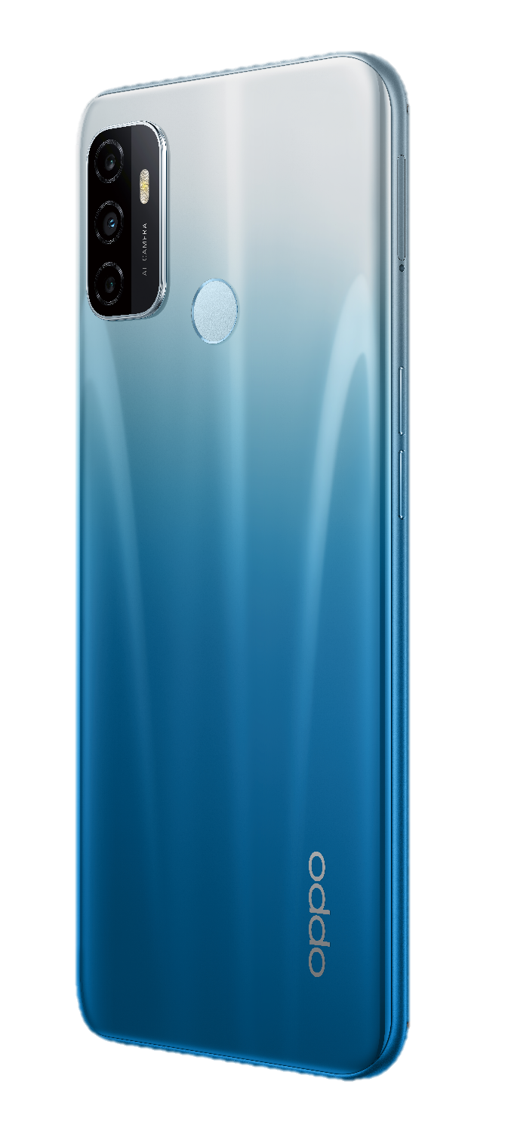
1.3 Frequently used parameters
OPPO A53&OPPO A53s&OPPO A33
Front camera | Punch-hole
USB type | USB Type-C
USB version | 2.0
Earphone | 3.5mm
Speaker | Dual speakers
Bluetooth | Bluetooth 5.0
ColorOS | ColorOS 7.2
Android | Android 10
Fancy Blue

Slide 6
Contents
Basic Parameter
Core Selling Points
ColorOS
Maintenance Precautions
FAQ
2.1 90HZ screen
2.2 Dual speakers
2.3 Large memory
2.4 Large battery
2.5 camera

Slide 7
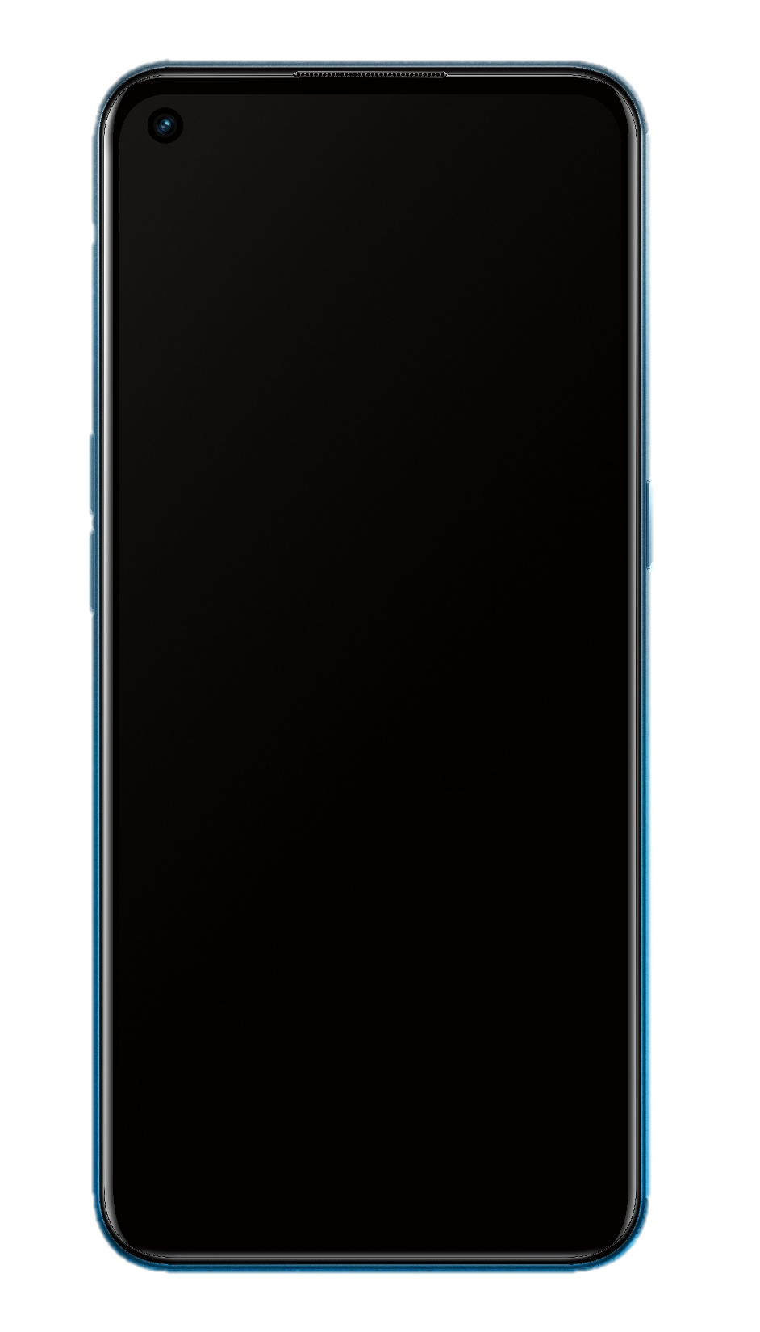

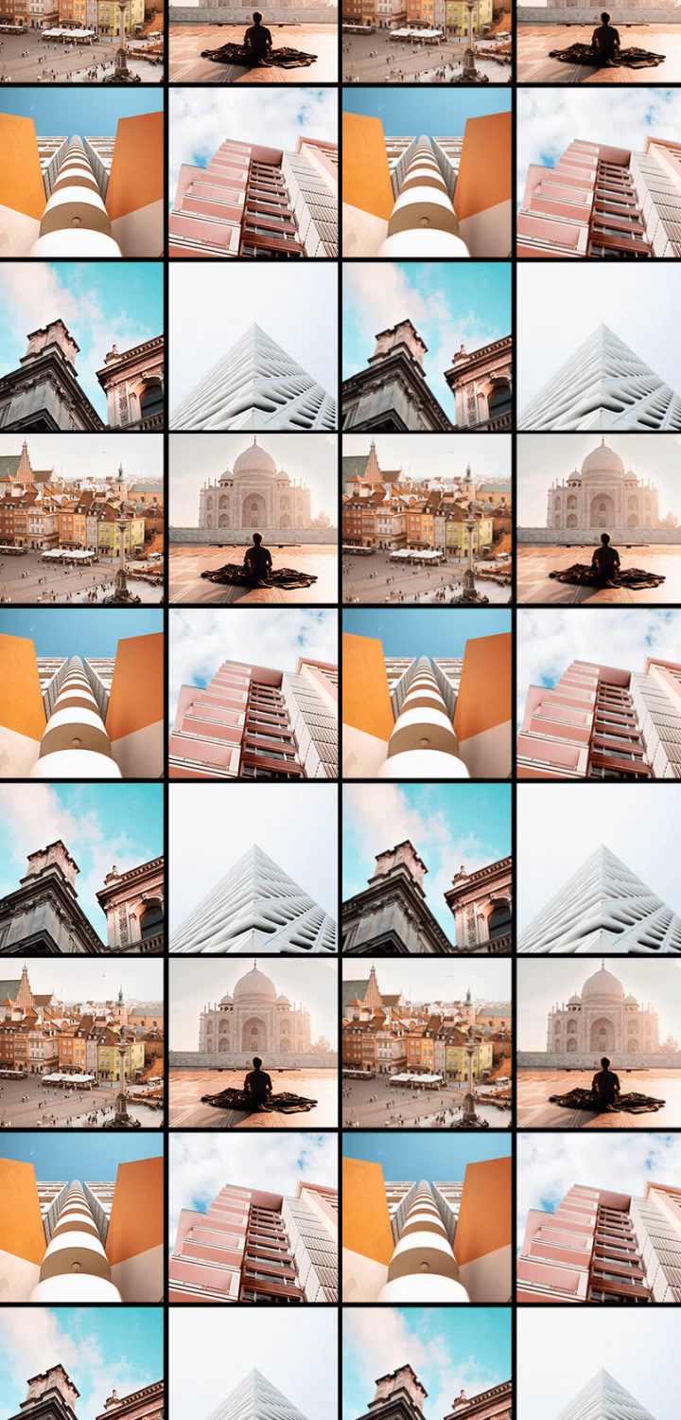

90Hz refresh rate screen is the flagship-level screen.
Compared with 60 Hz, It has the better watching experience and protect your eyes much more.
You can enjoy function below in 90Hz A53,
while 60Hz phone can’t:
Watching high FPS YouTube Movie
50% smoother in scanning FB & Twitter
Silky system animation and swipe feeling
Protect your eyes more
…..

Slide 8



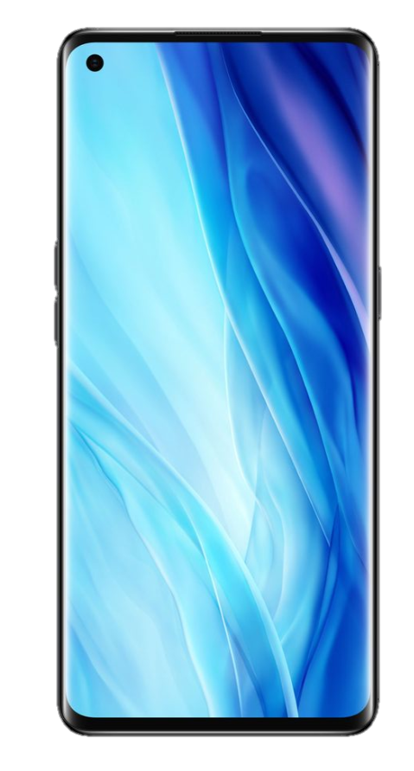

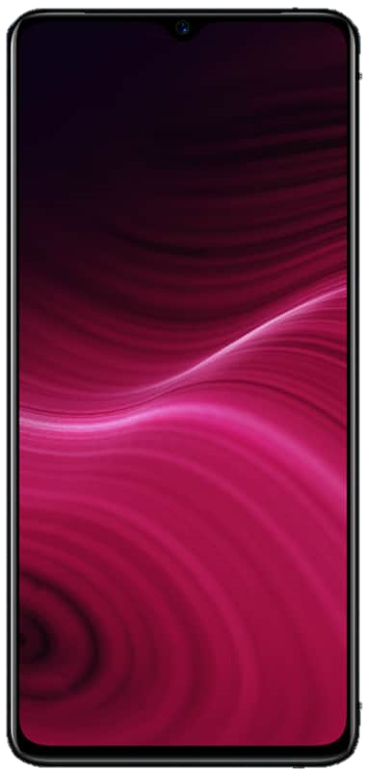
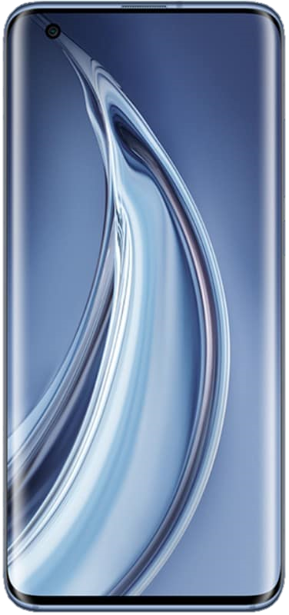
Smart Screen
90Hz--Flagship phone choice!
Best Screen in same price
Reference Words
OnePlus 7Pro
OPPO Reno4 Pro
OPPO A53 has same refresh rate to flagship screen! However you just need to spend 1x990 !
It will help your eyes health and got better watch experience.
Realme X2 Pro
Xiaomi 10 Pro

Slide 9

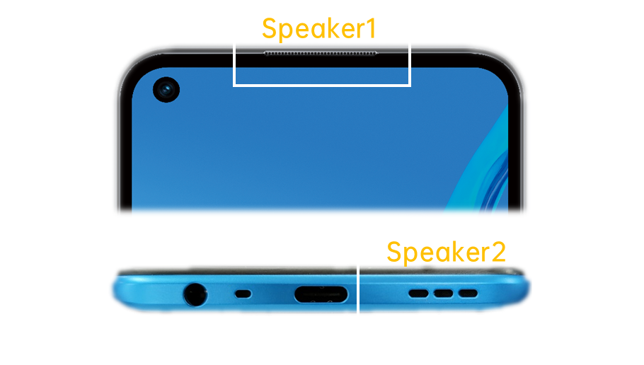


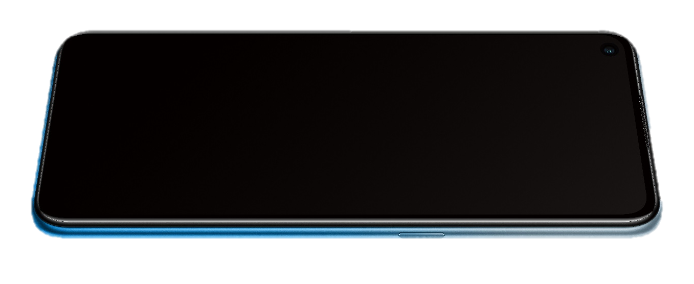


Strong Speakers
Show speakers to costumers:
Why dual-speakers is better?
Only dual-speakers in same price
Single Speaker
Dual-Speaker
Reference Words
As we have two ears, only with dual-speakers, we can have balance hearing sense.
Besides, the dual-speakers will directly bring bigger voice!
OPPO A53 have flagship-class dual-speakers!
When you go to party and have to play music, your A53 will have the loudest voice! You can have a try…
We must tell costumers: only high-level mobile use dual-speakers!
Like iPhone 11, OPPO Find X2, Samsung Note20…

Slide 10
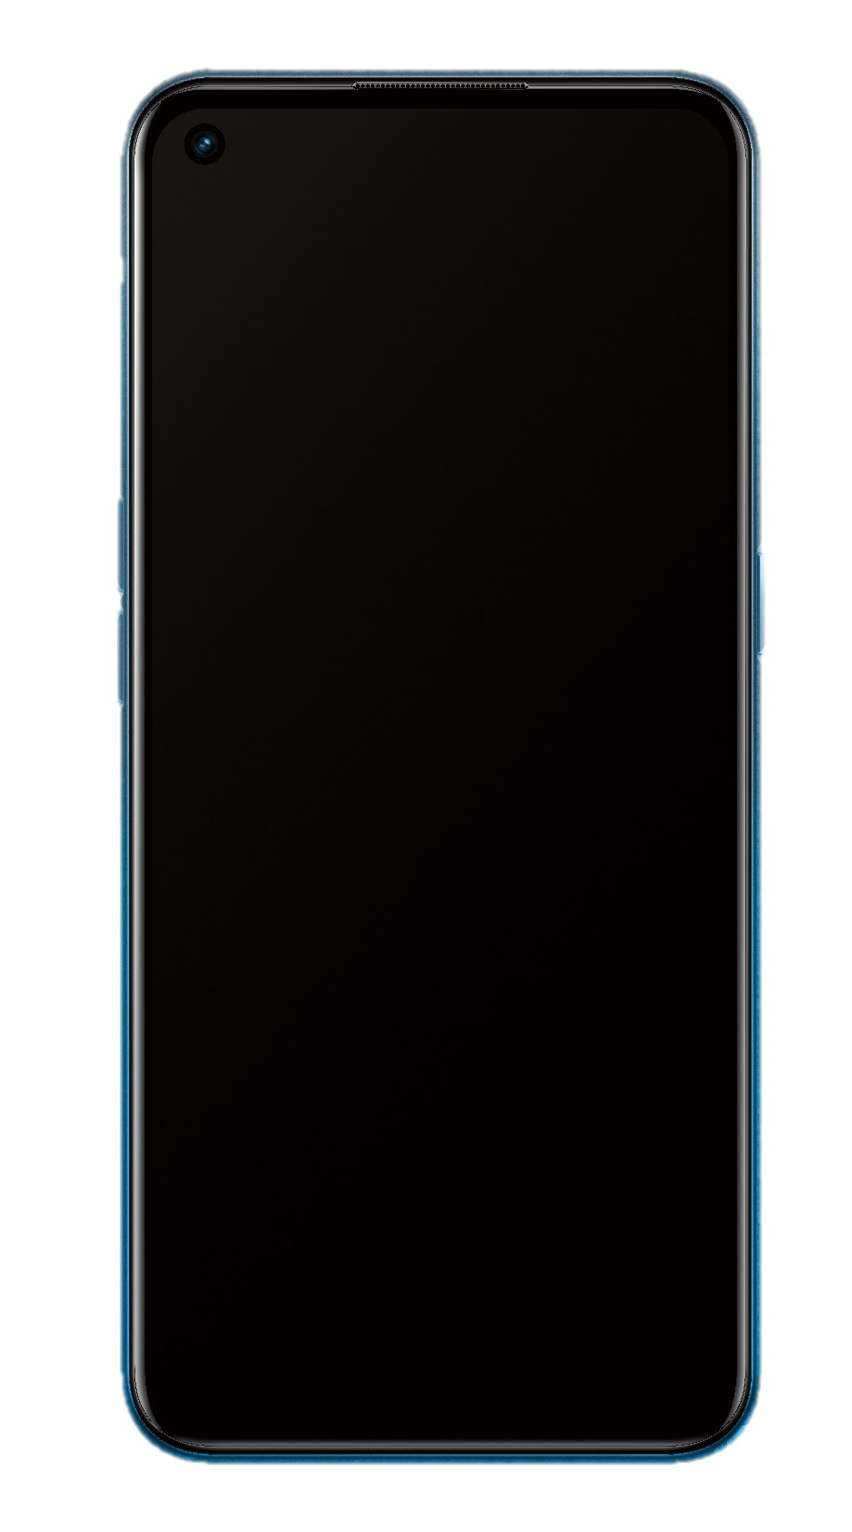



Strong Performance
A53 carry
Best processer in same price
Qualcomm
Snapdragon
460
Octa-core processor
Reference Words
Qualcomm always represents high-class and high quality !
With Octa-core 460, our A53 won’t lag even have used for a long time.
70%
Improvement than 450

Slide 11




Strong Performance
A53 has maximum to
Biggest storage in same price
6+128
Memory combination
Reference Words
256G
Maximum Micro-SD Supported
OPPO A53 has big storage max to 128G, and also all version support 256G Micro-SD.
With A53, you will never worry about having not enough memory.
Music, Photo, Video…
Save everything as you want!

Slide 12




Strong Battery
3D Diamond Blaze Design
Inspire from Tiffany and Bvlgari
OPPO A53 has
5000mAh
Huge Battery
Biggest battery & fastest charge in same price
18W
Reference Words
OPPO A53 has the biggest 5000mAh battery in market, hold 2 days long!
OPPO has the best charge technology in the world! 18W charge is very fast and safe.
Fast Charge
5000 mAh can make sure you to watch YouTube or play games whole day.
18W charge to 50% in 44 min, to 100% in 133min.

Slide 13
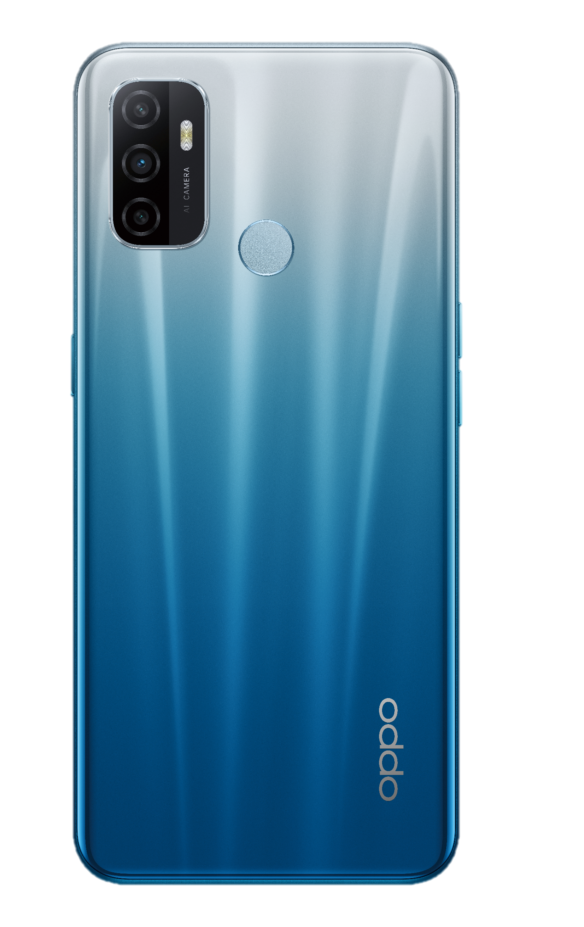

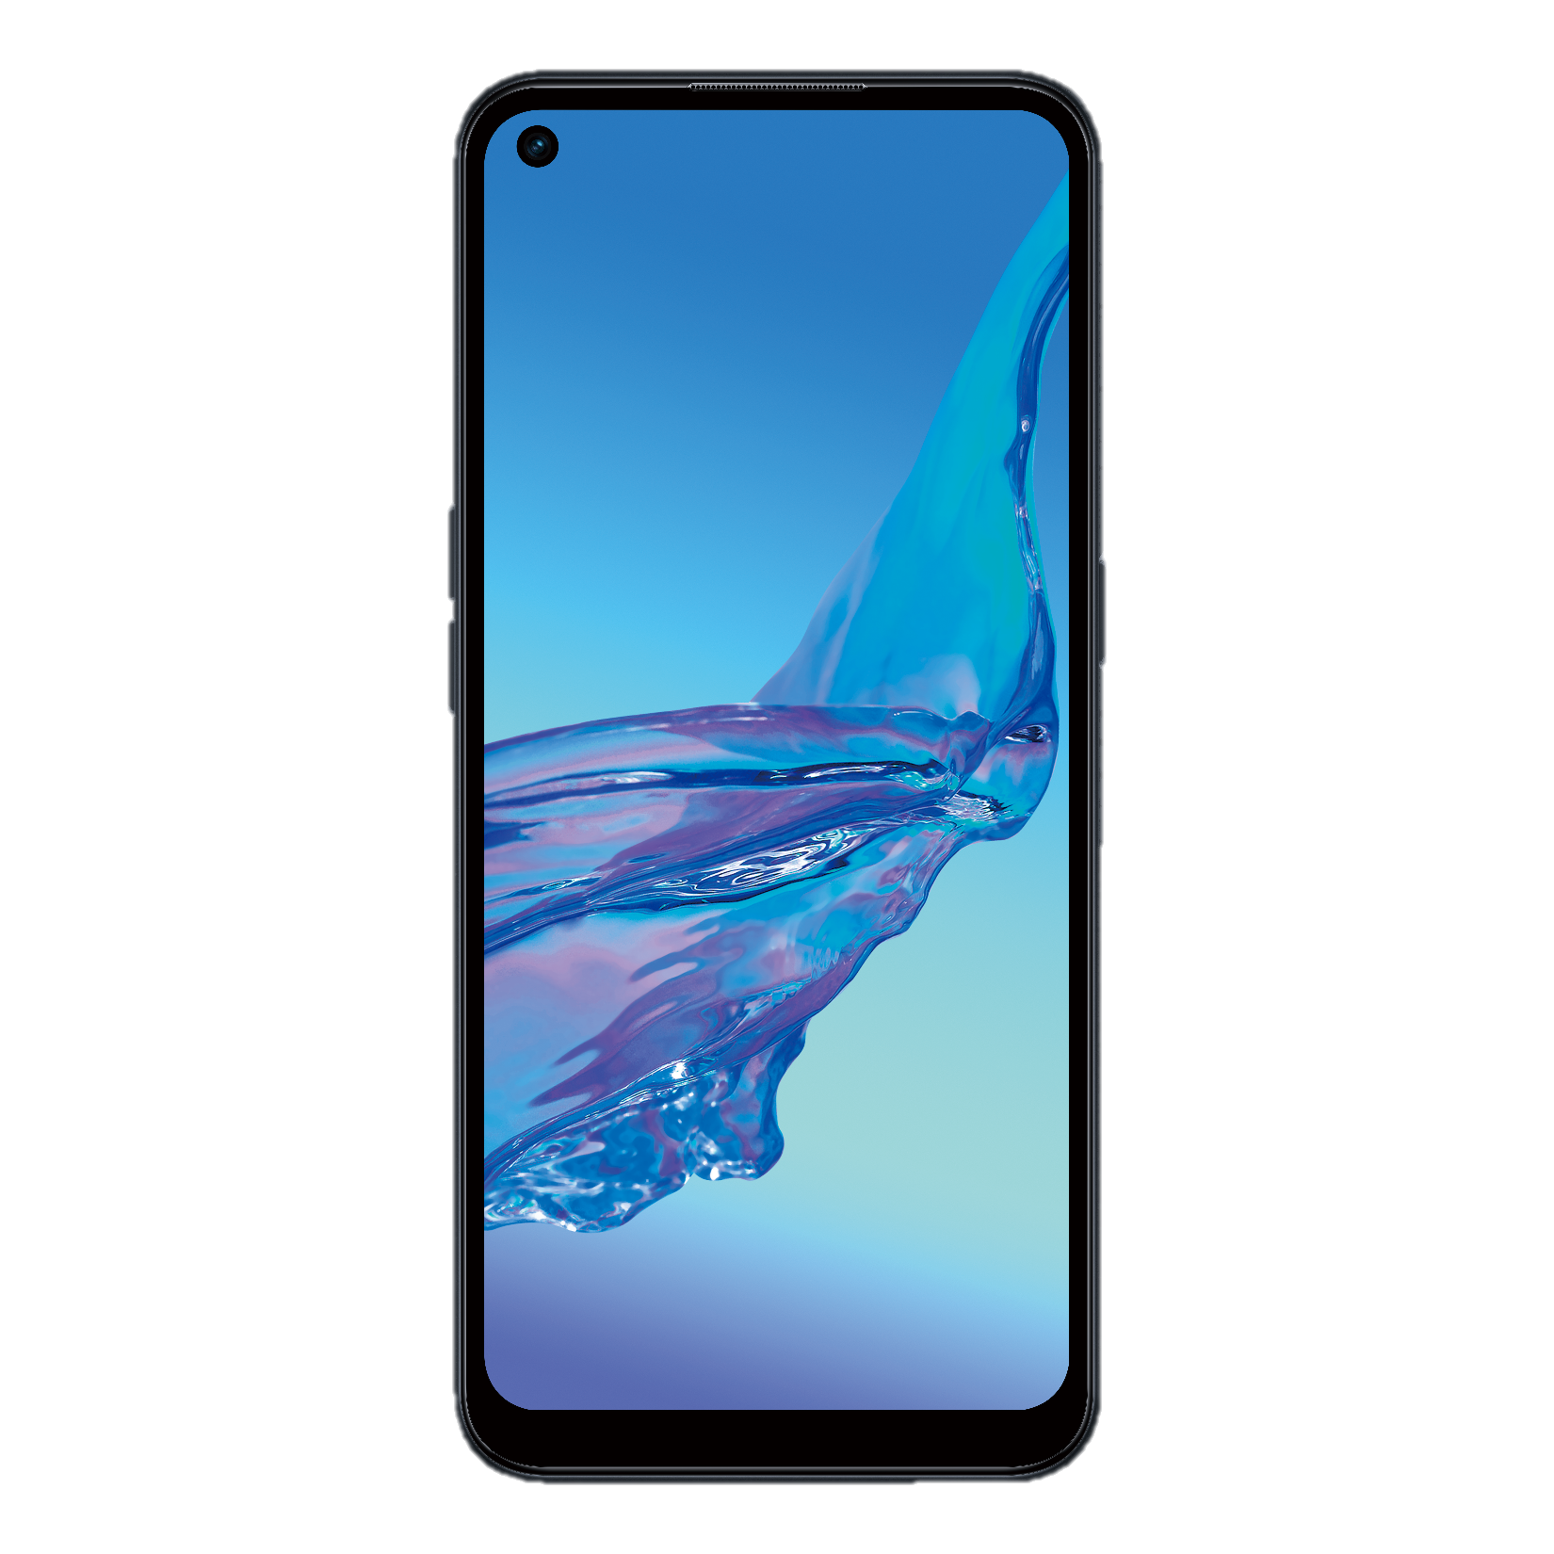
Smart Photo
2MP Macro camera
13MP Main
camera
2MP Depth camera
Best camera in same price
Reference Words
OPPO A53 has smart camera can handle all scenes, help you got satisfied photos!
Also, A53 have the highest front camera pixel in same price, make your selfie best!
Front camera in A53 is 16MP or 8MP, 16MP is the highest pixel in same price!
*In A33 /A53s is 8MP

Slide 14
Contents
Basic Parameter
Core Selling Points
ColorOS
Maintenance Precautions
FAQ

Slide 15
ColorOS 7.2 Function change
NO. | Features | Function description | Operation path
1 | Gravity Wallpapers | Gravity wallpaper can change dynamically depending on how user holds their device. Note: There is only one gravity wallpaper so far. | Settings > Home Screen & Lock Screen Magazine > Set wallpaper > Live wallpapers（Currently only the last one ）
2 | Icon Pull-Down Gesture | On the desktop, swipe upward on the left or right side of the screen to pull down app icons. Continue swiping to an icon and release to open the app. Note： The function is turned off by default. | Settings > Home Screen & Lock Screen Magazine > Icon Pull-Down Gesture
3 | Lock Home Screen Layout | After enabling this function, it is forbidden to add, delete, modify or move the desktop content (icons, folders, plug-ins, desktop shortcuts). When performing related operations, they do not respond, and prompt "Desktop layout is locked". | Settings > Home Screen & Lock Screen Magazine > Lock Home Screen Layout
4 | Screen Recording | 1.Support simultaneous recording of system sound and microphone sound. 2.Floating window Add a quick setting switch for sound, you can choose to record system sound, record microphone sound, or click more settings to enter the screen recording setting interface. 3.Increase the function of custom resolution and bit rate. 4.The recording resolution of the 2K screen model supports 2k recording.(Depends on models) | Slide the floating bar of Smart Sidebar, click the screen recording function icon.
5 | App lock | Cloned app support app lock now. | Settings>Security>App Lock

Slide 16
ColorOS 7.2 Function change
NO. | Features | Function description | Operation path
6 | Boot Wizard（Accessibility） | Boot wizard adds Color Accessibility Mode. After turning on, the system switches to Color Accessibility Mode. If you turn on this function in the boot wizard, the function will always be turned on, you can turn off in settings>other settings>accessibility>Color Accessibility Mode. | The entrance is in the upper right corner of the language selection interface in the boot wizard
7 | You might be looking for | Add recommendations for similar functions under the Do Not Disturb, Security, Battery, SIM Card & Mobile Data features and other functions list of of the settings app. Note: Not all settings pages are available. | Some system settings pages >"You might be looking for" is displayed at the bottom.
8 | Super Nighttime Standby | The ColorOS system optimizes power saving at night by learning the user's sleeping habits, so that the night's power consumption is only 2%, effectively reducing the user's anxiety of power consumption at night. | Low-level function, no setting path
9 | AI App Preloading | Through AI algorithm, ColorOS intelligently predict what app you would use next and preload it for you, so that it opens much faster. With AI APP Preload, the longer you use your phone, the smoother it gets. | Low-level function, no setting path
10 | 3-fingers screenshot | 3-fingers screenshot optimizes the scrolling screenshot experience. 1. The page will autoscroll when you take a scrolling screenshot. You don't need to scroll down the page by yourself anymore. 2.Scrolling screenshots in landscape mode are now supported, and the page will also autoscroll. | Scrolling screenshots in landscape mode

Slide 17
ColorOS 7.2 Function change
NO. | Features | Function description | Operation path
11 | Recent tasks manager | After entering the recent task interface, long press the clear button at the bottom to jump to the recent tasks manager interface. | After entering the recent task interface, long press the clear button at the bottom to jump to the recent tasks manager interface.
12 | Quik Launch Gestures | Double press either volume button to launch the camera when the screen is off.(Not available during audio playback) | Enter the camera app>Settings>Quik Launch Gestures
13 | Video snapshot | 1.Tap the snapshot button will intercept the current video frame. 2.The pictures are saved in the screenshot file. 3.Click on the thumbnail, it will jump to the big picture interface; If you don't click on the thumbnail, it will disappear after 3 seconds. 4.It does not affect video playback. | Open the Photos app>Select and open a video>Tap the button in the upper right corner
14 | App Baterry management | Allow foregroud activity After closing, it will effectively reduce the power consumption of the application, but it may cause the application to not work properly, and the corresponding notification may be delayed. Allow backgroud activity After opening, without any restrictions and optimization of the application background behavior, it may result in increased power consumption. | Settings>Battery>App battery management> Select and click an application>Allow foregroud activity/Allow backgroud activity

Slide 18
Contents
Basic Parameter
Core Selling Points
ColorOS
Maintenance Precautions
FAQ
4.1 Two screen components
4.2 Remove the fingerprint
4.3 Thermal gel

Slide 19
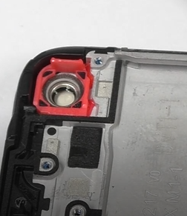
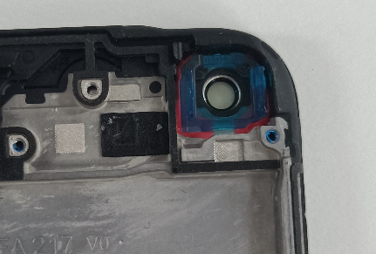
A53 screen components have two specifications, front camera 16M and front camera 8M uses two different screens.
Front camera bracket in the screen assembly red: 16M
Front camera bracket in the screen assembly light green: 8M
16M
8M

Slide 20
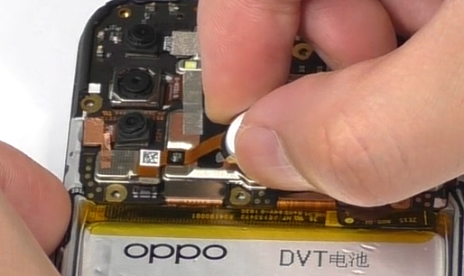
OPPO A53&OPPO A53s&OPPO A33&A32 is the fingerprint on the back of the battery cover. When disassembling the fingerprint, be careful not to break the fingerprint FPC.

Slide 21
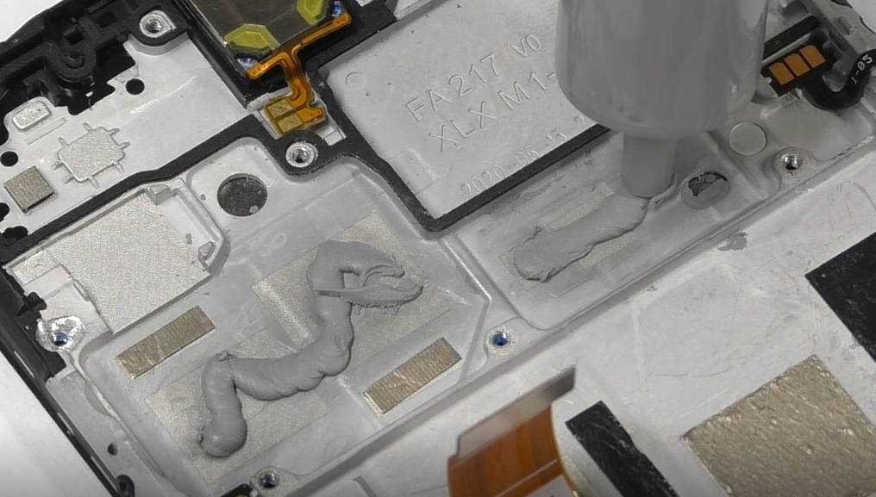
You need to apply thermal gel before installing the motherboard
Thermal gel

Slide 22
Contents
Basic Parameter
Core Selling Points
ColorOS
Maintenance Precautions
FAQ

Slide 23
FAQ
1、The secondary card is not registered on volte
Reason analysis: the page conflict between the primary and secondary cards, in order to prevent the secondary card from missing calls, let the secondary card fall back to 2/3G
Reference statement: In order to ensure that the user's secondary card will not miss a call, this problem will only occur in a special network environment with a low probability. The user can switch the flying mode or turn off the secondary card volte switch.
2. Fast power consumption in standby mode
Cause Analysis:
1). TOP social applications such as whatsapp, imo, Telegram, line are in the keep-alive list and are not controlled
2).gms, Google's core service, no control
3).mcs, oppo core service, no control
The application is active in the background, which makes it unable to sleep or sleep time is short
Reference statement: In the process of using social applications, in order to ensure the full-time and real-time delivery of messages, frequent network requests result in faster power consumption
Suggest:
1). Turn on power saving mode (settings-battery-power saving mode)
2). Prohibit self-starting and background running of non-essential software (settings-power池——应用耗电管理——选择应用关闭“允许应用自启动”）
3). Frequently clear background processes and clean up unnecessary software
4). Before going to bed at night, clear the background process and turn off the data network for standby to save power

Slide 24
3、Bright screen uses fast power consumption
Reason analysis: 90hz screen refresh rate leads to an increase in power consumption
Reference speech: 90Hz high refresh rate fluid screen, providing users with a smoother picture, more arbitrary operation, and a better experience in the game
Suggest: : Do not play large games. It is recommended that users modify the screen refresh rate to Smart Switch or 60HZ (Settings-Desktop and Brightness-Screen Refresh Rate)
4、PUBG driving and smoke bomb scenes appear to drop frames
Reason analysis: PUBG driving past places such as dense houses, game board junctions, wheat fields, etc., the resource loading is too large, which will cause the game to drop frames to a certain extent. The development has been analyzed and confirmed as a three-way problem
Reference statement: PUBG drives through places such as dense houses, game board junctions, wheat fields, etc. The resource loading is too large, which will cause the game to drop frames to a certain extent. This is a three-party game resource optimization problem. The three-party game resource optimization problem has been contacted. Will continue to optimize
5、The temperature rise at the fingerprint is too high during standby charging
Reason analysis: 18w fast charge, the thickness of the whole machine is reduced, and it is directly close to the motherboard. In order to improve the user experience of fast charging, the charging current is large in standby mode, and the temperature rise at the fingerprint is relatively obvious
Reference statement: The user does not use it in standby mode, so in order to increase the charging speed and improve the user experience, the standby charging current is increased, so that the temperature rise will increase. Once the user uses it, the charging current will drop, which will change to ensure the temperature rise experience. Therefore, it is normal for fingerprints to increase in temperature during standby charging.
Notes:
【参考讲解】
在ColorOS领域，我们还有很多好用的功能，像三指截屏、智能侧边栏等等，这些功能我们都会在ColorOS的专项培训中给大家详细介绍！
因此，可以说Reno3 Pro是不折不扣的“全能影像”

Slide 25

Notes:
【参考讲解】
2019年市场竞争变得非常激烈，我们OPPO人要“无所畏惧，勇往直前”，卖爆 Reno3系列！！！

