Slide 1
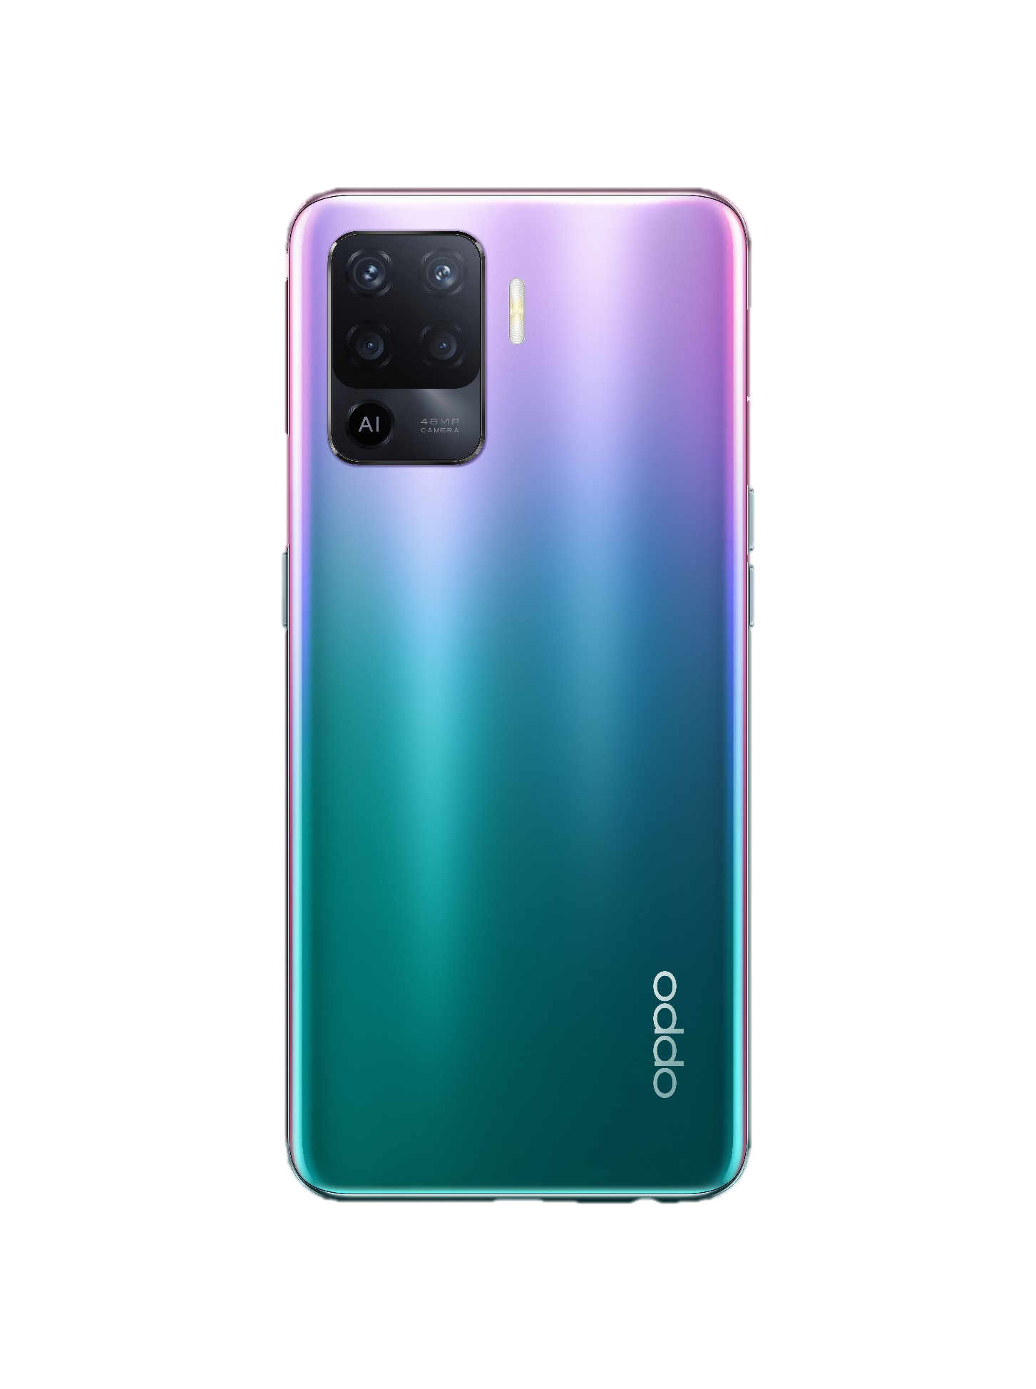
OPPO F19 Pro &Reno5 F
&A94&Reno5 Lite
Get ahead
everything in life

Slide 2
Contents
1.1 Appearance parameters
1.2 Configuration parameters
1.3 Frequently used parameters
Basic Parameter
Core Selling Points
ColorOS
Maintenance Precautions
FAQ

Slide 3
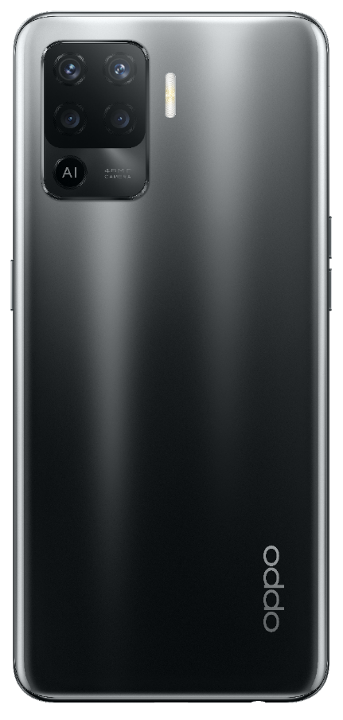
1.1 Appearance parameters
OPPO F19 Pro &OPPO Reno5 F&
OPPO A94&OPPO Reno5 Lite
Model name | CPH2285(IN,PK，LK，BD，NP，MM) CPH2217(ID,KE，NG，JO、IQ、LB、PS，MY) CPH2203(VN，KH、DZ,AE，SA，MA，TN,TH、PH、SG、EG) CPH2205(RU，KZ，UZ，UA，TR，PL，RO,MX、CL、CO)
Size | 16.01cm*7.32cm*0.78cm
Weight | About 172g
Screen size | 6.43inch
Screen resolution | 2400*1080
Screen ratio | 90.8%Full fit On-Cell
Screen glass | AMOLED
Color | Fluid Black/Crystal Silver/Fantastic Purple
Fluid Black

Slide 4
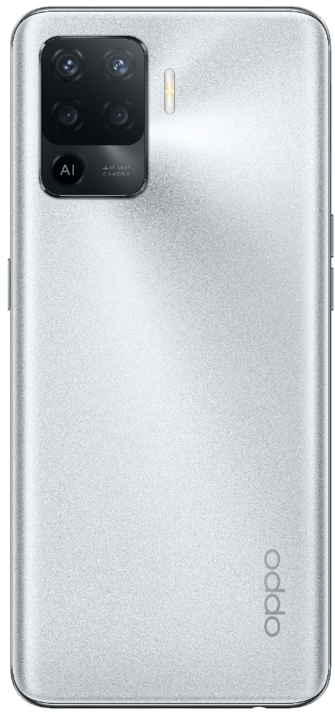
1.2 Configuration parameters
OPPO F19 Pro &OPPO Reno5 F&
OPPO A94&OPPO Reno5 Lite
CPU model | P95
Core | 8
RAM+ROM | 8GB+256GB/8GB+128GB
Front camera | 16M
Rear camera | Wide-angle: 8M Filter: 2M & 2M Main camera: 48M
Battery | 4220mAh（Min） 4310mAh（Typ）
Charging time | About 55 minute
Crystal Silver

Slide 5
1.3 Frequently used parameters
OPPO F19 Pro &OPPO Reno5 F&
OPPO A94&OPPO Reno5 Lite
Front camera | punch-hole
USB type | Type-C
USB version | 2.0
Earphone | 3.5mm
Speaker | 1
Bluetooth | LPDDR4x
ColorOS | ColorOS 11.1
Android | Android 11
Fantastic Purple

Slide 6
Contents
1.1 Appearance parameters
1.2 Configuration parameters
1.3 Frequently used parameters
Basic Parameter
Core Selling Points
ColorOS
Maintenance Precautions
FAQ
2.1 Get Ahead In Appearance
2.2 Get Ahead In Camera
2.3 Get Ahead In Speed

Slide 7
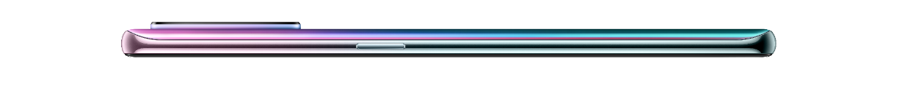
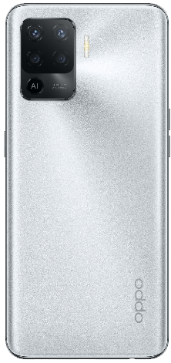
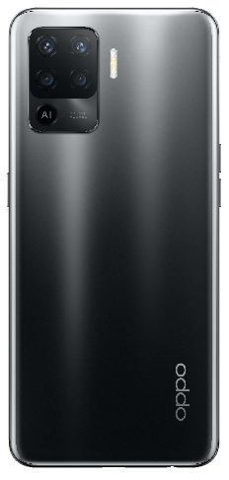
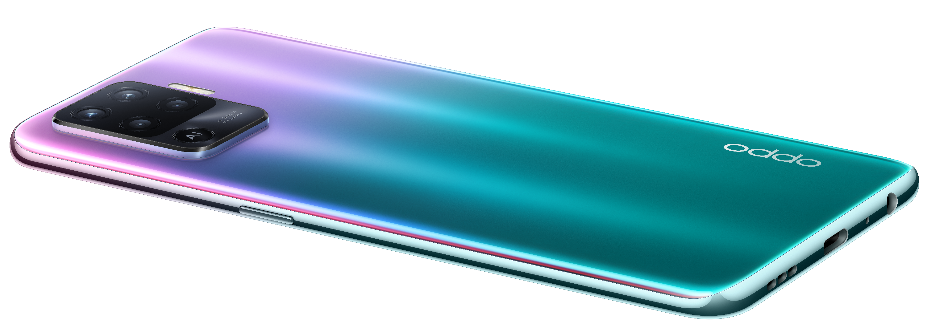
Get Ahead In Appearance
A phone
Shine like Aurora
Two characteristics
Three Color scheme
Shine like Aurora
Cool like Lamborghini（Crystal Silver）
Cool like Aston Martin（Fluid Black）
light&thin
7.8mm
172g
Cool like Sports Car
All-in-one Quad Camera
using a whole piece of glass to make the lens look more complete

Slide 8
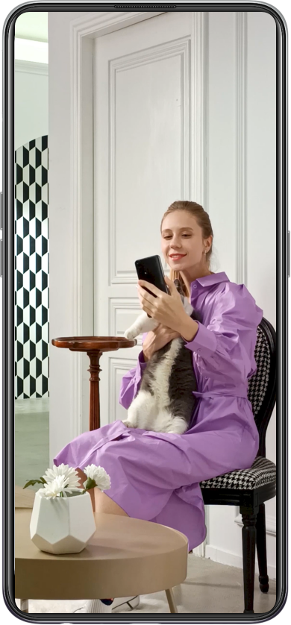
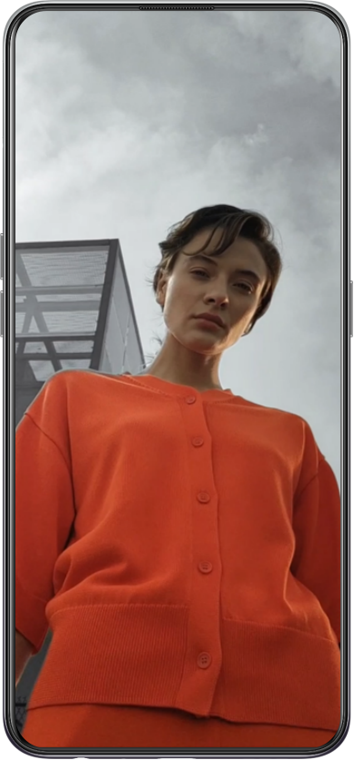

Get Ahead In Camera
Fun Videos
Dual-View Video
AI Color Portrait Video
First in its price range
First in its price range
Both front and rear cameras open at the same time
a master black and white filter，you are the focus
Support three kinds of split screen
Monochrome Video
Demonstration
Demonstration
Open camera，
more-Dual-View Video
Open camera，video-filter-AI Color Portrait Video

Slide 9









Interesting Photos
Dynamic Bokeh
AI Scene Enhancement 2.0
Night Plus
Night Flare Portrait
Let the main character more prominent at the same time, the background into a dynamic flow of light style
Intelligent recognition of the shooting scene, automatic adjustment of brightness, color, so that the picture is more natural
Cosmopolitan
Astral
Dazzle
Take night portrait photos with bright skin tone, soft bokeh and gorgeous light spots
Notes:
【Note】
According to the PPT

Slide 10
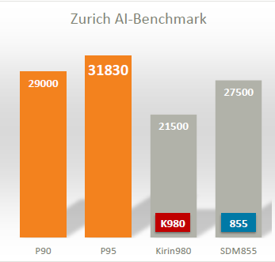



Get Ahead In Speed
30W VOOC Flash Charge 4.0
5 min charge 2.9 hours video playback
AI performance benchmark comparison
MediaTek Helio P95 AI Performance score surpasses Qualcomm Snapdragon 855
10min 25% | 20min 48% | 30min 69% | 56min Fully Charged
Super performance and super fast charging speed phone in this price range

Slide 11
Contents
1.1 Appearance parameters
1.2 Configuration parameters
1.3 Frequently used parameters
3.1 Translate anytime, anywhere
3.2 Full scenario game optimization
Basic Parameter
Core Selling Points
ColorOS
Maintenance Precautions
FAQ
2.1 Get Ahead In Appearance
2.2 Get Ahead In Camera
2.3 Get Ahead In Speed

Slide 12



Translate anytime, anywhere
It's too much trouble to read an article and copy it to translation software.
01
Students learn
foreign languages
02
Correspondence
with foreigners
03
Follow social media
The ColorOS and Google Lens teams have worked together to make the phone's internal functions work better with Google Lens functions. This allows users to quickly and easily access Google Lens's translation capabilities.
Browse news and articles quickly, and overcome language barriers
Make translation quicker and easier
Support more than 60 languages
Demonstration
3-finger screenshot /the Smart Sidebar,then select translation at the top
Tips: *数据来源于 OPPO 实验室

Slide 13
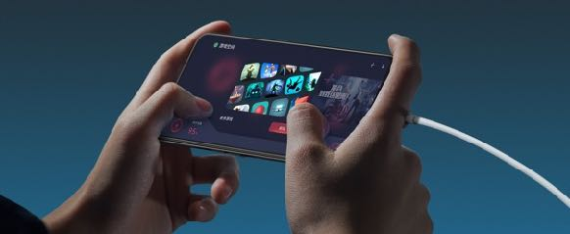
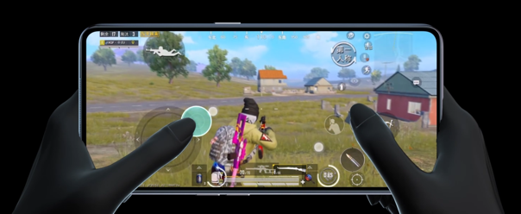

Full scenario game optimization
Before the game starts
During the game
01
Quick Startup
02
Bullet Screen Message
03
Game Focus Mode
no more waiting on the loading page while playing games with friends
Important messages will not be missed as they will be sent as bullet comments
Block notifications and prevent the status bar and navigation keys from touching by mistake in order to provide immersive game experience

Slide 14
Contents
1.1 Appearance parameters
1.2 Configuration parameters
1.3 Frequently used parameters
3.1 Translate anytime, anywhere
3.2 Full scenario game optimization
Basic Parameter
Core Selling Points
ColorOS
Maintenance Precautions
FAQ
2.1 Get Ahead In Appearance
2.2 Get Ahead In Camera
2.3 Get Ahead In Speed
4.1 Precautions for screw installation

Slide 15
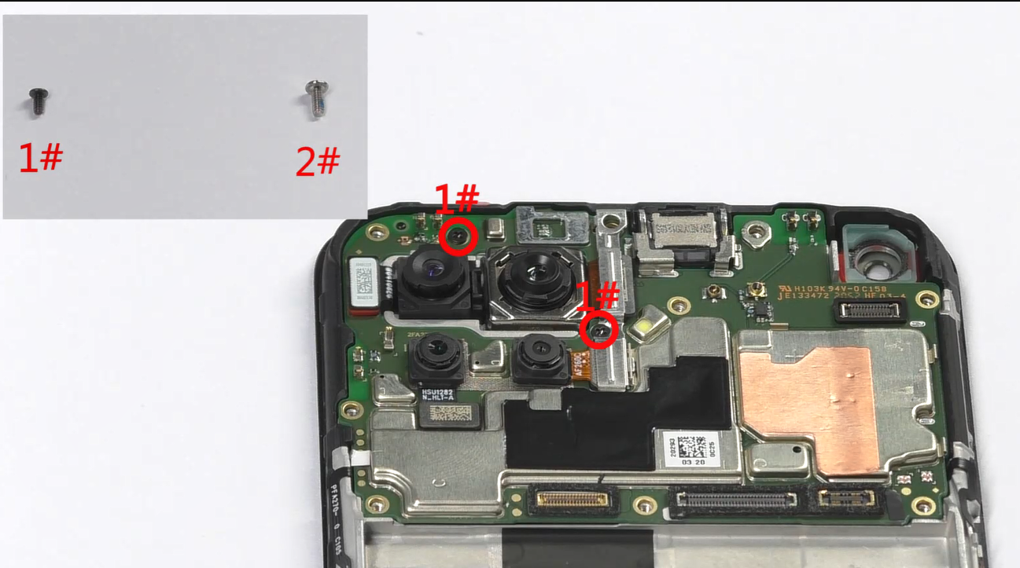
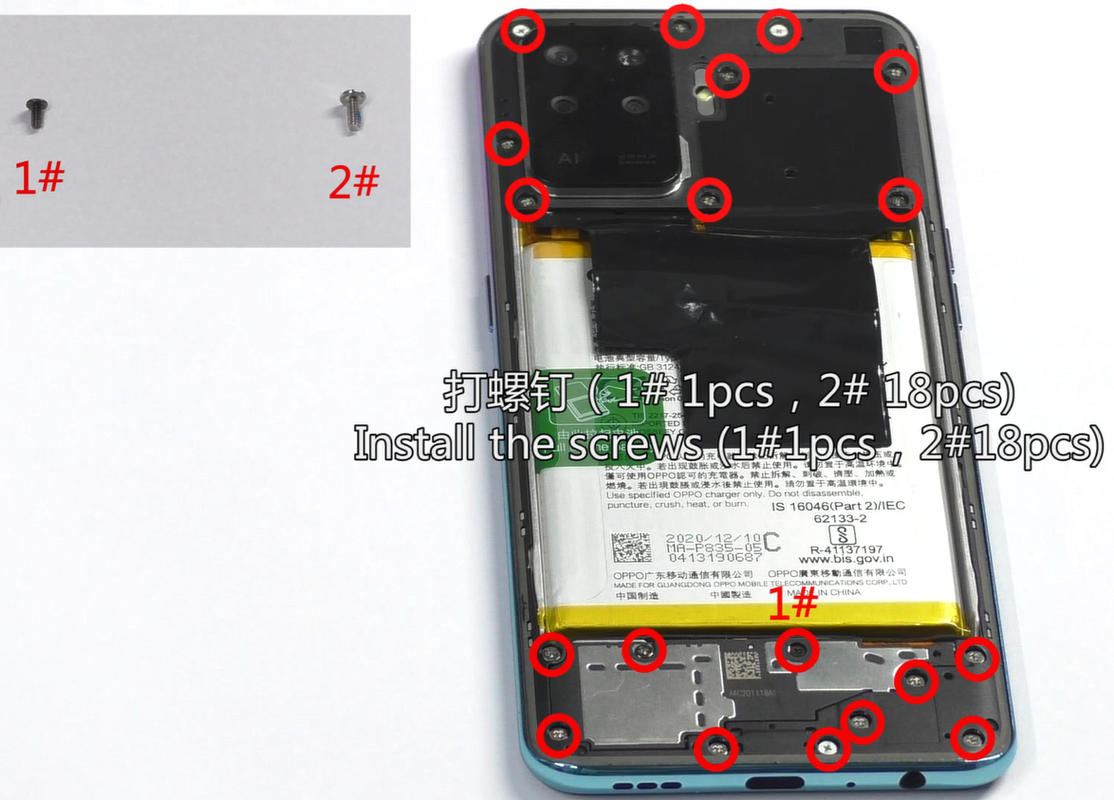
Precautions for screw installation
There are two types of screws, 1# and 2#.
Please make sure not to make the wrong position.

Slide 16
Contents
1.1 Appearance parameters
1.2 Configuration parameters
1.3 Frequently used parameters
5.1 hardware FAQ
5.2 Software FAQ
3.1 Translate anytime, anywhere
3.2 Full scenario game optimization
Basic Parameter
Core Selling Points
ColorOS
Maintenance Precautions
FAQ
2.1 Get Ahead In Appearance
2.2 Get Ahead In Camera
2.3 Get Ahead In Speed
4.1 Precautions for screw installation

Slide 17
Hardware FAQ
1、There is a visual illusion when viewing the silver back cover from the side of the camera
——Hello, I'm sorry to bring you a bad experience. The silver back cover is a product of our company using a new technology. The purpose is to achieve a fine grainy effect. A slight difference effect is a normal phenomenon from different angles. And will not affect any functions, nor is it raised. It is just a visual illusion. Please rest assured to use it.
2. There is a low probability that the time to enter the VOOC fast charge mode is 15s slower than the normal time
——Hello, I’m sorry to bring you a bad experience; in order to charge reliably, the phone itself will perform a self-check on the hardware status, and the fast charge VOOC sign appears on the phone slowly during the self-check process (about 15s slower than normal) . After the self-inspection is completed, it will return to normal. The frequency of the self-inspection is low and will not affect your normal use. Please rest assured.
Notes:
【参考讲解】
在ColorOS领域，我们还有很多好用的功能，像三指截屏、智能侧边栏等等，这些功能我们都会在ColorOS的专项培训中给大家详细介绍！
因此，可以说Reno3 Pro是不折不扣的“全能影像”

Slide 18
Software FAQ
1. When the game voice interface is in the floating window mode, WhatsApp or other social applications call or record voice, social applications cannot record sound.
——To protect user privacy, Android R restricts multiple simultaneous recordings;If a call application is recording in the foreground, the background recording function cannot be enabled normally.(Game voice also belongs to the call category)
2、When using Messenger to record video, the editing video interface is severely stuck
——Hello, I’m sorry for the inconvenience; this model only supports 4k30fps decoding ability, the video clip recorded by this application exceeds this decoding ability range.
3. Click the photo to view immediately after taking the photo, and it will display loading
——Hello, this is a normal phenomenon. In order to improve the effect of taking pictures and get clearer and more beautiful photo effects, HDR and beautification algorithms have been upgraded; if you don’t want the "loading" prompt, you can turn off HDR and beautification

Slide 19

Notes:
【参考讲解】
2019年市场竞争变得非常激烈，我们OPPO人要“无所畏惧，勇往直前”，卖爆 Reno3系列！！！

