Slide 1

2020年海外备件管理培训
2020 Overseas Spare Parts Management Training
备件护航 服务创不凡
Spare Parts Supporting
Service Soaring

Slide 2
备件需求预测及计划管理
Spare Parts Demand Forecasting and Planning Management
2020/6/15

Slide 3
Contents 目录
Part 1 产品生命周期-Product Life Circle
Part 2 各阶段备料原则-Preparation Principle in different stages
Part 3 特殊业务影响-Special business
Part 4 呆滞产生原因- Causes of sluggish

Slide 4
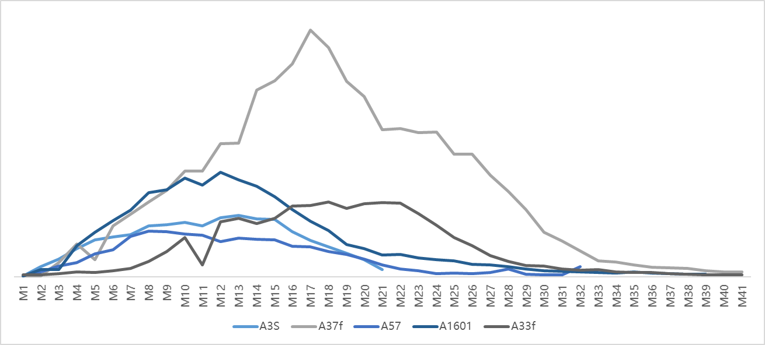
产品生命周期的划分
Product Life Circle
屏幕消耗趋势
Screen Consumption Trend
主板消耗趋势
MB Consumption Trend
停产前
Before EOP
停产后
After EOP
成长期 Growing
成熟期 Maturation
衰退期 Recession
生命尾期 Ending
【特点】：消耗增长迅速
Soar in consumption
【备料】：参照历史同款产品进行预估备料
Refer to consumption of similar model
【特点】：消耗高峰期，趋势稳定
High consumption with a steady trend
【备料】：定期盘点库存以及消耗数据，滚动备料
即可Monitor stock and consumption regularly
【特点】：消耗下降
Decrease in consumption
【备料】：滚动备料，重点关注消耗趋势
Focus on consumption trend
【特点】：消耗低，工厂已无供应
EOP, low consumption
【备料】：剩余生命周期的预估Remaining
life circle forecasting

Slide 5
Contents 目录
Part 1 产品生命周期-Product Life Circle
Part 2 各阶段备料原则-Preparation Principle in different stages
Part 3 特殊业务影响-Special business
Part 4 呆滞产生原因- Causes of sluggish

Slide 6

新品导入及成长期备料策略
1
2
3
大货预计出货量
历史消耗比率
技术组维修手册
出货国家
网点数量
品质不良率
定制机型，定制配置（颜色、主板内存等）
总部
出货量*历史消耗比率决定了消耗的绝对值
国家数量和网点数量决定了最小铺货量
异常因素考量
当地销售量
历史机型消耗比率
技术组维修手册
网点数量
新机型上市如何备料？
参考上一代机型各物料的消耗情况与当时的销售量
再结合新机型的销售量进行备料
代理/库管
很多代理反馈新机型上市不知道如何备料？
平衡铺货和物料成本

Slide 7
Preparation principle in NPI and Growing stage
1
2
3
Expected volume for handset
Historical consumption rate of similar model
Service manual
Total qty of countries
Total qty of service center
Defective rate
Customize models and configuration
HQ
Shipment qty*historical consumption rate decides the absolute value of consumption
Qty of countries and service center decides minimum pull in qty
Take irregular factors into consideration
Local sales
Historical consumption rate of similar model
Service manual
Qty of service center
How to anticipate consumption of new model?？
Agents/Spare parts administrator
Don’t know how to anticipate consumption of new model?
Balance material cost and pull in qty
Refer to consumption rate and sales of similar model along with sales of new model

Slide 8

成熟期备料策略
1
2
3
大货累计出货量
返修率
各物料消耗趋势
海外库存数据
大货停产前：
  跟大货通用的物料可以随时备料不受MOQ限制
大货停产后：
  MOQ限制
品质不良率
翻新机、业务演示机、大客户翻新需求等非售后维修需求
总部
当前存量用户数量*返修率预测决定未来消耗趋势
异常因素考量
物料消耗趋势
安全库存策略
与总部的物流、清关时效
本地物料时效
运输成本
翻新机、业务演示机、大客户翻新需求等非售后维修需求
营销活动
代理较总部的优势边在于没有MOQ的限制
只需要做好本地安全库存的管控
代理/库管
非常规的售后维修需求提前跟总部沟通，避免缺料

Slide 9
Preparation principle in maturation stage
1
2
3
Accumulated shipment of phones/Repair rate
Consumption trend of different commodity groups
Overseas on hand stock
Before EOP：
  Materials sharing with phones have no MOQ limitation
  After EOP：
  MOQ limitation
Defective rate
Non-aftersales demand such as refurbishment、demo machine、key account refurbish demand
HQ
Qty of current customer with phone on hand*estimated repair rate decides future consumption
Take irregular factors into consideration
Consumption trend
Safety stock strategy
Customs clearance and logistic time
Local material transportation time
Transporting cost
Non-aftersales demand such as refurbishment、demo machine、key account refurbish demand
Promotion
Advantage of agents compared to HQ lies in no MOQ limitation
Monitor local safety stock is enough
Agents/Spare parts administrator
Keep HQ informed of irregular aftersales needs in advance to avoid shortage

Slide 10

衰退期备料策略
1
2
3
大货累计出货量
返修率
各物料消耗趋势
海外库存数据
控制库存水平：
  消耗数据迅速下滑，调整安全库存策略，控制成品库存
  促销活动的推广
品质不良率
翻新机、业务演示机、大客户翻新需求等非售后维修需求
总部
当前存量用户数量*返修率预测决定未来消耗趋势
异常因素考量
物料消耗趋势
安全库存策略
本地物料时效
与总部的物流、清关时效
运输成本
消耗趋势快速下降，重点关注消耗数据，盘点库存数据，避免呆滞
对于呆滞物料及时采取价格工具
本阶段重点是消耗数据的监控，控制安全 库存，避免呆滞
当出现呆滞的时候， 及时处理呆滞物料
代理/库管

Slide 11
Preparation principle in recession stage
1
2
3
Accumulated shipment of phones/Repair rate
Consumption trend of different commodities
Overseas on hand stock
Control stock volume：
  Consumption drop rapidly，adjust safety stock strategy, control FG stock
  Promotion
Defective rate
Non-aftersales demand such as refurbishment、demo machine、key account refurbish demand
HQ
Qty of current customer with phone on hand*estimated repair rate decides future consumption
Take irregular factors into consideration
Consumption trend
Safety stock strategy
Local material transportation time
Customs clearance and logistic time
Transporting cost
Consumption drop rapidly，monitor stock status and focus on those with high consumption. Avoid sluggish
Pricing strategy on sluggish material
Monitoring consumption data is very critical during this stage.
Focus on controlling safety stock, avoid sluggish and
handle in time if any.
Agents/Spare parts administrator

Slide 12

生命尾期备料策略
1
2
3
各物料消耗趋势
海外库存数据
针对消耗量大的物料盘点原材料、供应商供应条件，尽力继续保持供应
控制库存水平：
  监控各区域的库存，做好最后的物料分配
  呆滞物料处理
品质不良率
翻新机、业务演示机、大客户翻新需求等非售后维修需求
总部
总部物料已停产，代理需要根据本地的供应策略，做好最后一次备料
呆滞物料的处理
代理本地的LTB管理
代理/库管

Slide 13
Preparation principle in ending stage
1
2
3
Consumption trend of different commodities
Oversea on hand stock
Find out raw material & supply condition of items with high consumption,
try to maintain supply
Control stock volume：
  Monitor region stock and allocate reasonably
  Sluggish material handling
Defective rate
Non-aftersales demand such as refurbishment、demo machine、key account refurbish demand
HQ
Material already EOP in HQ, agents need to apply LTB reasonably based on local supply strategy
Sluggish material handling
Manage local LTB
Agents/Spare parts administrator

Slide 14
物料管控二八法则
关键物料
主板，屏幕组件
贵重物料的安全库存建议设置在3个月左右（非首次采购），根据其消耗趋势大致区分如下：
需求增长上升阶段：
订单+总库存：前一个月消耗*（3.5个月+（订单处理时长/30天））
需求下降阶段：
订单+总库存：前一个月消耗*（2个月+（订单时长/30天））
关键料占比：85%
非关键物料
FPC小板，小五金，双面胶，镜片，下盖，摄像头，指纹，电池盖
针对拆机必换物料及低价值辅料，每次备料覆盖10个月左右的需求以减少物料运输成本，在备料时还需考虑网点数量，根据网点进行铺货，避免影响一小时快修考核成绩
针对维修率极低且价值较高的物料，需要平衡物料成本与运输成本，在物流便利的情况下可以备在区域总仓
部分辅料因需求数量较低，后期采购困难，需要在停产前一次备完
非关键料占比：15%

Slide 15
Pareto’s principle in Inventory Value Control
Critical parts
Mainboard, Screen
We suggest 3 months of safety stock for critical material（except first time buy）and can be roughly divided into two stages based on consumption trend.
Demand rising stage：
Order + total inventory：RR of former month*（3.5months+（order processing duration/30days））
Demand decline stage：
Order + total inventory ： RR of former month *（2months+（ order processing duration /30days））
Critical parts：85%
Non-critical parts
FPC，metal fittings，double-sided tap，lens，camera，fingerprint，battery cover
For material need to be replaced once tear down and of low value, every preparation covers around 10 months demand to minimize logistic cost. Qty of service center should also be taken into account to support 1HFF.
Balance material cost and logistic cost of material with extremely low repair rate but of high value. Stock them in general WH if local transportation is convenient.
Some subsidiary materials need to be ready in only one time preparation before EOP. Because the demand is low and it’s difficult to purchase in ending stage.
Non-critical parts：15%

Slide 16
Contents 目录
Part 1 产品生命周期-Product Life Circle
Part 2 各阶段备料原则-Preparation Principle in different stages
Part 3 特殊业务影响-Special business
Part 4呆滞产生原因- Causes of sluggish

Slide 17
特殊业务影响
突增的订单需求
01
02
翻新业务需求订单
03
大客户演示机订单
问题与影响
1、申请节奏不均衡，突增的需求容易导致总部供应困难，无法及时满足需求，另一方面占用库存，容易导致其他区域正常的需求无法得到满足
2、一些特殊业务导致消耗突增，影响对未来消耗趋势的判断，易导致追加需求，产生呆滞
对策及建议
1、定期监控库存状况以及消耗趋势，根据安全库存，滚动备料，避免临时需求
2、对于翻新业务、大客户演示机等特殊场景业务提前一个月跟工厂沟通需求

Slide 18
Special business impact
01
02
Refurbishment demand
03
Unexpected huge
order demand
Key account demo
machine need
1、Place order in an irregular tempo，unexpected huge order demand can lead to HQ supply bottleneck，fail to fulfill order in time. Disturb normal MFG tempo, result in shortage of other regions
2、Unexpected Huge consumption caused by special business，interfere demand forecasting and lead to supplementary demand，cause sluggish
1、Monitor stock and consumption trend regularly. Place order in a regular tempo per safety stock
2、Inform HQ one month in advance on special needs
Problems and influences
Countermeasure and advice

Slide 19
Contents 目录
Part 1 产品生命周期-Product Life Circle
Part 2 各阶段备料原则-Preparation Principle in different stages
Part 3 特殊业务影响-Special business
Part 4 呆滞产生原因-Causes of sluggish

Slide 20
呆滞产生原因
外部需求变化
计划能力
1、外部需求变化超过预测，增长或者下降的趋势幅度与预期偏差较大
2、突发的业务需求
1、缺乏完善的数据信息汇整以及数据分析能力
2、库存、消耗数据的及时监控，安全库存策略以及备料节奏
品质异常
Inventory
产品物料的熟悉性
1、品质不良率的不稳定，导致不同机型的部件消耗趋势不同
2、重大的品质事故
1、对维修手册的不熟悉，对不同物料的返修率差异缺乏经验
MOQ以及LTB
新业务
1、最小订单量的限制，为了避免缺料，导致有时不得不超过需求量
2、LTB的需要覆盖的时间过长，无法预测清晰
1、IoT等新业务越来越多，而且缺乏过往的备料经验支持

Slide 21
Factors may cause sluggish
Changes in external demand
Forecasting accuracy
1、The trend of external demand has a large deviation from the expected
2、Unexpected business needs
1、Data summary and analysis capabilities
2、Monitor Inventory, consumption，safety stock strategy, order placing tempo
Quality issue
Inventory
Familiarity with different commodities
1、Uncertainty of defective rate causes different consumption trend of every model.
2、Serious quality issue
Unfamiliar with the service manual or repair rate of different materials
MOQ and LTB
New business
1、To avoid shortage, we have to buy MOQ which exceeds demand from Agent sides.
2、LTB needs to cover too long service month, difficult to forecast accurately.
New branch of business like IoT is getting more and more. At the same time, we do not have similar experience to refer to.

Slide 22
备料参考数据
历史机型消耗分布
历史规律的参考
物料月/周消耗统计
机型备料比例
监控消耗趋势变化，及时调整备料策略
收集汇整不同机型备料比率，借助过往经验，对总体备料情况做到心里有数
可以作为新机型以及LTB备料参考
品质不良预估率
服务手册
参考品质不良率，了解不同机型、不同物料的返修率，作为备料参考
了解哪些物料属于拆必换物料，哪些物料属于维修率极低的物料

Slide 23
Reference data for forecasting
Consumption of previous model
Refer to historical trend
Consumption analysis
by month/week
Preparation ratio
Monitor consumption trend, adjust forecasting strategy in time
Be aware of material preparation status on the whole based on prepare ratio of different models
Reference to new model and LTB
Estimated defect rate
Service manual
Refer to defect rate and repair rate when forecasting
Be aware of must change once tear down material and those of extremely low repair rate

Slide 24
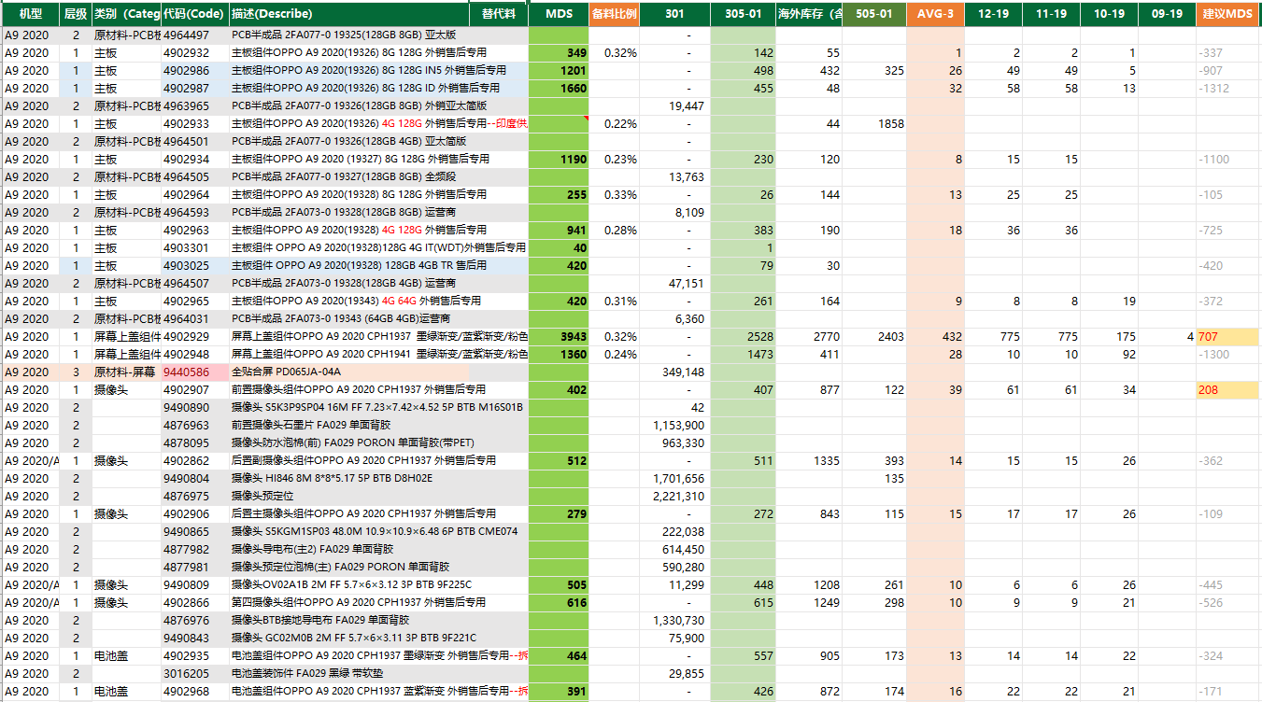
物料消耗统计报表Consumption analysis report

Slide 25
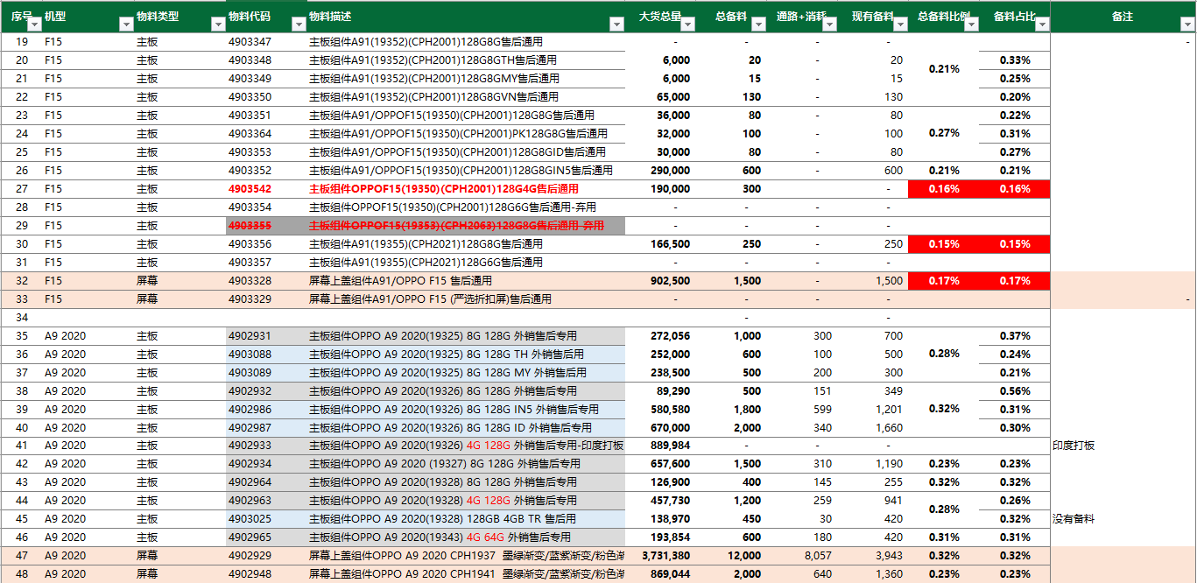
机型备料比例统计Preparation ratio analysis report

Slide 26
Q&A

Slide 27
随堂测验In class quizzes
1、产品的生命周期有哪几个阶段？Which stages are contained in product life circle?
A、成长期 Growing B、成熟期 Maturation C、衰退期 Recession D、生命尾期 Ending
答案：（ABCD）
2、物料在哪个产品生命周期消耗趋于下降？From which stage consumption starts to decrease?
A、成熟期 Maturation B、衰退期 Recession C、生命尾期 Ending D、成长期 Growing
答案：（B）

Slide 28
随堂测验In class quizzes
3、代理/库管在新品导入及成长期阶段的备料依据有哪些？During NPI and Growing stage, which factors should be considered of material preparation?
A、当地销售量 Local sales
B、历史机型消耗比率 Historical consumption rate of similar model
C、技术组维修手册 Service manual
D、品质不良率 Defective rate
E、网点数量 Qty of service center
答案：（ABCE）

Slide 29
随堂测验In class quizzes
4、呆滞产生的业务场景有哪些？Which factors may cause sluggish?
A、外部需求变化 Changes in external demand
B、库存、消耗数据的及时监控 Timely monitor of stock and consumption trend
C、品质异常 Quality issue
D、MOQ&LTB
E、不产品熟悉产品物料 Unfamiliarity with different commodities
答案：（ACDE）
5、新机型以及LTB备料不用参照历史机型的备料比率。
When prepare material of new model and last time buy, we do not need consider preparation ratio of historical similar model.
答案：(错/F)

