Slide 1
OPPO Cambodia Weekly Report
（Week 1, 2019.2.18-2019.2.24）

Slide 2
KPI Review

Slide 3
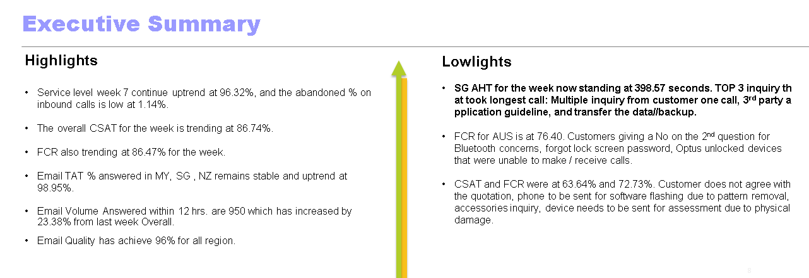
KPI Review
Main finding
Highlights
(Example):
The overall CSAT for the week is trending at 86.74%.
FCR also trending at 86.47% for the week.
Lowlights
CSAT and FCR were at 63.64% and 72.73%.

Slide 4
Tally Analysis
Tally 1 Segregation Analysis
Malfunction for hardware/software Tally 2 Call driver (Top 5)
Top 3 Call drivers :
28.2% - related to ‘Function (Setting) enquiry
27.8% - related to ‘Business Inquiry’
15.8% - related to ‘Other Enquiry’.
Scenario for the Top 1 malfunction :
Customer mainly feedback xxxxxx regarding Third-Party Applications Functional Malfunction

Slide 5
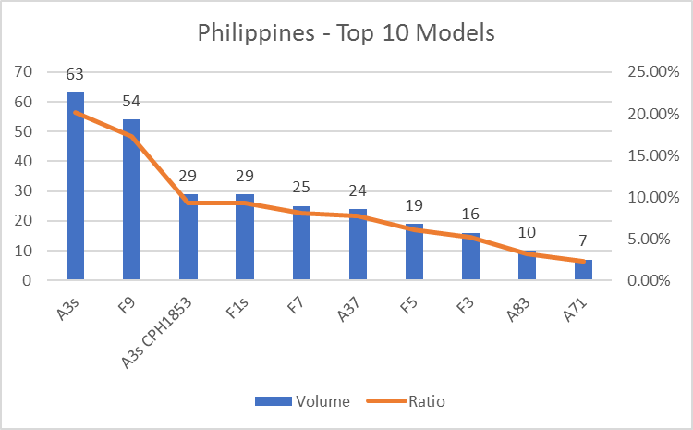
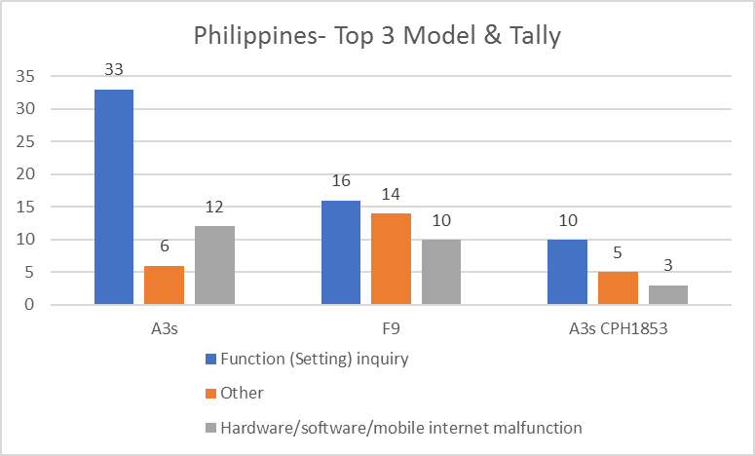
Model Analysis
Top Model Segregation Analysis
Voice of customer
Feedback and suggestion from customer
Suggestion toward product :
Suggestion toward service :
Complaint of this week:

Slide 6
Return visit ratio analysis
Remark :

Slide 7
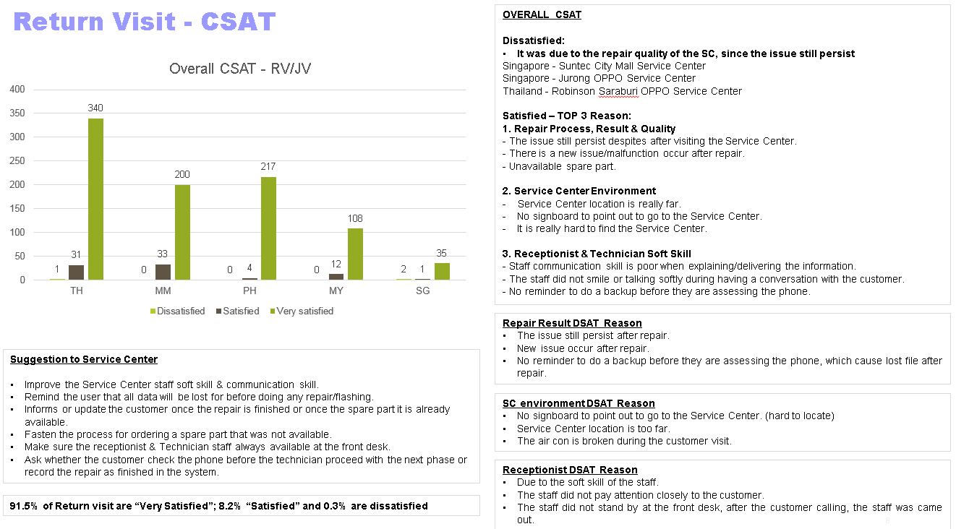

Slide 8


