Slide 1

Support Mail Signature-Structure
Agent Name
Mary
OPPO Philippines
Customer Support Team
T: 180018536776 - For PLDT, Smart and Sun subscribers;
23956776 - For Globe subscribers & all land line users (9AM - 9PM, MON - SUN; Including Holidays)
E: support@oppo.com.ph
W: www.oppo.com
This e-mail and its attachments contain confidential information from OPPO, which is intended only for the person or entity whose address is listed above. Any use of the information contained herein in any way (including, but not limited to, total or partial disclosure, reproduction, or dissemination) by persons or other than the intended recipient(s) is prohibited. If you receive this e-mail in error, please notify the sender by phone or email immediately and delete it!
OPPO Region
Business Information
OPPO
Social Media
Disclaimer

Slide 2
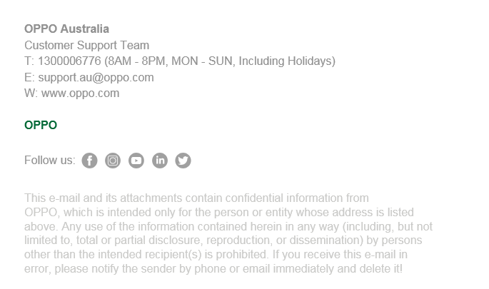

Support Mail Signature-Format
Name> Either OPPO [Region] or [Agent Name] choose one only
Font: Arial (Bold) | Size: 12 | Color: RGB 146 146 146
Business information>
T: [Hotline Number (Hours)] no space in between Hotline Number
E: [Support Mail] no hyperlink
W: www.oppo.com no hyperlink
Font: Arial | Size: 12 | Color: RGB 146 146 146
OPPO> Font: Arial (Bold) | Size: 12 | Color: RGB 4 105 56
Social media>
Follow us:
Font: Arial | Size: 12 | Color: RGB 146 146 146
Icons to be aligned with what’s on OPPO Official Websites
Disclaimer>
Content to be confirmed by DPO of the Region
Font: Arial | Size: 12 | Color: RGB 202 202 200
Index>
Purple words: Notice, or further explanation;
Red words: Settings for Font | Size | Color.

