Slide 1
WCSM RV Module Training
——By Online Service MGT Team

Slide 2
01
Salesforce & WCSM Comparison
02
RV SOP on WCSM
03
Service Standard & Target
04
Data & Report

Slide 3



Salesforce & WCSM Comparison
WCSM
Account
Management
Create | Edit | Delete | Reset Password etc.
All available for CC HQ only
CC Site Manager can Create | Edit | Disable | Reset Password
for all CC accounts
L4 ID to assign tasks to agents manually
Difficult due to multi-region service
System Assignment as per certain rules as main method
Manual Assignment can be applied when necessary
RV Task
Management
Tasks can’t be recalled before deadline
Tasks can be recalled/withdrawal anytime when needed
CC can’t check sample record on system
CC can check Sample Record
Agent need click on RO one by one for RV
Next RO will be popped out automatically when one is closed
RV Service
SOP
Easy to miss the promised time for 2nd attempt
Time for 2nd call can be set and the case will pop out before due time
CC can’t amend samples closed already
CC HQ can amend samples after they are closed when needed
CC can only check RV data through report
CC can review single sample online
Data & Report
CC can’t check RV Sample Judgment result
CC can check RV Judgement Result and do self-check
CC need analyze RV ratios manually from dump
CC can check RV ratio chart from system

Slide 4
01
Salesforce & WCSM Comparison
02
RV SOP on WCSM
03
Service Standard & Target
04
Data & Report

Slide 5
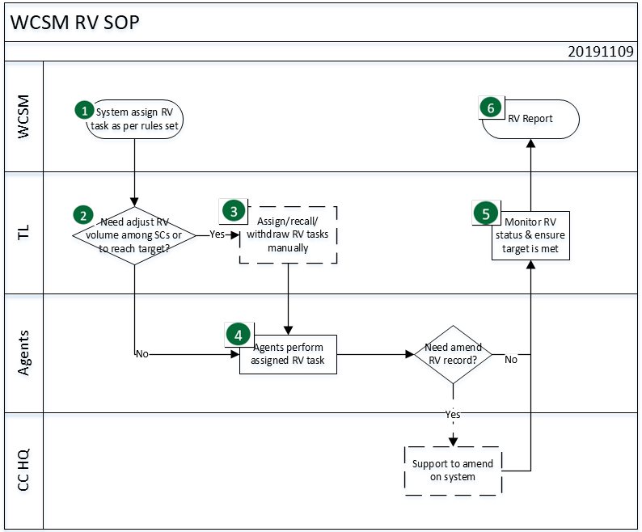
RV SOP on Salesforce

Slide 6
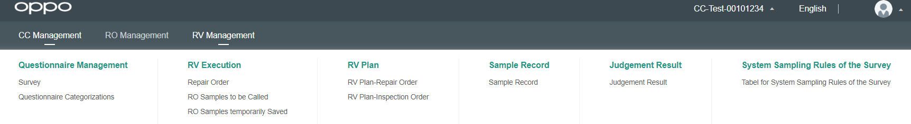
1. System Assign RV Task as per Rules Set
Rules can be set and edited by HQ only.
Rules are based on sample volume of each region and balanced among Service Centers & Agents.
100% is set for regions where RV%=100%, thus no need to adjust manually.
However, TL is required to monitor RV Status and adjust RV volume when needed
When local office expects more samples for certain SC
When any SC didn’t meet the minimum sample amount (15/month)
When CC would assign more tasks to typical agents

Slide 7
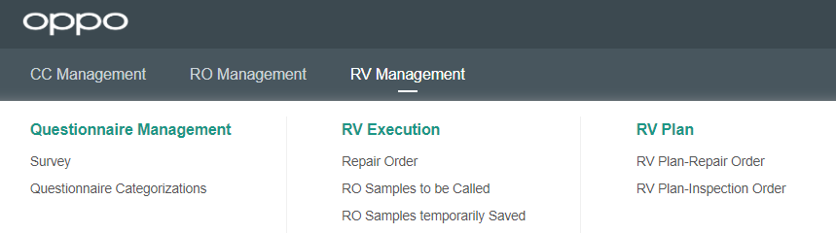
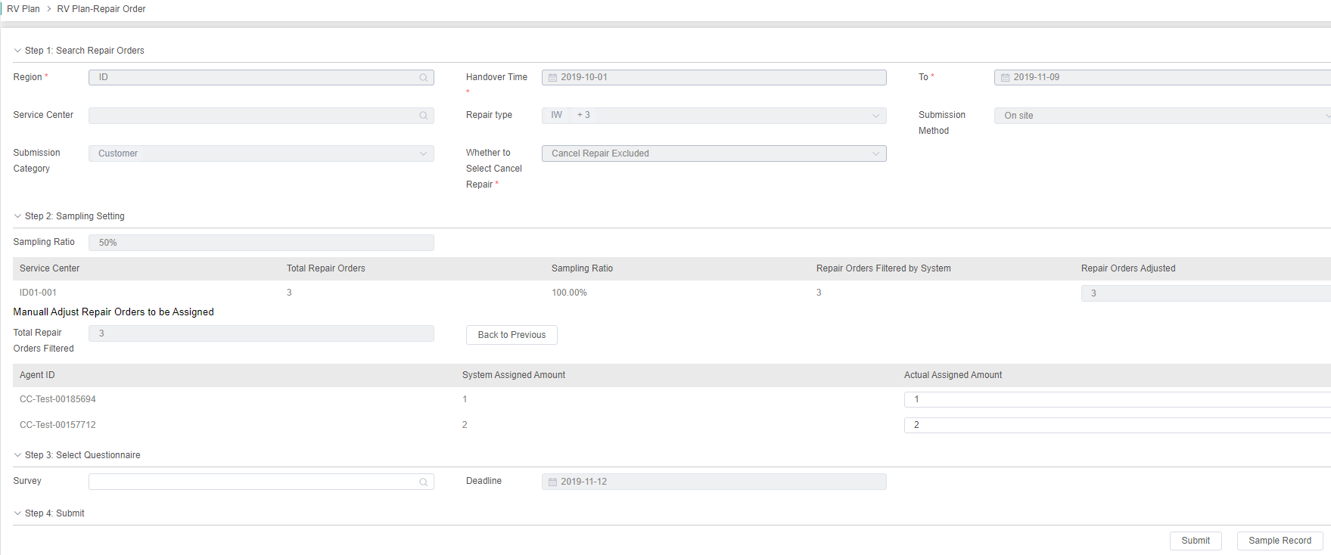
2. Adjust RV Tasks Manually
Handover Time=Delivery Time
Repair Type≠COnsultation
SBU:
Submission Method=On site
Submission Category=Customer
Cancel Repair Excluded by default. No need to change
As per request
Can be adjusted as per request
The total amount should be equal to Repair Order Adjusted
Select the Questionnaire “RV Survey”
Set a Deadline for the task

Slide 8
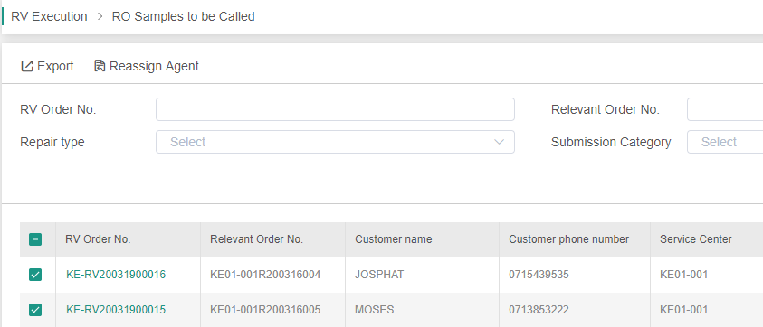
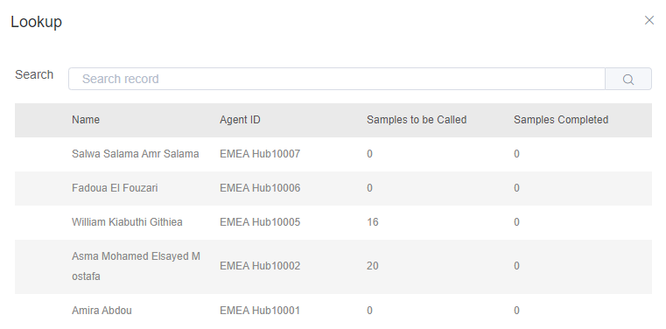
Select Agent ID to reassign the task to other agents

Slide 9
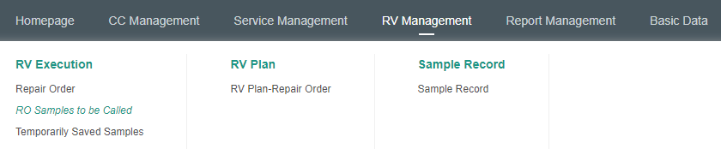
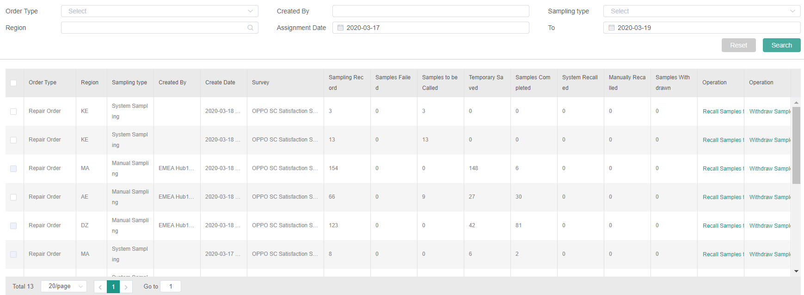
3. Recall/Withdraw RV Tasks
Width can be adjusted manually
Samples will be withdrawal to dump if the task is not completed by due time
Recall: The samples won’t be filtered next time
Withdraw: The samples can still be filtered next time

Slide 10
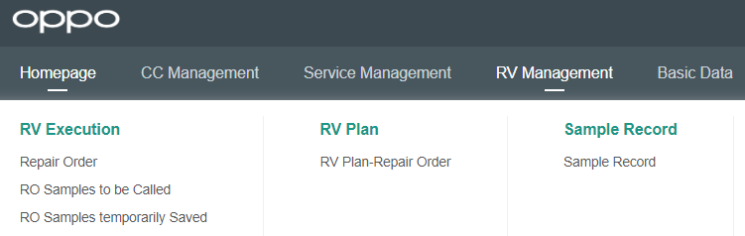
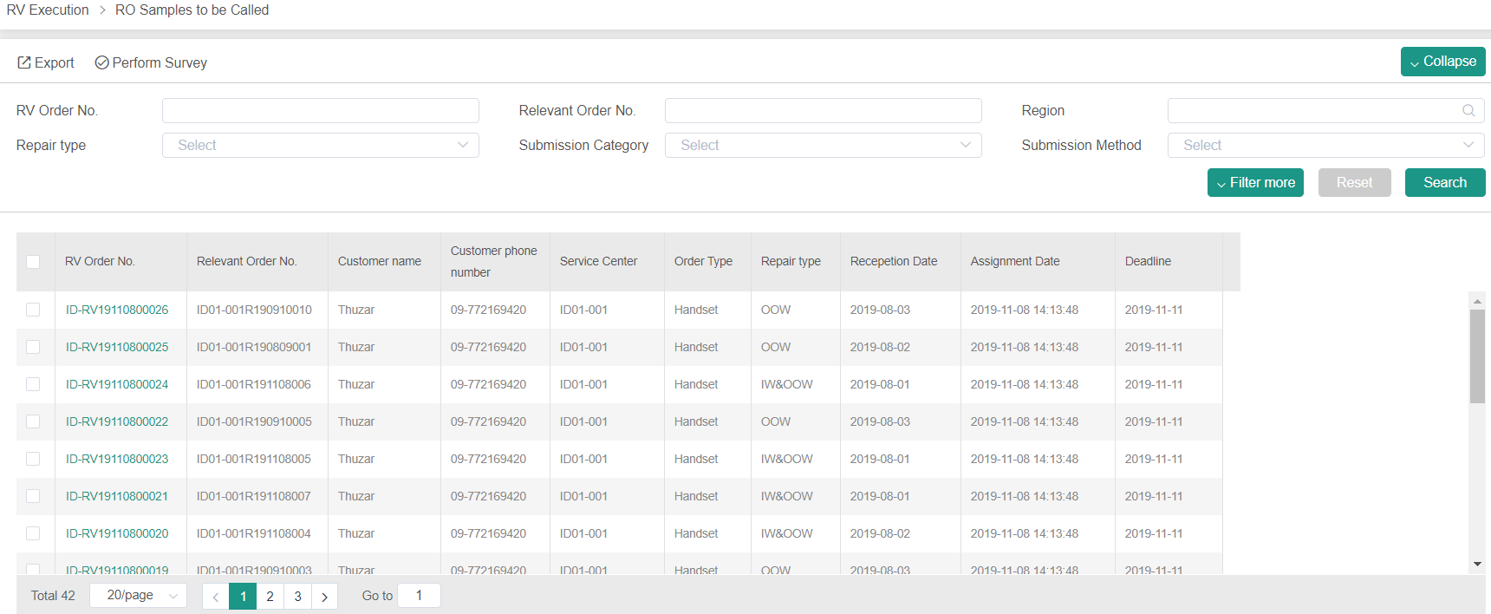
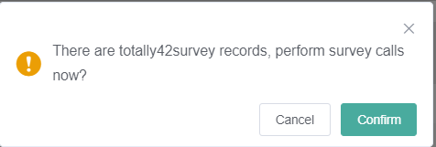
4. Agents Perform RV Task

Slide 11
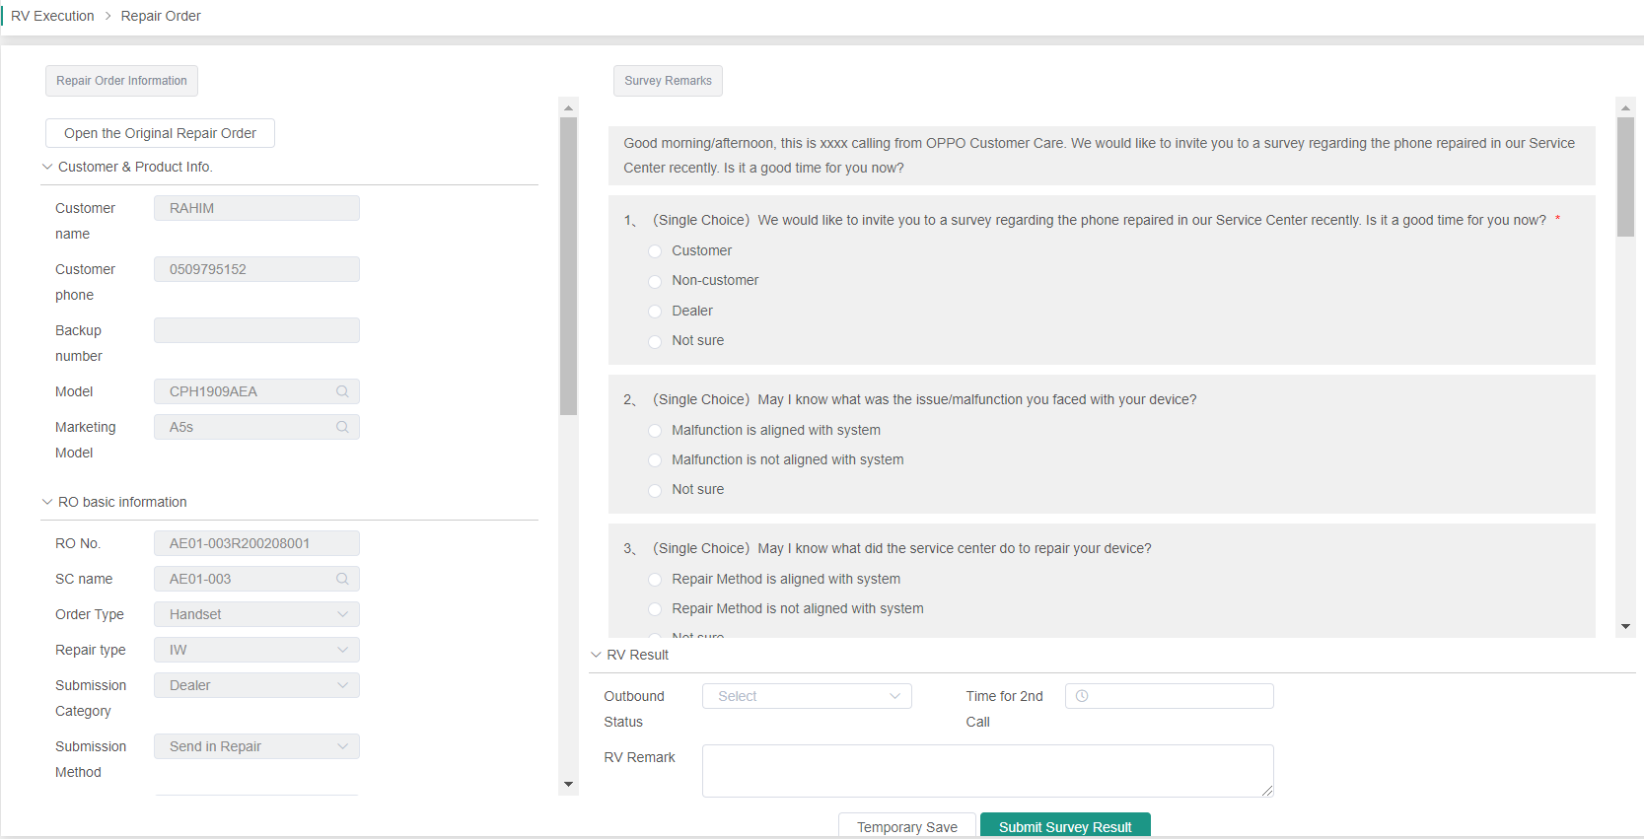
Agent can set a time for 2nd call. The sample will pop out 5min before due time

Slide 12
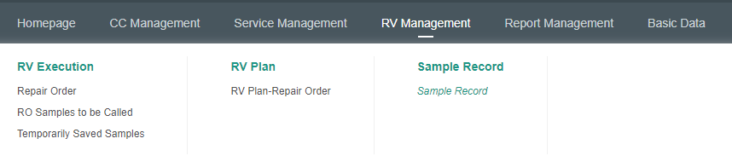
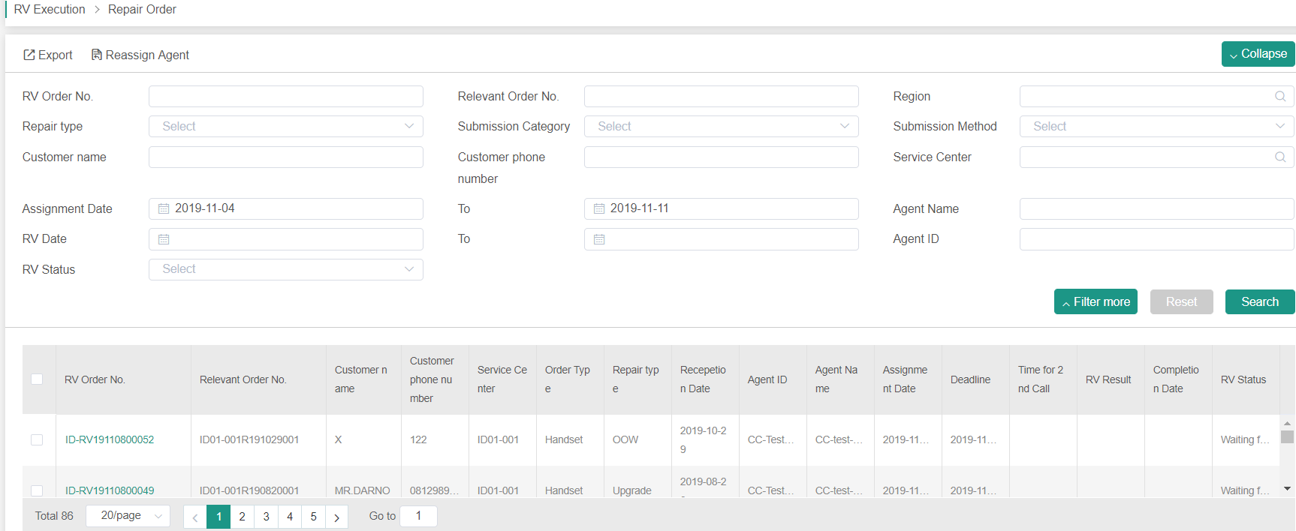
5. Monitor RV Status
Select filters as needed to get RV status

Slide 13
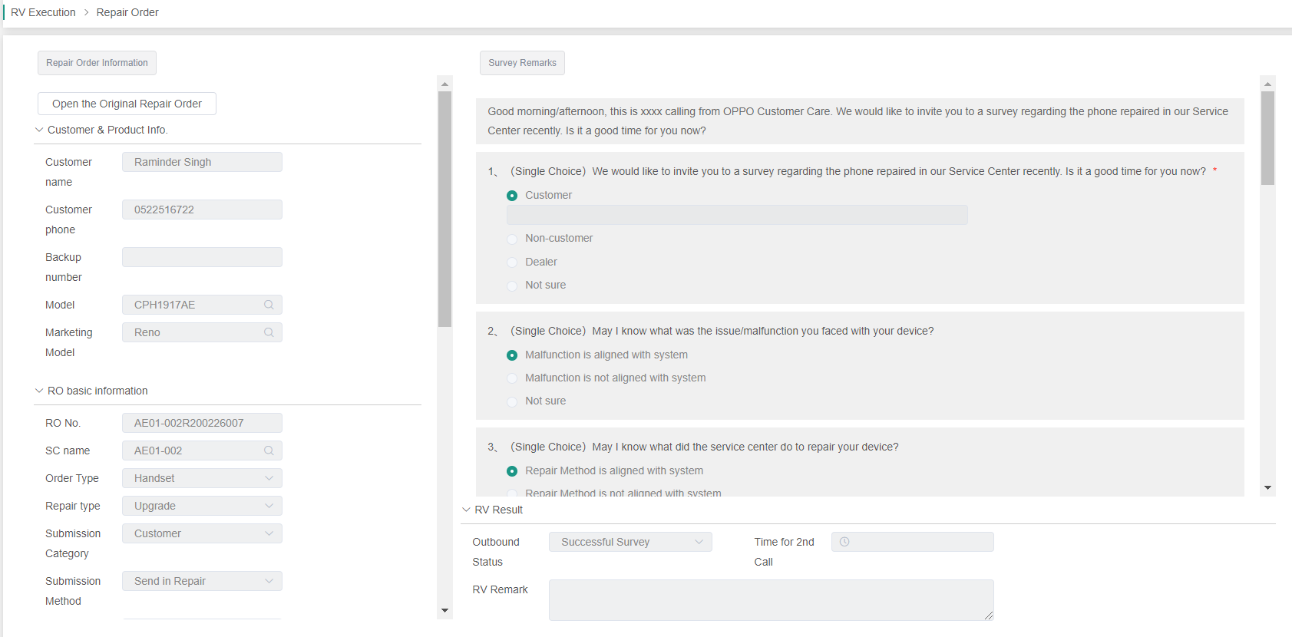

Slide 14
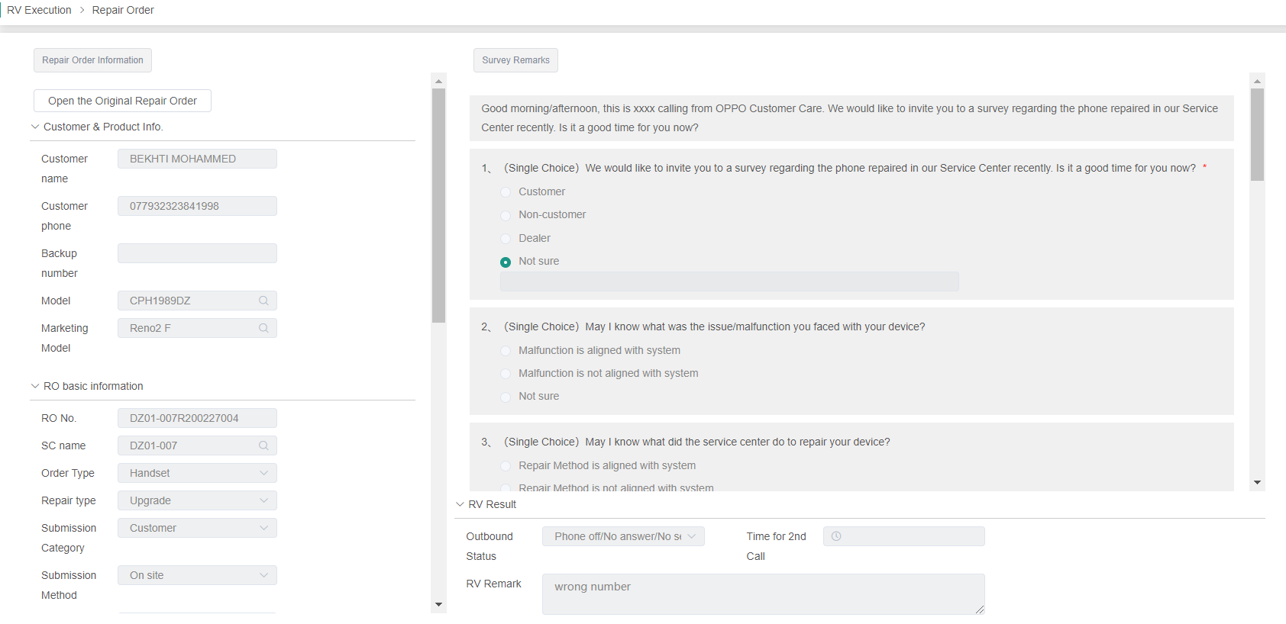
6. Amend RV Sample
CC HQ can amend the RV samples which have been closed on system before 7th every month (starting from May)
RV TL is responsible to submit amending request on weekly basis before 7th

Slide 15
01
Salesforce & WCSM Comparison
02
RV SOP on WCSM
03
Service Standard & Target
04
Data & Report

Slide 16
1. WCSM RV Service Standard

Slide 17
2. RV Target
To Be Finalized soon

Slide 18
01
Salesforce & WCSM Comparison
02
RV SOP on WCSM
03
Service Standard & Target
04
Data & Report

Slide 19
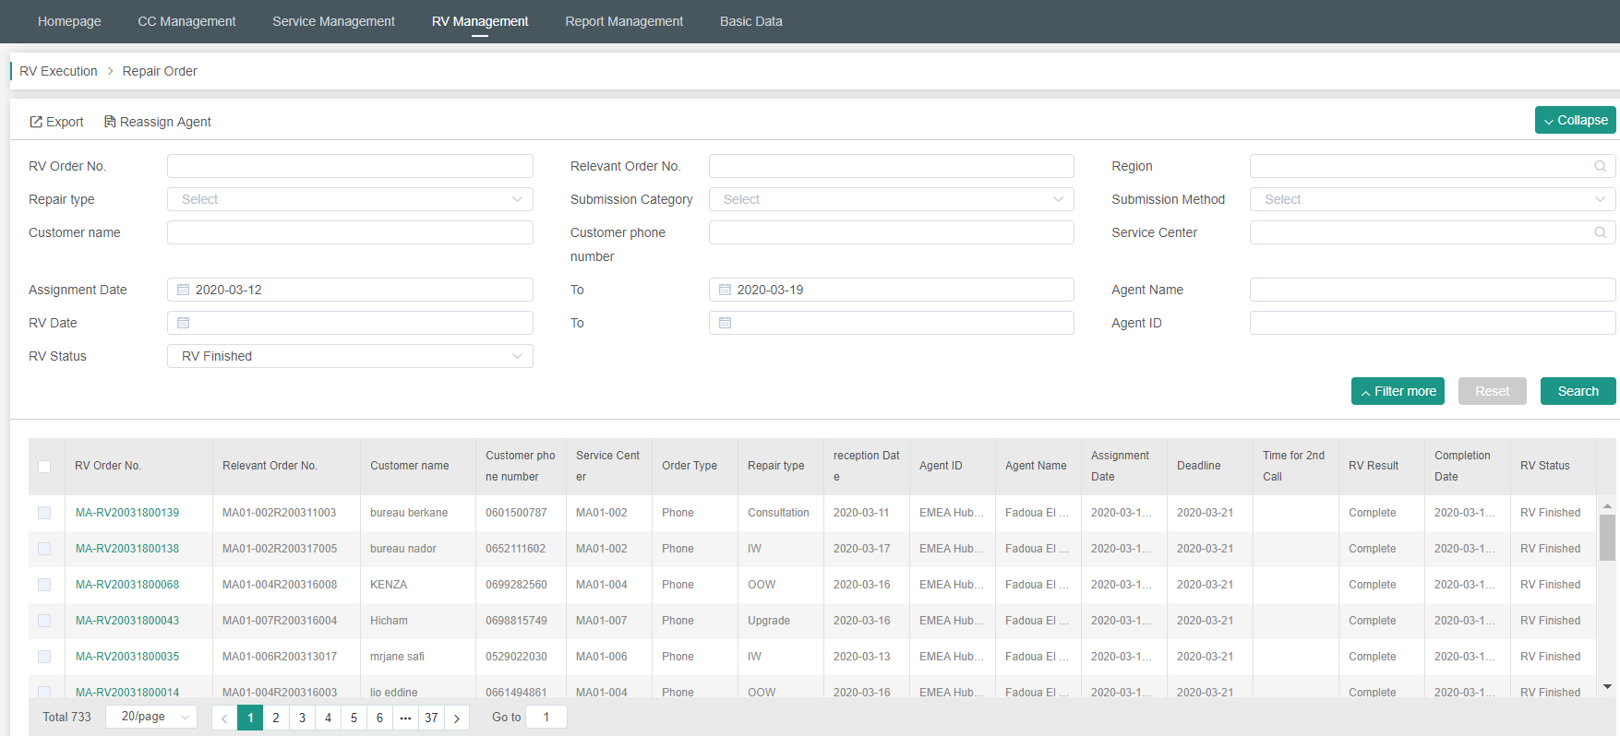
1. Data Monitoring
CC will be able to check RV ratio table on system directly as shown above, which is still under development and will be available by May
CC TL can use Lerina’s account to check RO data before May

Slide 20
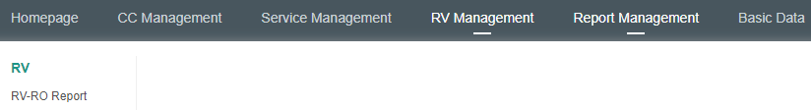
2. RV Related Reports
CC will be able to check and generate:
RV-RO Report for RV details
RO Appeal Report to check False Order Status——Under development
RO Report is not available for Contact Center for data security

Slide 21


