Slide 2
New process of flashing
Original flash machine process
flashing process after modification
User needs
User needs
This adjustment content:
1.All flashing of the customer service center and the operator need to apply for flashing in the "account mobile phone binding relationship" module of the WCSM system to allow flashing 。
2.Cancel the email verification code login and use Google ID.
Login flash tool
Log in to WCSM
Verification password and email verification code
Flash Application import
Login flash tool
Flash operation
Verify password and Google ID
Flash operation

Slide 3
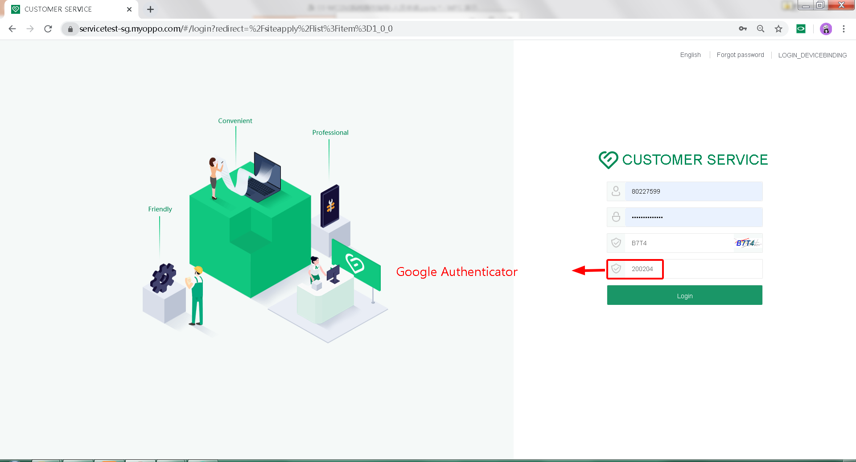
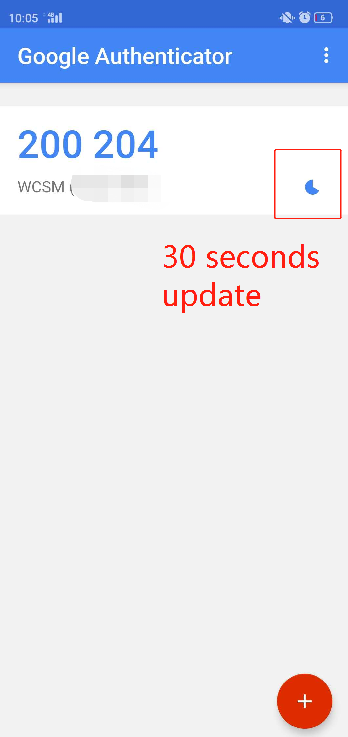
WCSM system login
User needs
9
Device Binding
Log in to WCSM
Flash Application import
Login flash tool
Verify password and Google ID
1.Enter the system landing page -- enter Staff WCSM account -- account password -- captcha (please note!! : captcha is easy to expire, please click update verification code) -- enter the dynamic password of the Google authenticator (dynamic password is automatically updated every 30 seconds, please pay attention to the 30-second time schedule of the small circle on the right) -- click Login to Login
WCSM system access address:： https://service-sg.myoppo.com/#/login
Flash operation

Slide 4
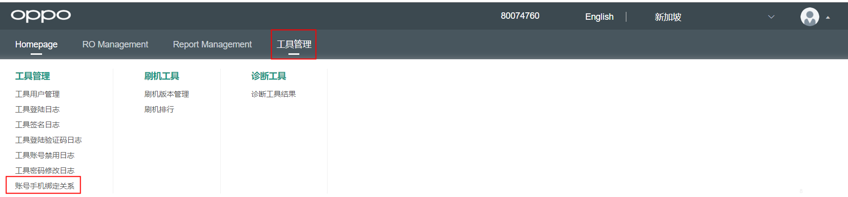
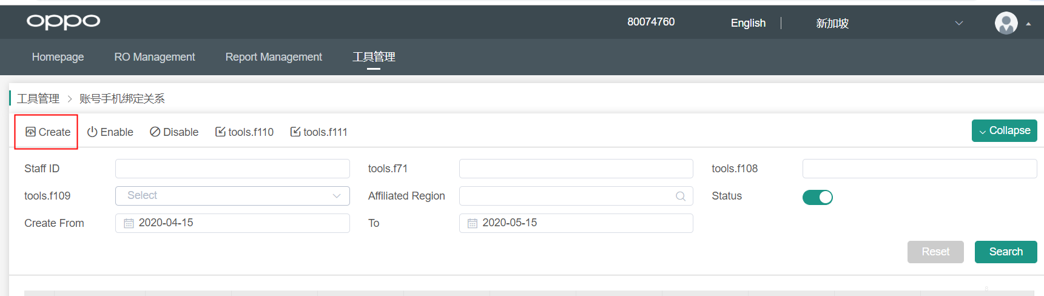
Flash application
User needs
Log in to WCSM
Flash Application import
Login flash tool
Verify password and Google ID
After entering the system interface, select the “tool management-account phone binding relationship” module。
Click the Create to enter the application interface
Flash operation

Slide 5
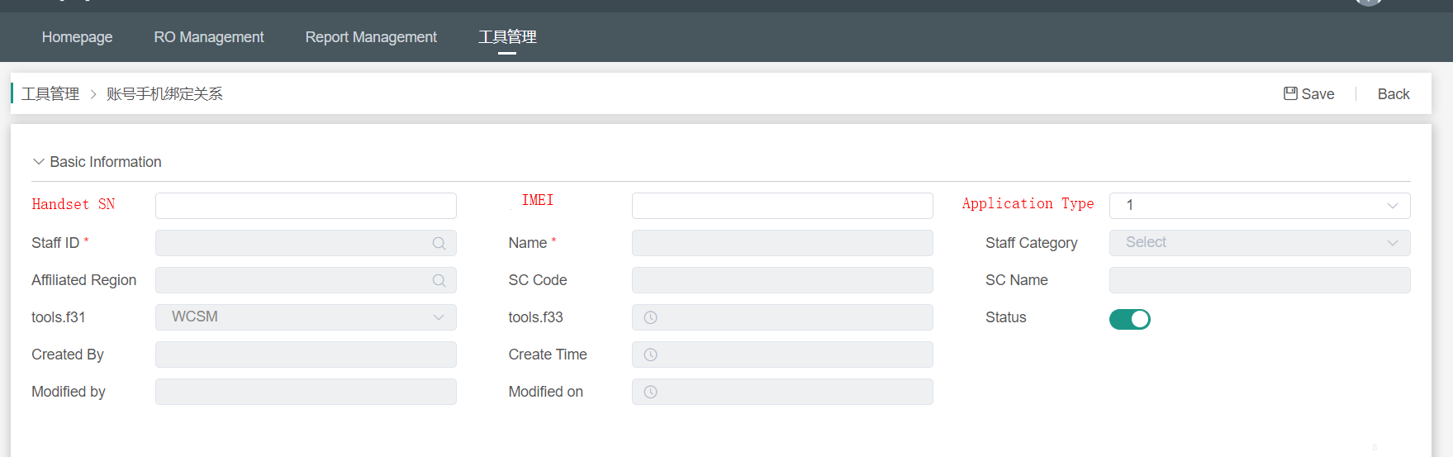
Flash application
User needs
Log in to WCSM
Flash Application import
Binding relationship type: Flash application, white list
Flash application is the latest security measure. Flashing in the customer service center needs to be applied in the WCSM system to be allowed to flash. Flash application is only allowed for those who have permission to flash.
Fill in the content: chip ID or IMEI number (You can fill in one)
The white list is the company's permission to open bills, allowing the customer service center to apply directly to deal with the problem that the version is not in the after-sales system or Chinese model. Whitelist permissions are only open: technical supervisor, quality feedback, customer service manager
Fill in content: chip ID or IMEI number (You can fill in one), personnel account
Login flash tool
Verify password and Google ID
Flash operation

Slide 6
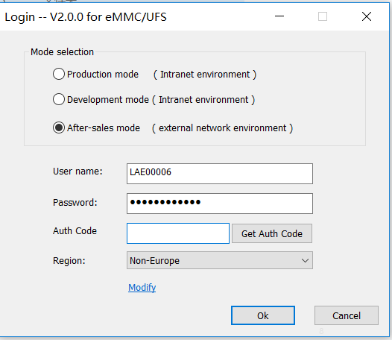
Login flash tool
User needs
Log in to WCSM
Flash Application import
Login flash tool
Verify password and Google ID
1. Open the WCSM version flash tool. (Download link :)
2. Enter the account number and password.
3. Open the corresponding Google identity verifier and enter the verification code information. (Valid for 30 seconds)
Flash operation

Slide 7
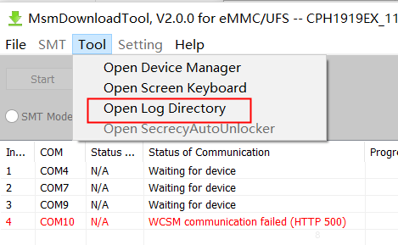
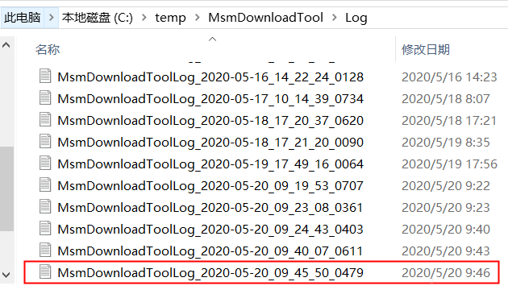
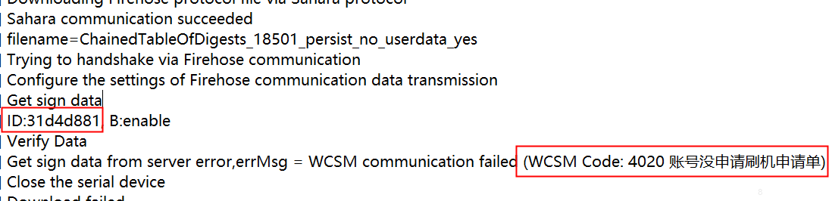
Flash application： Mobile phone can not be turned on (unable to obtain IMEI information)
Qualcomm series
1. Open the corresponding software tool to flash ，After waiting for an error, click on the toolbar to choose to open the LOG directory
2.Find the corresponding time brush log and open it
3. Find the corresponding error content, the ID information above the corresponding content is the SN number of the mobile phone. If you cannot find it, you can use the text search function to search for characters: Verify the ID information above the characters is the mobile phone SN information.

Slide 8
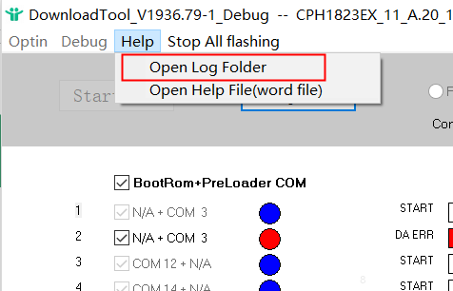
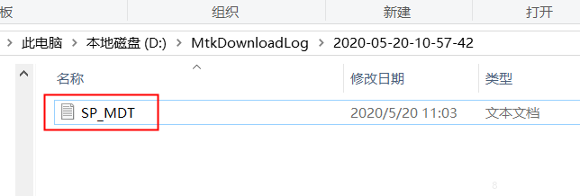
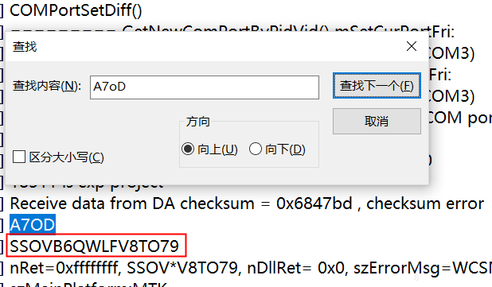
Flash application： Mobile phone can not be turned on (unable to obtain IMEI information)
MTK series
1. Open the corresponding software tool to flash the machine, wait for the error and click the help bar to select to open the LOG folder
2. Find the corresponding time brush log and open it (file name: SP_MDT)
3. Through the text search function, search the information below A7OD for MTK series model SN information.
Ctrl+F Search function shortcuts

Slide 9
THANK YOU

