Slide 1
Staff Management
Author: Willian
Date: 2020/05/08

Slide 2
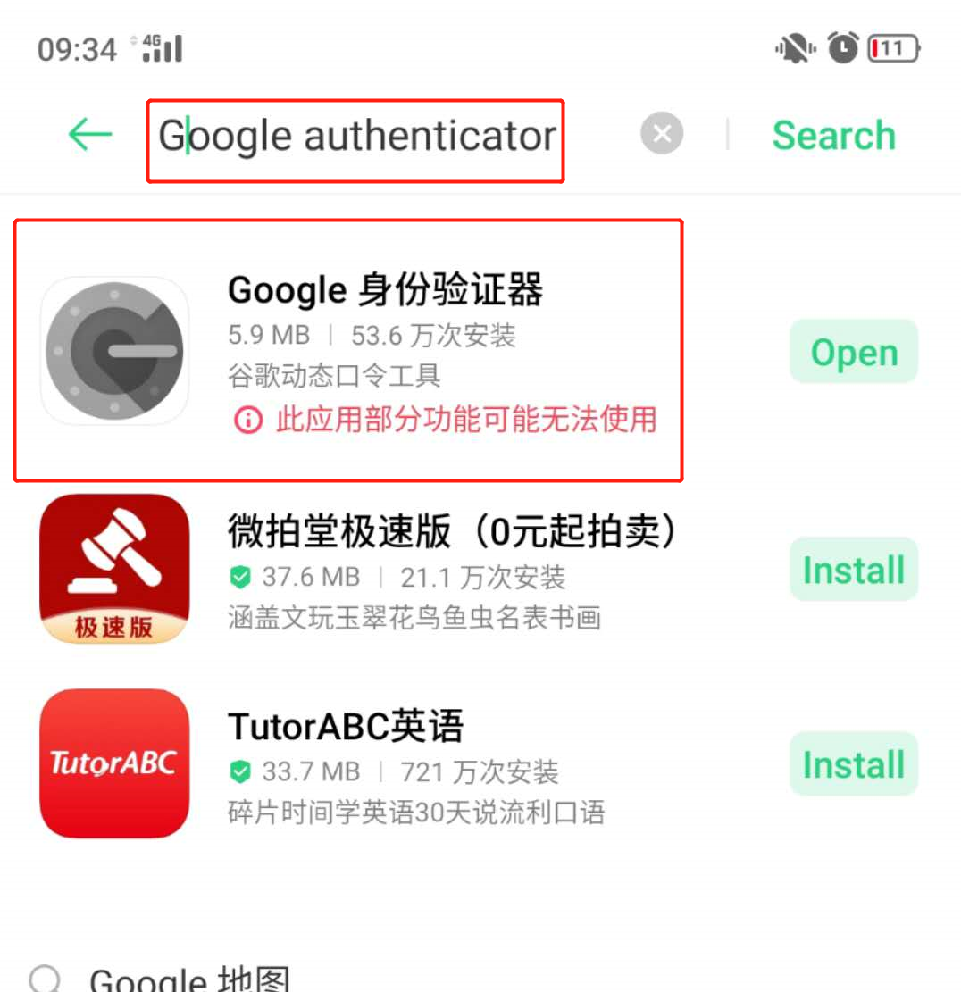
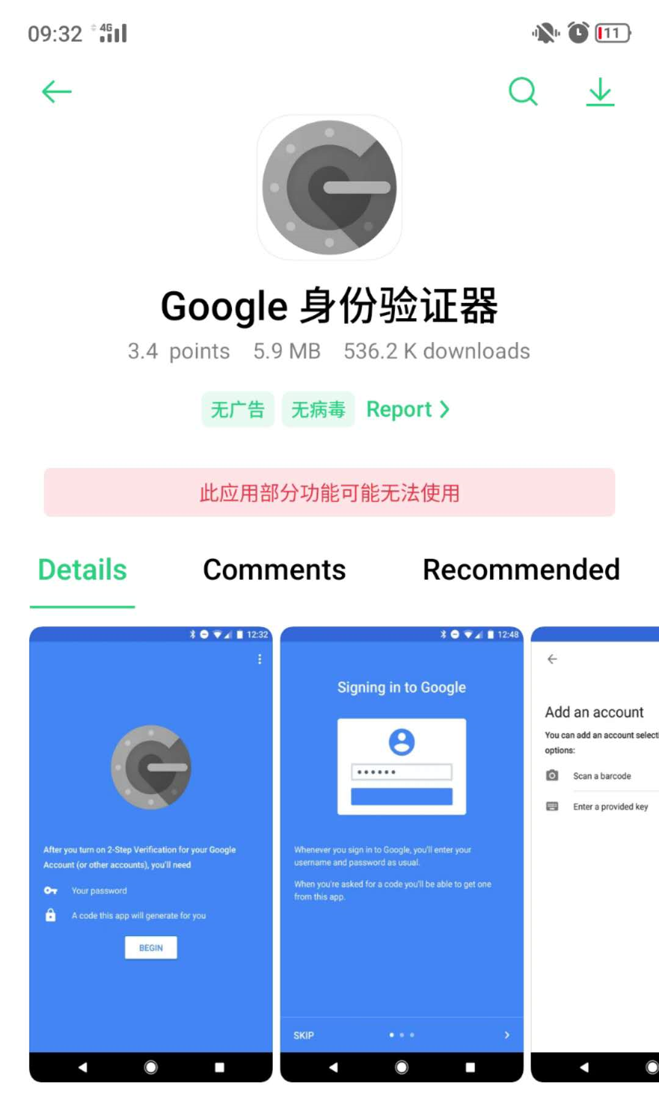
New Staff Application: Binding Google authenticator
Create
Save
Submit
Activate
Binding Google authenticator
Binding MAC address
1. Download from the Mobile phone APP Store: Google authenticator

Slide 3
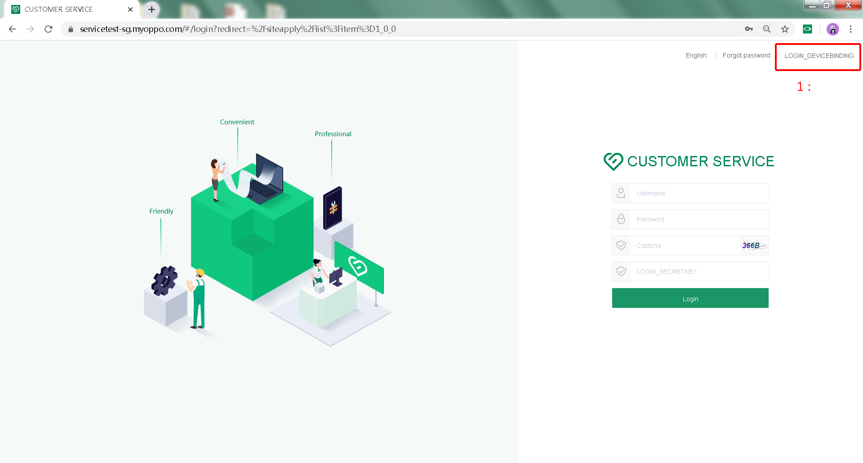
New Staff Application: Binding Google authenticator
Create
Device Binding
1
Save
Submit
Activate
Binding Google authenticator
1、Click on the top right：Device Binding,Start binding the Google authenticator
Binding MAC address

Slide 4
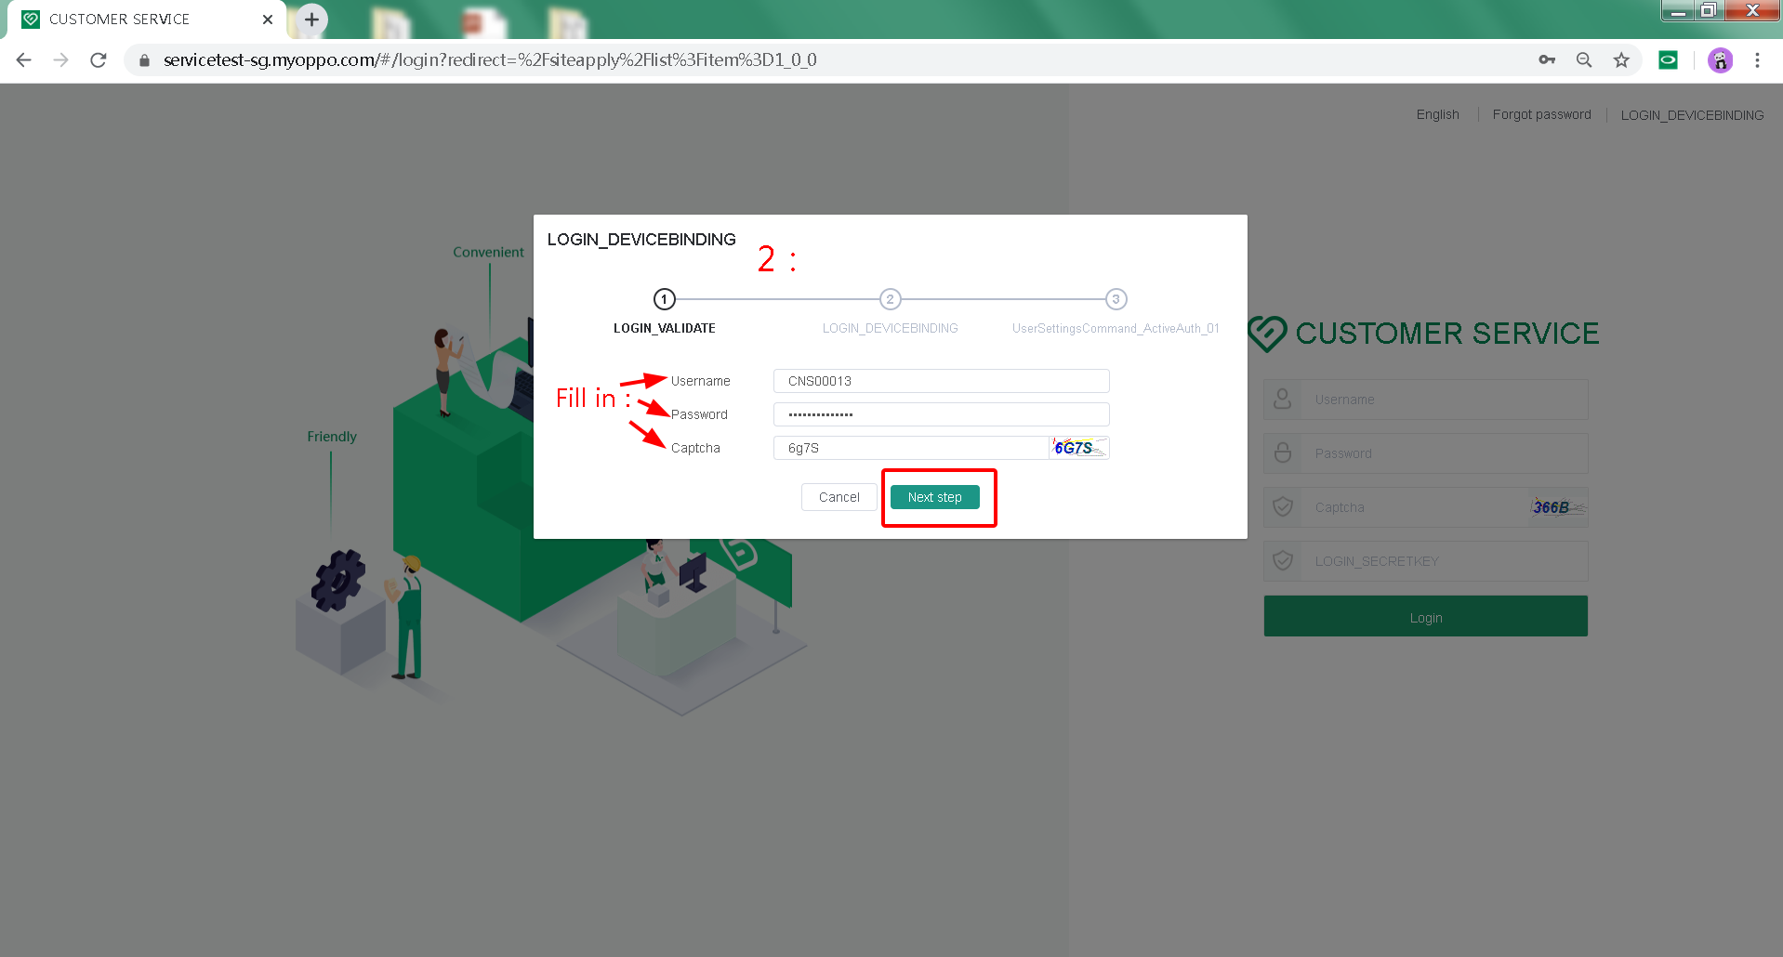
New Staff Application: Binding Google authenticator
Create
Device Binding
2
Save
Submit
Activate
Binding Google authenticator
2. Enter this page and enter: Staff WCSM account, password and verification code; Click: Next step
Attention please!! : captcha is easy to expire. Please click to update the captcha
Binding MAC address

Slide 5
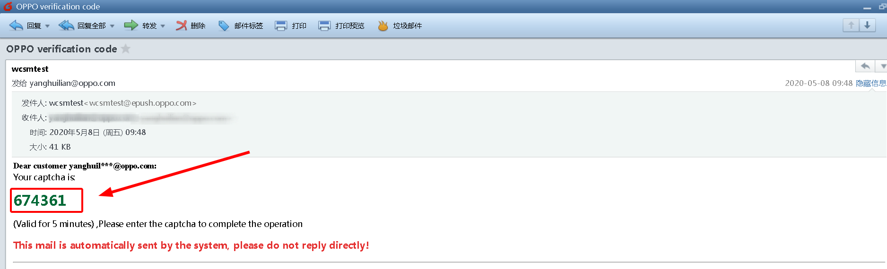
New Staff Application: Binding Google authenticator
Create
3
Save
Submit
30
Activate
Binding Google authenticator
Binding MAC address
3. The employee's mailbox will receive the email verification code sent by the system
Please note: email verification code is valid for 30 minutes only!!

Slide 6
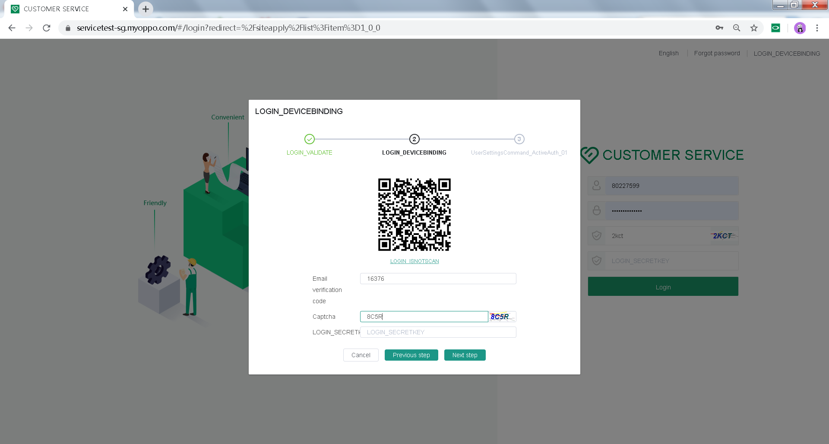

New Staff Application: Binding Google authenticator
Create
Device Binding
4
Save
Submit
Activate
Binding Google authenticator
4. Fill in the email verification code first -- then enter the Captcha (please note!! : captcha is easy to expire, please click update captcha) --
-- open the Google authenticator APP, click: Scan a barcode， and Scan the qr code on the page
Binding MAC address

Slide 7
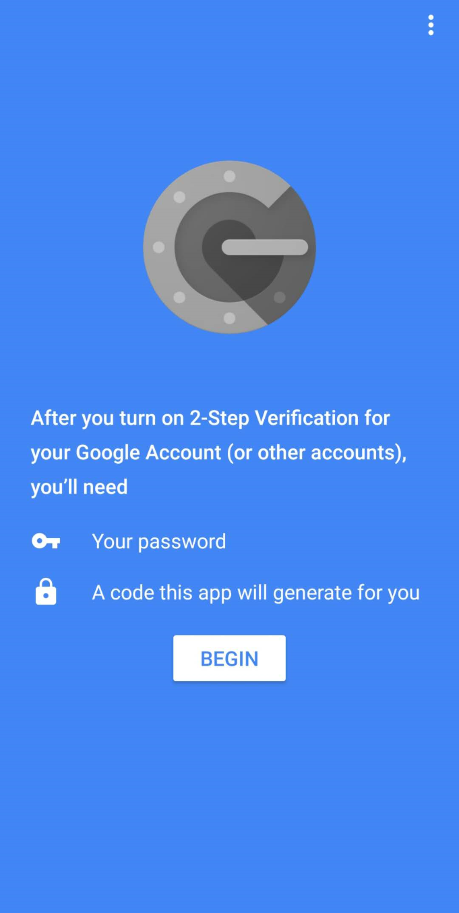
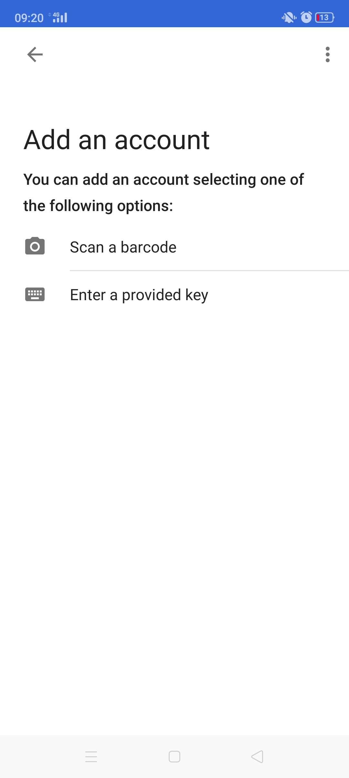
New Staff Application: Binding Google authenticator
Create
5
Save
Submit
Activate
Binding Google authenticator
Binding MAC address
5. Open: Google authenticator on the phone -- click: BEGIN,x

Slide 8
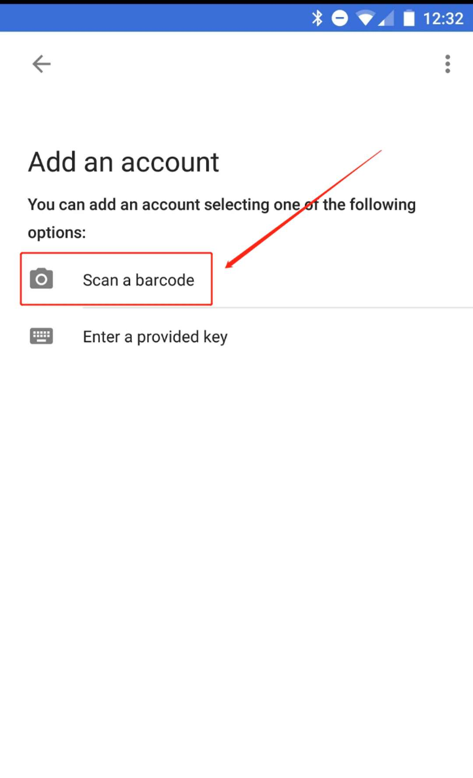
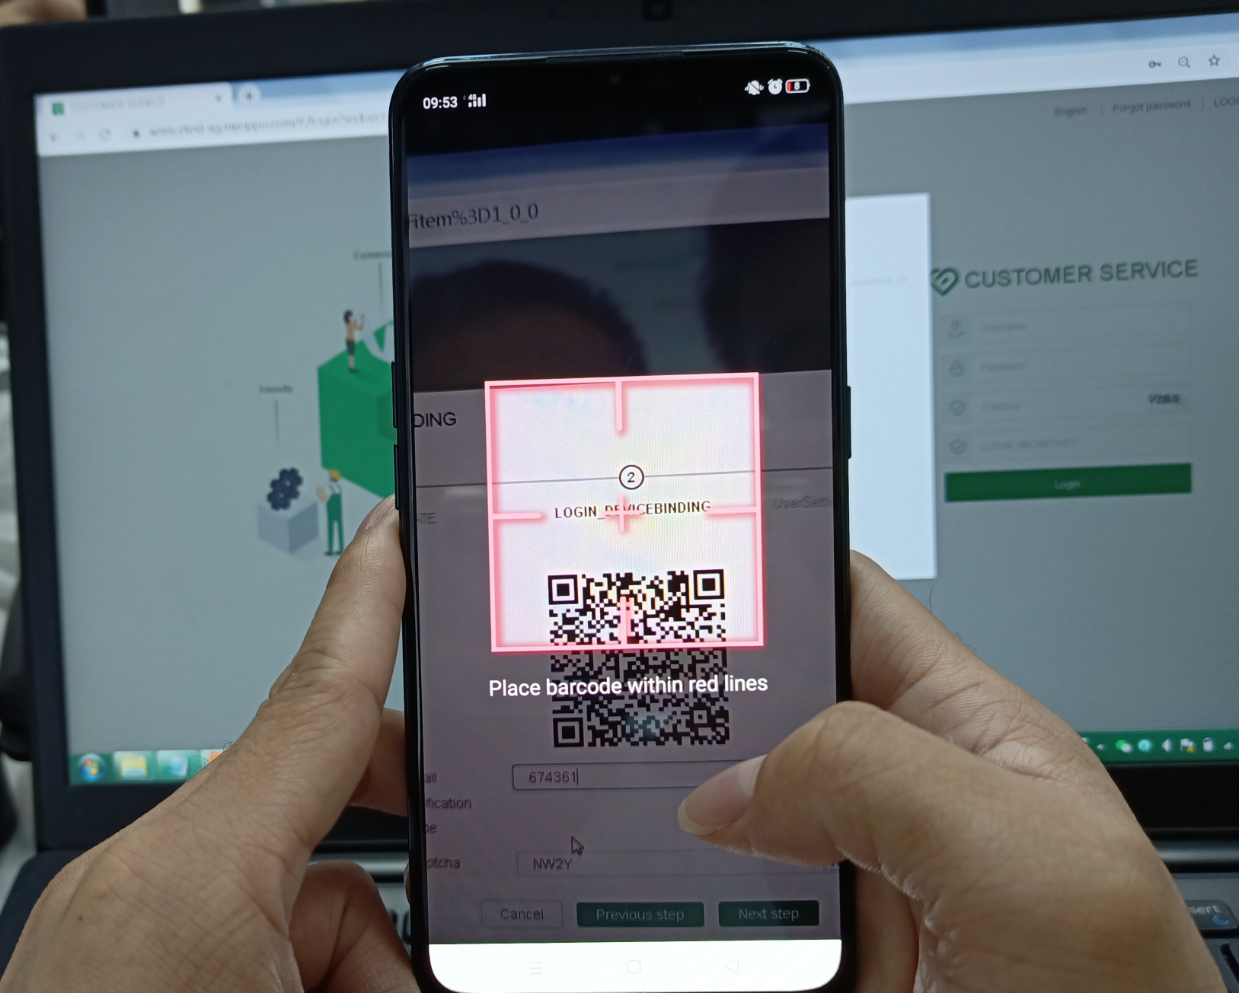
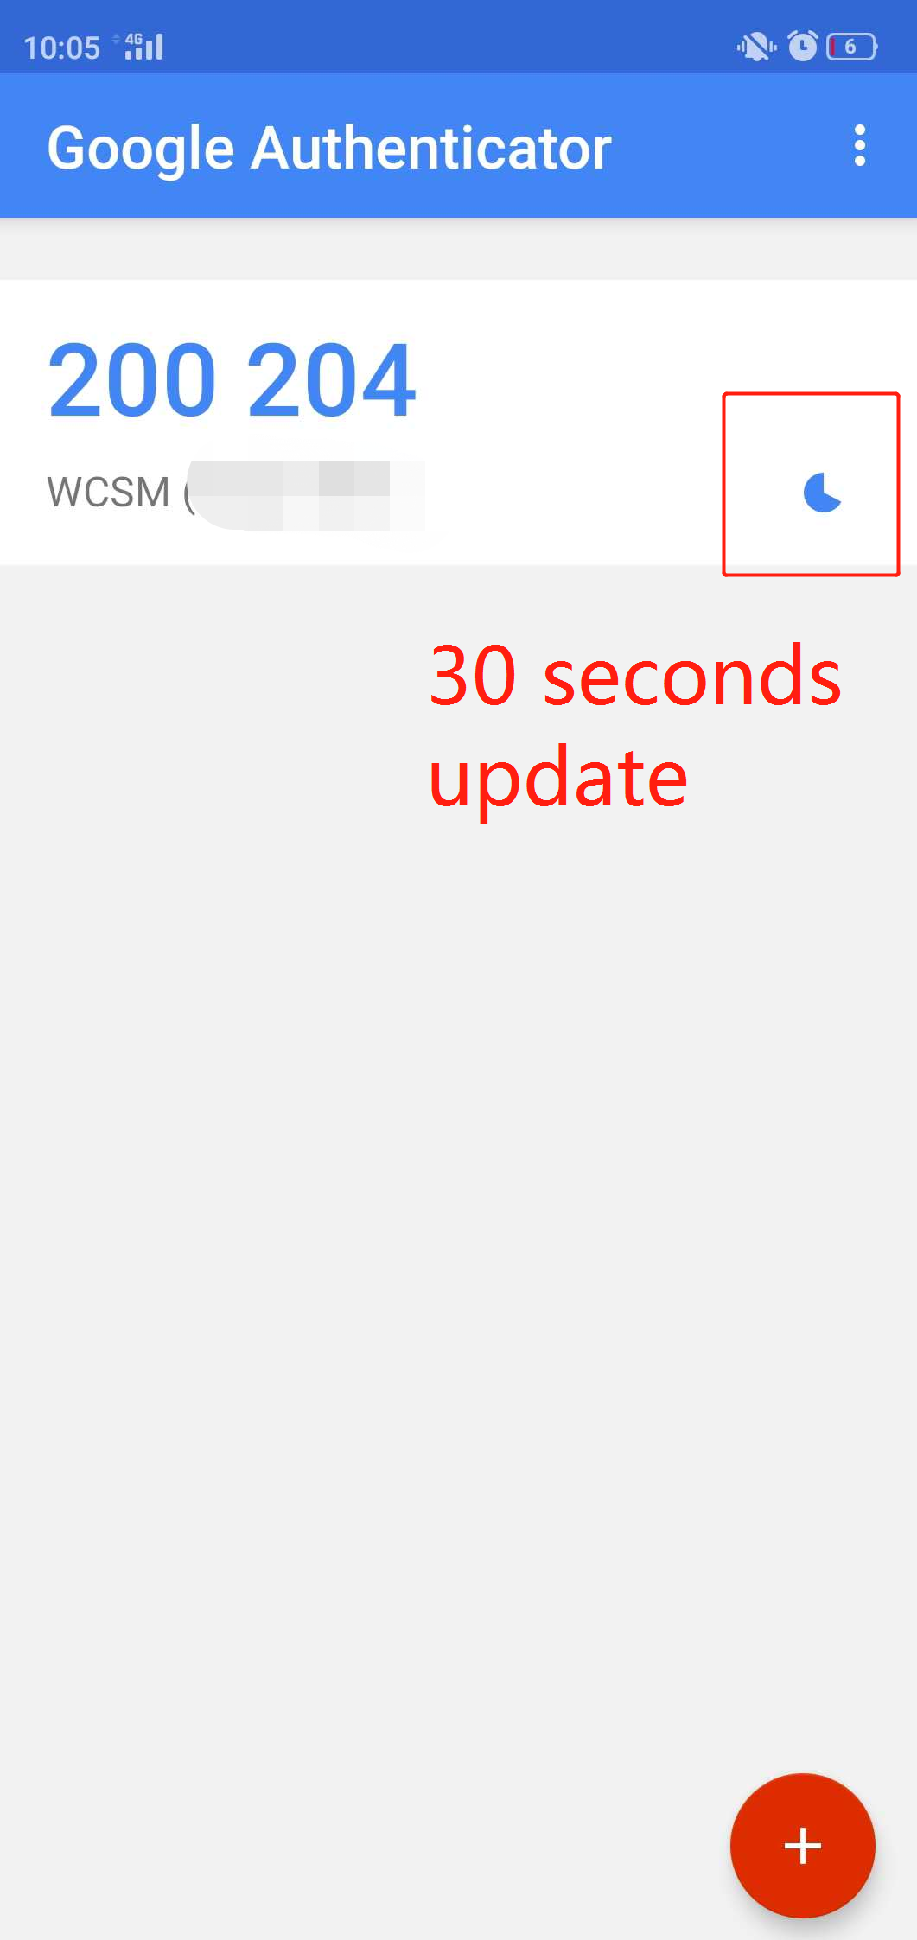
New Staff Application: Binding Google authenticator
6
Create
Save
Submit
Activate
Binding Google authenticator
6. Open the Google authenticator APP and click: Scan a barcode:
The phone scans the qr code on the computer screen for binding. After scanning, the Google authenticator APP page shows that the Authentication code
Binding MAC address

Slide 9
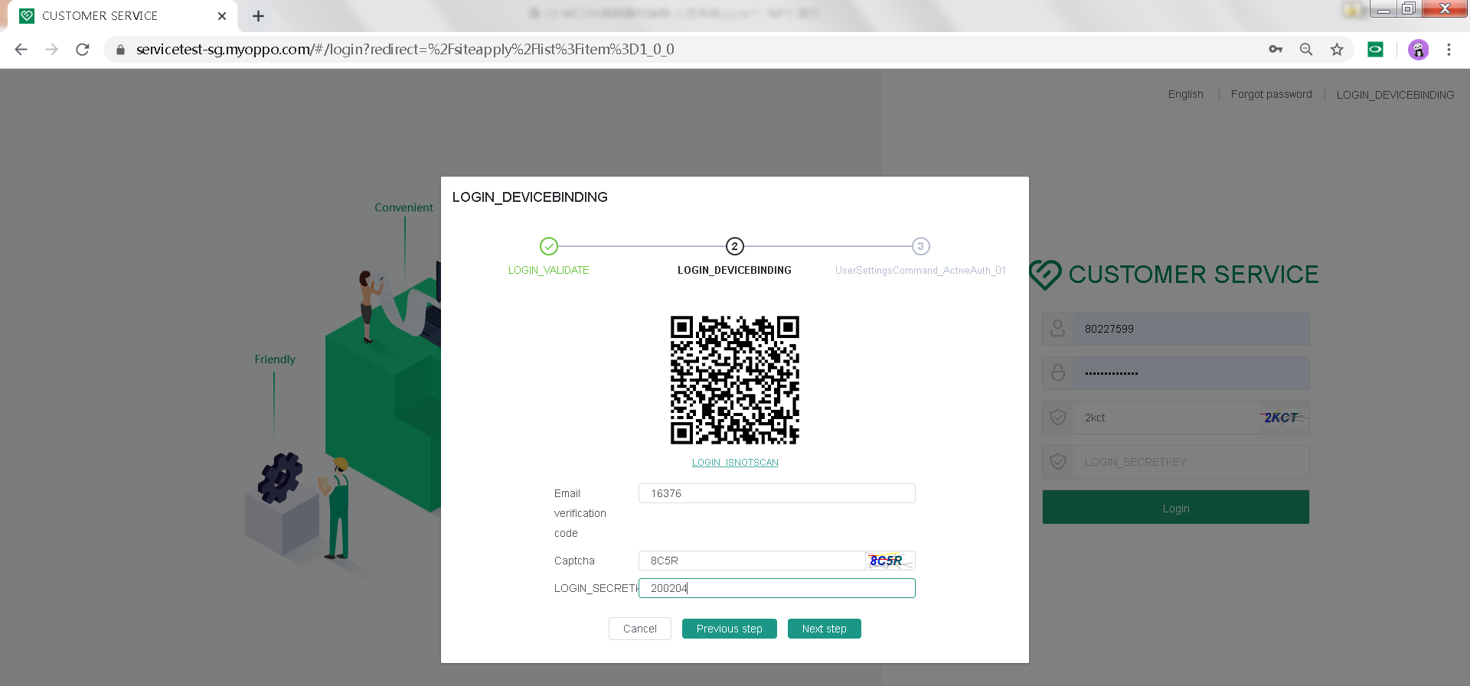
New Staff Application: Binding Google authenticator
Create
7
Save
Submit
Activate
7、Enter the code of the Google authenticator (the code is automatically updated every 30 seconds, please note the 30-second time schedule of the small circle on the right) -- click: next Step
Binding Google authenticator
Binding MAC address

Slide 10
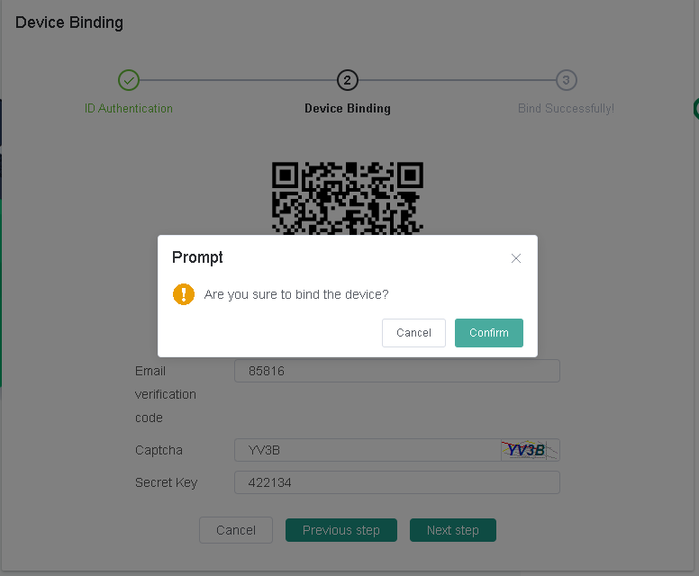
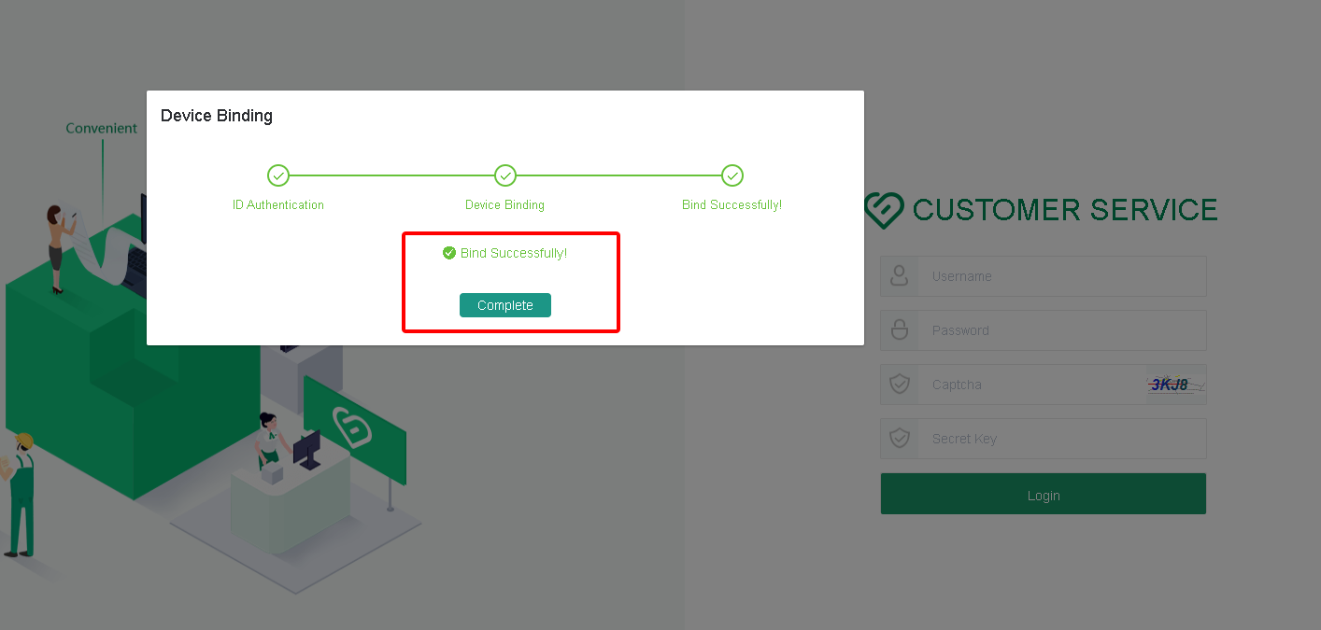
New Staff Application: Binding Google authenticator
Create
8
Save
Submit
Activate
Binding Google authenticator
8. Click: confirm -- the binding is completed
Binding MAC address

Slide 11
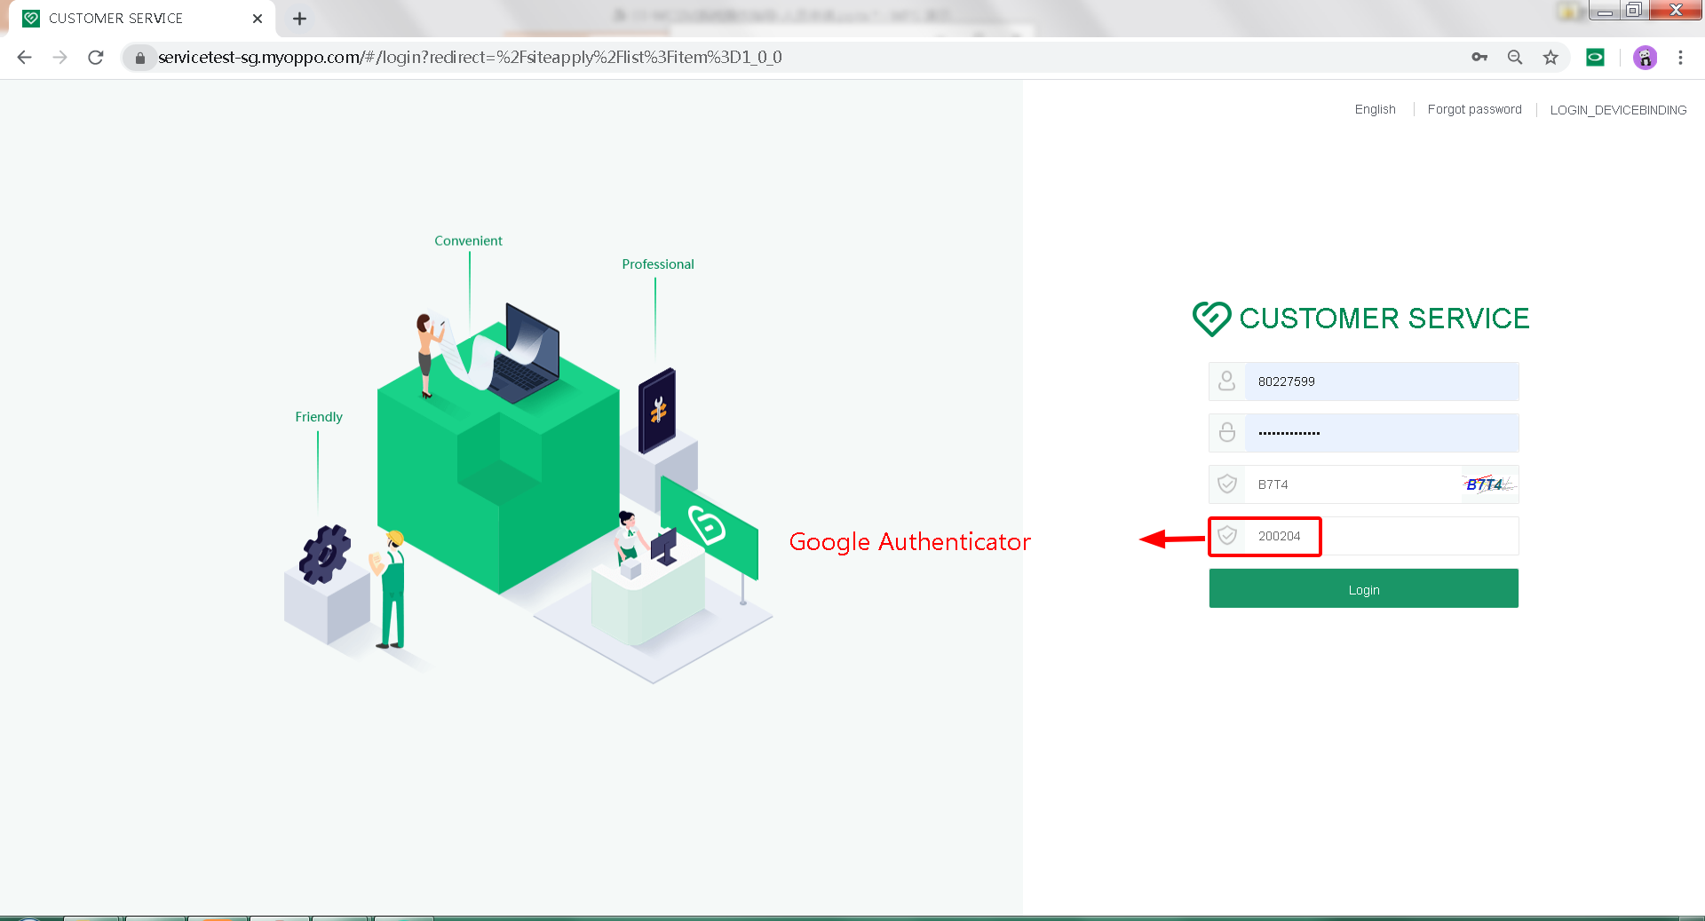
New Staff Application: Binding Google authenticator
Create
9
Device Binding
Save
Submit
Activate
Binding Google authenticator
9. Return to the system login page -- enter Staff WCSM account -- account password -- captcha (please note!! : captcha is easy to expire, please click update verification code) -- enter the dynamic password of the Google authenticator (dynamic password is automatically updated every 30 seconds, please pay attention to the 30-second time schedule of the small circle on the right) --
-- click Login to Login
Binding MAC address

Slide 12
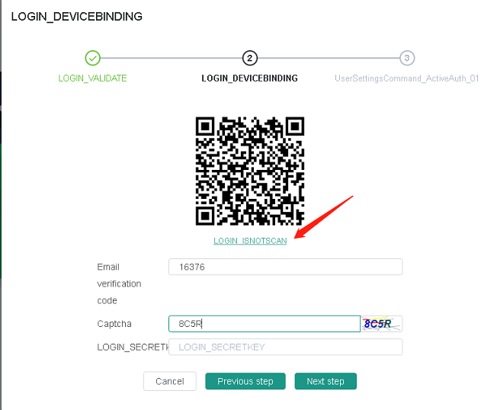
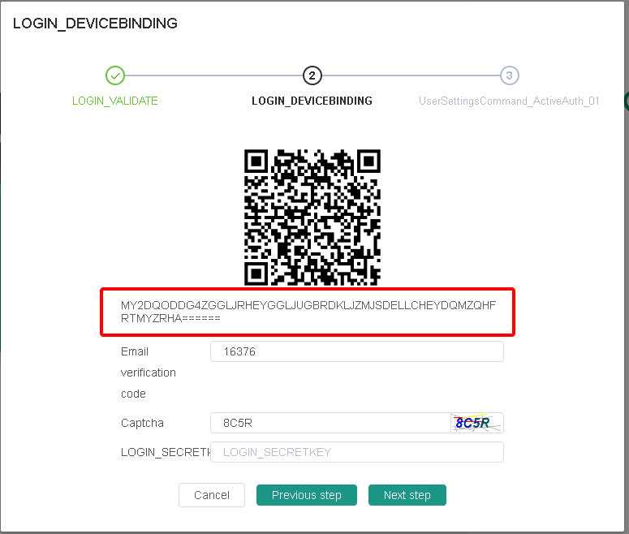
New Staff Application: If the qr code scan fails
Create
A1
Save
Submit
cannot scan？
Activate
Binding Google authenticator
A1. If scanning the qr code fails -- click: cannot scan -- a string of words appears -- copy this string of words -- open the Google authenticator APP on the phone
Binding MAC address

Slide 13
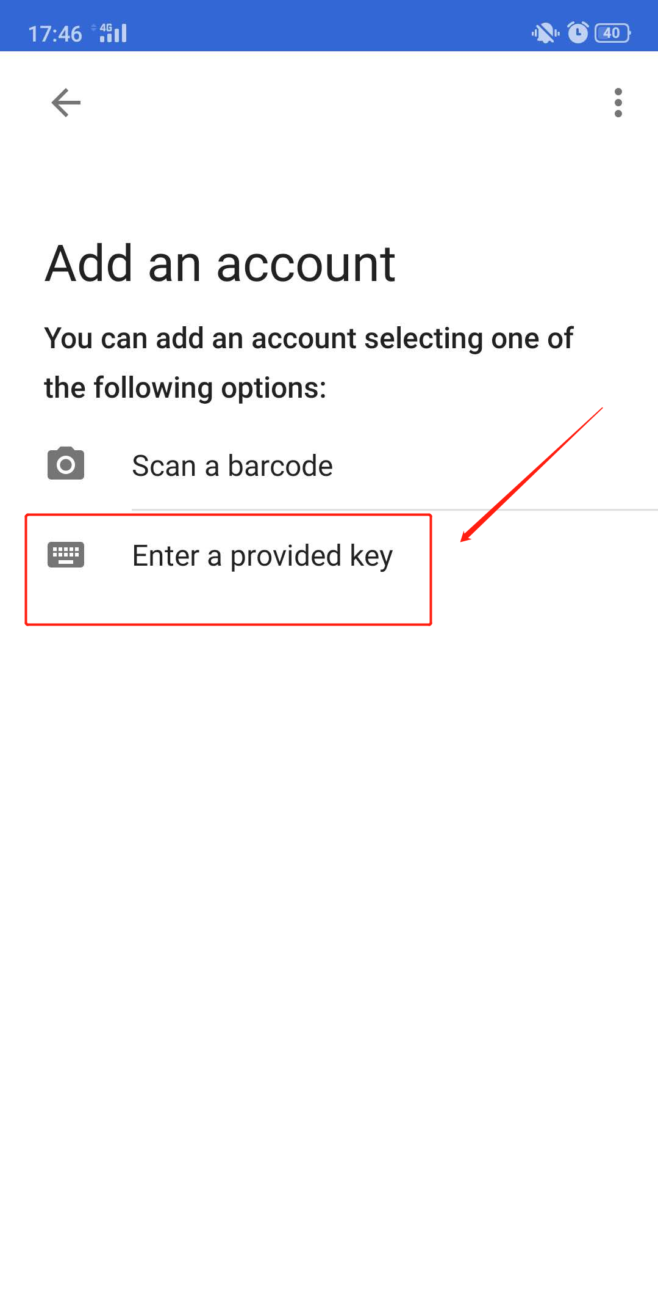
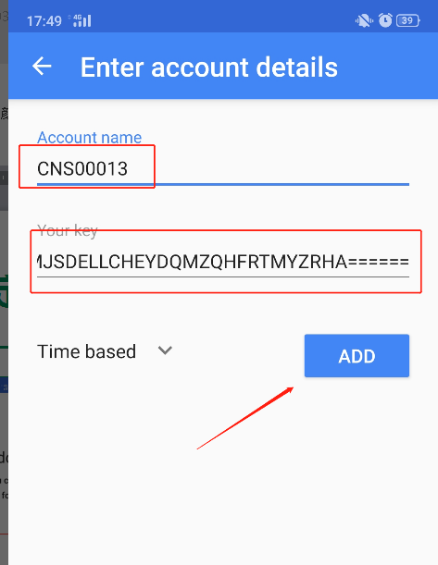
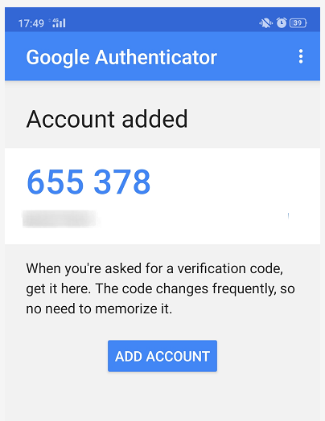
New Staff Application: If the qr code scan fails
A2
Create
Save
Submit
Activate
Binding Google authenticator
A2、Click：Enter provided key——Enter the wcsm account ——enter the string words you just copied——click :ADD——bind successful
Binding MAC address

Slide 14
New Staff Application: Special case
Usage scenarios:
1. If an staff's phone is lost or stolen:
Please ask the agent HR to contact the system administrator of the HQ -- the HQ will release the lost phone from the binding -- and then the agent staff will use the new phone to bind again
2. If staff forget to bring their cell phones to work:
Please go back for it! -- if it takes more than three days for the employee to get the phone: please contact the system administrator of the HQ for the agent HR -- the HQ will release the old phone and bind it again after the agent staff the phone
3. If an staff 's phone breaks down and they buy a new one:
Please ask the agent HR to contact the system administrator of the HQ -- the HQ will release the binding of the old phone -- and then the agent staff will use the new phone to re-bind
4. If the mobile phone is broken and under repair, no mobile phone can be used within a few days:
You can borrow the phone of a family member, or in special cases, the spare phone of the service center -- ask the HQ administrator to reset the secret key -- and then reset the secret key again after the phone is fixed
Create
Save
Submit
Activate
Binding Google authenticator
Binding MAC address

Slide 15
THANK YOU

